Slide 1
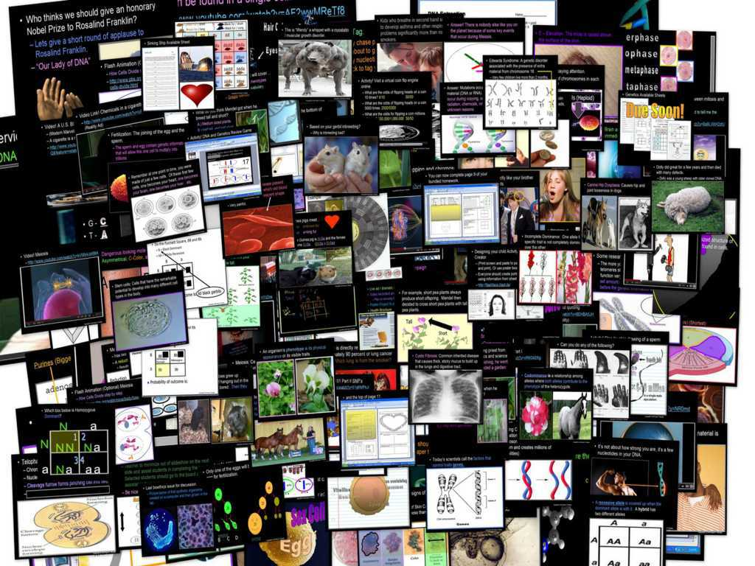
DNA and Genetics Unit

Slide 2
DNA and Genetics Unit
Areas of Focus within The DNA and Genetics Unit:
DNA, DNA Extraction, Structure of DNA, Discovery of the Double Helix, Rosalind Franklin, Nucleotides, RNA, Cell Division, Mitosis, Phases of Mitosis, Chromosomes, Cancer, Ways to Avoid Cancer, What is Inside a Cigarette?, Facts about Smoking?, Anti-Smoking Ads, Meiosis, Phases in Meiosis, Mendelian Genetics, Gregor Mendel, Punnett Squares, Probability, Dihybrid Cross, Codominance, Bio-Ethics, Stem Cell Debate, Cloning Debate
http://sciencepowerpoint.com/DNA_Genetics_Unit.html

Slide 3

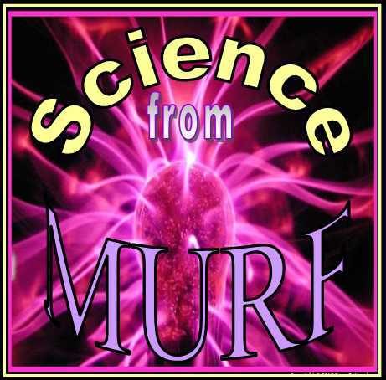
The entire four year curriculum can be found at... http://sciencepowerpoint.com/ Please feel free to contact me with any questions you may have. Thank you for your interest in this curriculum.
Sincerely,
Ryan Murphy M.Ed
www.sciencepowerpoint@gmail.com

Slide 4
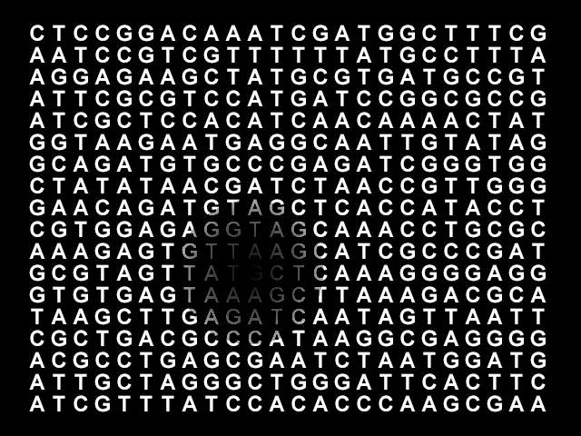
Part V Genetics Review Game
Copyright © 2010 Ryan P. Murphy

Slide 5
Part V Genetics Review Game
MEN DULL | TYPO | HOT LOTTO | THINK INSIDE THE BOX | -Bonus- FAMILY TIES
1 | 6 | 11 | 16 | *21
2 | 7 | 12 | 17 | *22
3 | 8 | 13 | 18 | *23
4 | 9 | 14 | 19 | *24
5 | 10 | 15 | 20 | *25

Slide 6
How to play…
  Don’t play like Jeo_ _ _ _ y.
  Class should be divided into several small groups.
  Groups should use science journal (red slide notes), homework, and other available materials to assist you.
  Groups can communicate quietly with each other but no sharing answers between groups.
    Practice quietly communicating right now?
    Practice Communication Question:
    Your group gets to order one pizza and you can have two toppings. What does your group want?

Slide 7

Questions 1-20 = 5pts Each
Final Category (Bonus) = 1pt Each
Final Questions = 5 pt wager
If you wager 5 on the last question and get it wrong you lose 5 pts. Wager 5 and get it right you get 5 pts.
Find the Owl =
Secretly write “Owl” in the correct box worth 1pt.
“I’ll be about this big.”

Slide 8
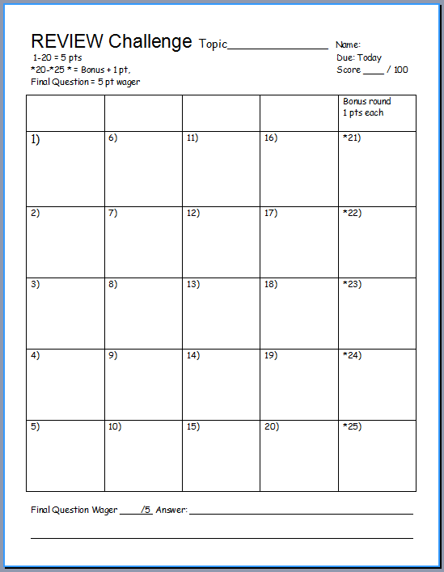
Is your name on the review sheet?
Name

Slide 9
Is your name on the review sheet?
Add the categories
along the top
on the next slide.

Slide 10
Part V Genetics Review Game
MEN DULL | TYPO | HOT LOTTO | THINK INSIDE THE BOX | -Bonus- FAMILY TIES
1 | 6 | 11 | 16 | *21
2 | 7 | 12 | 17 | *22
3 | 8 | 13 | 18 | *23
4 | 9 | 14 | 19 | *24
5 | 10 | 15 | 20 | *25

Slide 11
Part V Genetics Review Game
MEN DULL | TYPO | HOT LOTTO | THINK INSIDE THE BOX | -Bonus- FAMILY TIES
1 | 6 | 11 | 16 | *21
2 | 7 | 12 | 17 | *22
3 | 8 | 13 | 18 | *23
4 | 9 | 14 | 19 | *24
5 | 10 | 15 | 20 | *25

Slide 12
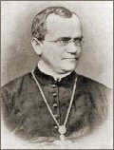
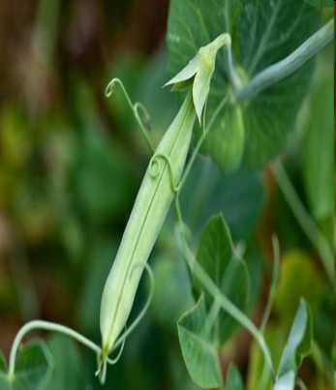
This Monk is known as the father of modern genetics for his work with pea plants.
1
Copyright © 2010 Ryan P. Murphy

Slide 13
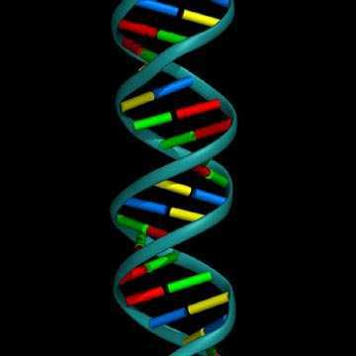
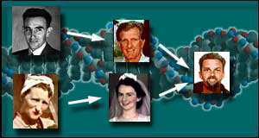
This is the term for when organisms pass traits from parents to offspring.
  A.) Genetics
  B.) Punnett Squares
  C.) Alleles
  D.) Heredity
  E.) Homozygous
2
Copyright© 2010 Ryan P. Murphy

Slide 14
This is the term for when organisms pass traits from parents to offspring.
  A.) Genetics
  B.) Punnett Squares
  C.) Alleles
  D.) Heredity
  E.) Homozygous
2
Copyright© 2010 Ryan P. Murphy

Slide 15
This is the term for when organisms pass traits from parents to offspring.
  A.) Genetics
  B.) Punnett Squares
  C.) Alleles
  D.) Heredity
  E.) Homozygous
2
Copyright© 2010 Ryan P. Murphy

Slide 16
This is the term for when organisms pass traits from parents to offspring.
  A.) Genetics
  B.) Punnett Squares
  C.) Alleles
  D.) Heredity
  E.) Homozygous
2
Copyright© 2010 Ryan P. Murphy

Slide 17
This is the term for when organisms pass traits from parents to offspring.
  A.) Genetics
  B.) Punnett Squares
  C.) Alleles
  D.) Heredity
  E.) Homozygous
2
Copyright© 2010 Ryan P. Murphy

Slide 18
This is the term for when organisms pass traits from parents to offspring.
  A.) Genetics
  B.) Punnett Squares
  C.) Alleles
  D.) Heredity
  E.) Homozygous
2
Copyright© 2010 Ryan P. Murphy

Slide 19
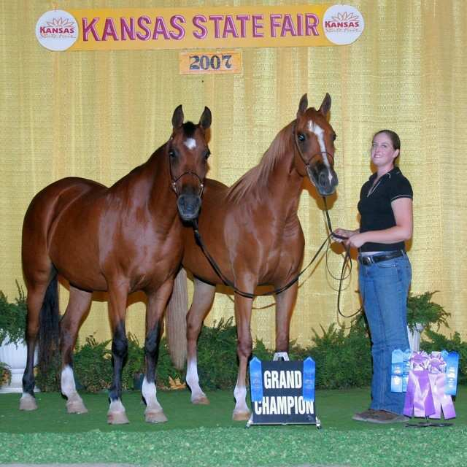
When two purebreds mate, they always produce…
  A.) Offspring with different traits as the parent.
  B.) Offspring with the same traits as the parent.
  C.) Offspring without any traits.
  D.) Purebreds cannot produce offspring.
3
Copyright© 2010 Ryan P. Murphy

Slide 20
When two purebreds mate, they always produce…
  A.) Offspring with different traits as the parent.
  B.) Offspring with the same traits as the parent.
  C.) Offspring without any traits.
  D.) Purebreds cannot produce offspring.
3
Copyright© 2010 Ryan P. Murphy

Slide 21
When two purebreds mate, they always produce…
  A.) Offspring with different traits as the parent.
  B.) Offspring with the same traits as the parent.
  C.) Offspring without any traits.
  D.) Purebreds cannot produce offspring.
3
Copyright© 2010 Ryan P. Murphy

Slide 22
When two purebreds mate, they always produce…
  A.) Offspring with different traits as the parent.
  B.) Offspring with the same traits as the parent.
  C.) Offspring without any traits.
  D.) Purebreds cannot produce offspring.
3
Copyright© 2010 Ryan P. Murphy

Slide 23
When two purebreds mate, they always produce…
  A.) Offspring with different traits as the parent.
  B.) Offspring with the same traits as the parent.
  C.) Offspring without any traits.
  D.) Purebreds cannot produce offspring.
3
Copyright© 2010 Ryan P. Murphy

Slide 24
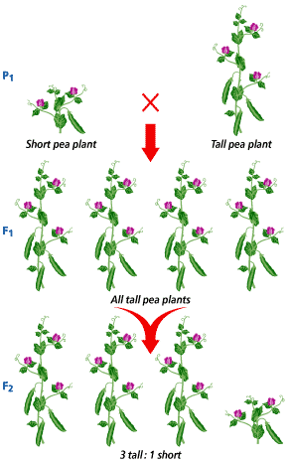
4
What were Mendels results in the F2 Generation?
?
?
?
?
Copyright© 2010 Ryan P. Murphy

Slide 25
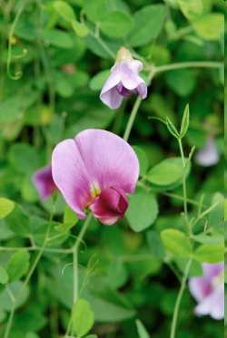
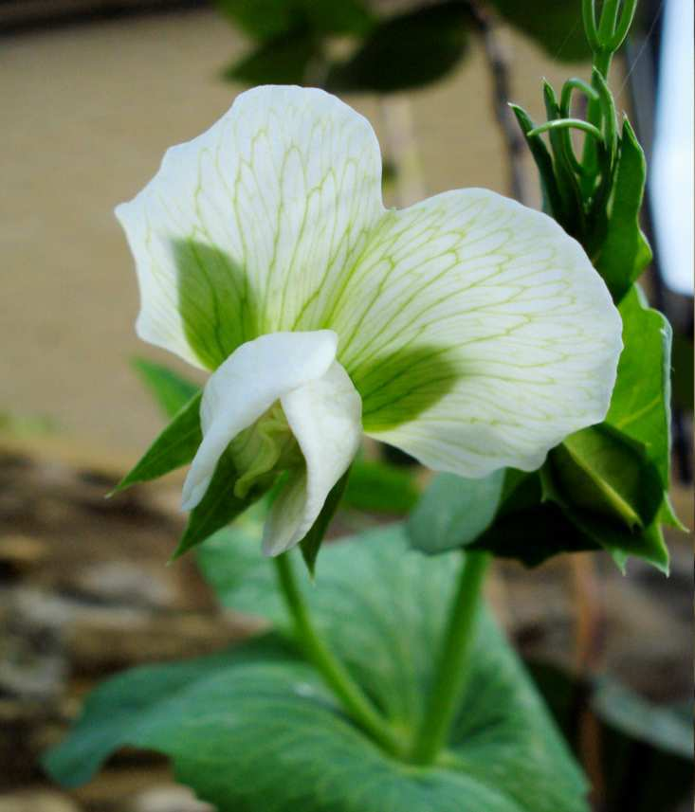
This is the name for an organism’s physical appearance or its visible traits.
5

Slide 26
Part V Genetics Review Game
MEN DULL | TYPO | HOT LOTTO | THINK INSIDE THE BOX | -Bonus- FAMILY TIES
1 | 6 | 11 | 16 | *21
2 | 7 | 12 | 17 | *22
3 | 8 | 13 | 18 | *23
4 | 9 | 14 | 19 | *24
5 | 10 | 15 | 20 | *25

Slide 27
Part V Genetics Review Game
MEN DULL | TYPO | HOT LOTTO | THINK INSIDE THE BOX | -Bonus- FAMILY TIES
1 | 6 | 11 | 16 | *21
2 | 7 | 12 | 17 | *22
3 | 8 | 13 | 18 | *23
4 | 9 | 14 | 19 | *24
5 | 10 | 15 | 20 | *25

Slide 28
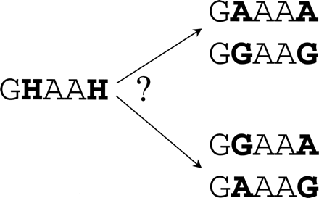
This is the name for an organism’s genetic makeup, or allele combinations
6
Copyright© 2010 Ryan P. Murphy

Slide 29
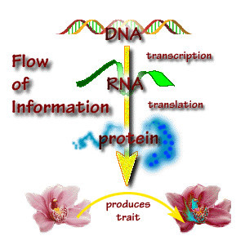
7

Slide 30
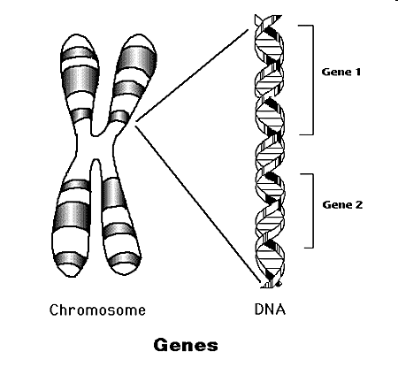
Geneticists call the factors that control traits genes .
8
Copyright© 2010 Ryan P. Murphy

Slide 31
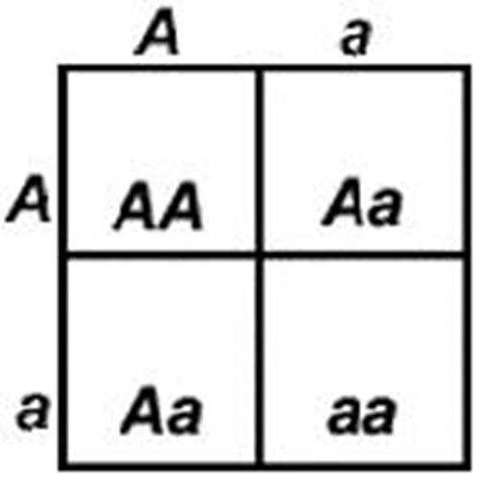
This type of allele always shows up in the organism when the allele is present.
  A.) Recessive
  B.) Dominant
  C.) Heterozygous
  D.) Incomplete
  E.) Mendellion Allele
9
Copyright© 2010 Ryan P. Murphy

Slide 32
This type of allele always shows up in the organism when the allele is present.
  A.) Recessive
  B.) Dominant
  C.) Heterozygous
  D.) Incomplete
  E.) Mendellion Allele
9
Copyright© 2010 Ryan P. Murphy

Slide 33
This type of allele always shows up in the organism when the allele is present.
  A.) Recessive
  B.) Dominant
  C.) Heterozygous
  D.) Incomplete
  E.) Mendellion Allele
9
Copyright© 2010 Ryan P. Murphy

Slide 34
This type of allele always shows up in the organism when the allele is present.
  A.) Recessive
  B.) Dominant
  C.) Heterozygous
  D.) Incomplete
  E.) Mendellion Allele
9
Copyright© 2010 Ryan P. Murphy

Slide 35
This type of allele always shows up in the organism when the allele is present.
  A.) Recessive
  B.) Dominant
  C.) Heterozygous
  D.) Incomplete
  E.) Mendellion Allele
9
Copyright© 2010 Ryan P. Murphy

Slide 36
This type of allele always shows up in the organism when the allele is present.
  A.) Recessive
  B.) Dominant
  C.) Heterozygous
  D.) Incomplete
  E.) Mendellion Allele
9
Copyright© 2010 Ryan P. Murphy

Slide 37
This type of allele is covered up when the dominant allele is with it?
10
Copyright© 2010 Ryan P. Murphy

Slide 38
Part V Genetics Review Game
MEN DULL | TYPO | HOT LOTTO | THINK INSIDE THE BOX | -Bonus- FAMILY TIES
1 | 6 | 11 | 16 | *21
2 | 7 | 12 | 17 | *22
3 | 8 | 13 | 18 | *23
4 | 9 | 14 | 19 | *24
5 | 10 | 15 | 20 | *25

Slide 39
Part V Genetics Review Game
MEN DULL | TYPO | HOT LOTTO | THINK INSIDE THE BOX | -Bonus- FAMILY TIES
1 | 6 | 11 | 16 | *21
2 | 7 | 12 | 17 | *22
3 | 8 | 13 | 18 | *23
4 | 9 | 14 | 19 | *24
5 | 10 | 15 | 20 | *25

Slide 40
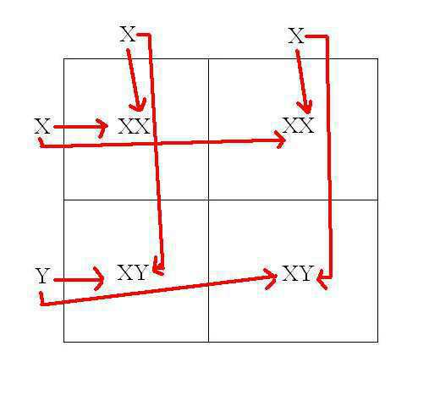
This is the name for a diagram that is used to predict the outcome of a particular cross
11
Copyright© 2010 Ryan P. Murphy

Slide 41
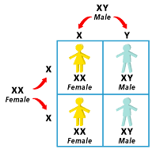
Which gender decides the childs gender?
Use the Punnett Square below to help you.
  XX=Female XY=Male
12
Copyright© 2010 Ryan P. Murphy

Slide 42
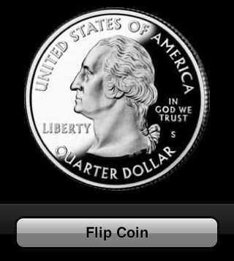
Genetics deals heavily with probability, or the likelihood that a particular event will occur.
13
Copyright© 2010 Ryan P. Murphy

Slide 43
14
The letters below represent…
  A.) Both are Heterozygous Dominant
  B.) Homozygous recessive and Homozygous Dominant
  C.) Heterozygous and Heterozygous
  D.) Both are Heterozygous Recessive
  E.) Homozygous Dominant and Heterozygous
ZZHh
Copyright© 2010 Ryan P. Murphy

Slide 44
14
The letters below represent…
  A.) Both are Heterozygous Dominant
  B.) Homozygous recessive and Homozygous Dominant
  C.) Heterozygous and Heterozygous
  D.) Both are Heterozygous Recessive
  E.) Homozygous Dominant and Heterozygous
ZZHh
Copyright© 2010 Ryan P. Murphy

Slide 45
14
The letters below represent…
  A.) Both are Heterozygous Dominant
  B.) Homozygous recessive and Homozygous Dominant
  C.) Heterozygous and Heterozygous
  D.) Both are Heterozygous Recessive
  E.) Homozygous Dominant and Heterozygous
ZZHh
Copyright© 2010 Ryan P. Murphy

Slide 46
14
The letters below represent…
  A.) Both are Heterozygous Dominant
  B.) Homozygous recessive and Homozygous Dominant
  C.) Heterozygous and Heterozygous
  D.) Both are Heterozygous Recessive
  E.) Homozygous Dominant and Heterozygous
ZZHh
Copyright© 2010 Ryan P. Murphy

Slide 47
14
The letters below represent…
  A.) Both are Heterozygous Dominant
  B.) Homozygous recessive and Homozygous Dominant
  C.) Heterozygous and Heterozygous
  D.) Both are Heterozygous Recessive
  E.) Homozygous Dominant and Heterozygous
ZZHh
Copyright© 2010 Ryan P. Murphy

Slide 48
14
The letters below represent…
  A.) Both are Heterozygous Dominant
  B.) Homozygous recessive and Homozygous Dominant
  C.) Heterozygous and Heterozygous
  D.) Both are Heterozygous Recessive
  E.) Homozygous Dominant and Heterozygous
ZZHh
Copyright© 2010 Ryan P. Murphy

Slide 49
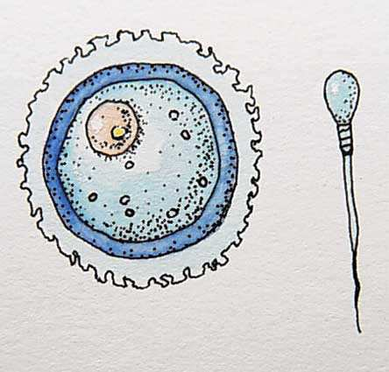
From all of Mendel’s’ results, he reasoned that individual factors must control the inheritance of traits in peas.
  Mendel knew that the female contributes one factor, while the male contributes the other factor in sexual reproduction.
15
Copyright© 2010 Ryan P. Murphy

Slide 50
Part V Genetics Review Game
MEN DULL | TYPO | HOT LOTTO | THINK INSIDE THE BOX | -Bonus- FAMILY TIES
1 | 6 | 11 | 16 | *21
2 | 7 | 12 | 17 | *22
3 | 8 | 13 | 18 | *23
4 | 9 | 14 | 19 | *24
5 | 10 | 15 | 20 | *25

Slide 51
Part V Genetics Review Game
MEN DULL | TYPO | HOT LOTTO | THINK INSIDE THE BOX | -Bonus- FAMILY TIES
1 | 6 | 11 | 16 | *21
2 | 7 | 12 | 17 | *22
3 | 8 | 13 | 18 | *23
4 | 9 | 14 | 19 | *24
5 | 10 | 15 | 20 | *25

Slide 52

16
Please complete the Punnett Square,
Tt and Tt
  T = Tall
  tt = Short
Both parents are heterozygous
How many will be tall, and how many will be short ___ : ___
Copyright© 2010 Ryan P. Murphy

Slide 53
16
Please complete the Punnett Square,
Tt and Tt
  T = Tall
  tt = Short
T t
T
t
Both parents are heterozygous
How many will be tall, and how many will be short ___ : ___
Copyright© 2010 Ryan P. Murphy

Slide 54
New
Question

Slide 55
17
Please complete the Punnett Square,
Tt and tt
  T = Tall
  tt = Short
One parent heterozygous and one homozygous recessive.
How many will be tall, and how many will be short ___ : ___
Copyright© 2010 Ryan P. Murphy

Slide 56
17
Please complete the Punnett Square,
Tt and tt
  T = Tall
  tt = Short
T t
t
t
One parent heterozygous and one homozygous recessive.
How many will be tall, and how many will be short ___ : ___
Copyright© 2010 Ryan P. Murphy

Slide 57
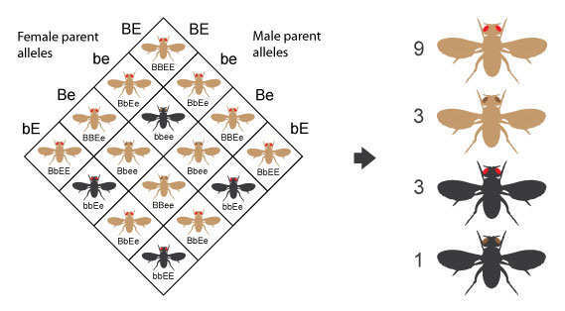
What color body and eye type will the fly be for A, B, C, and D?
B=Brown, b=black, E=Red, e=brown
18
A
B
C
D

Slide 58
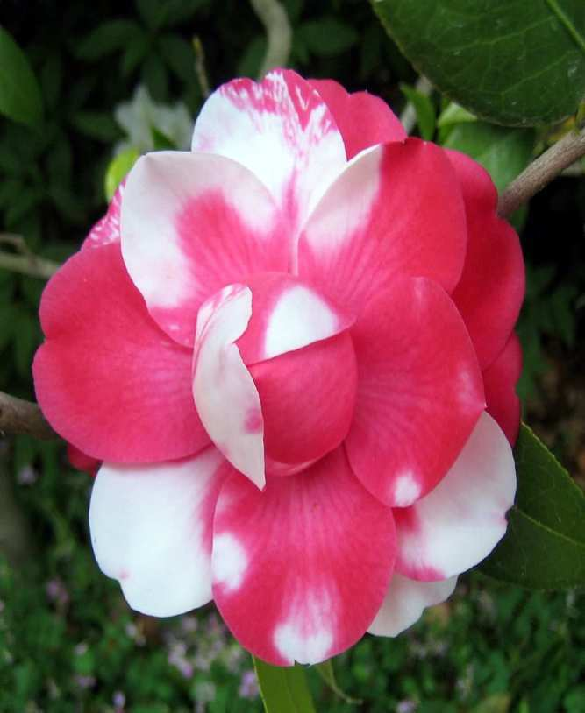
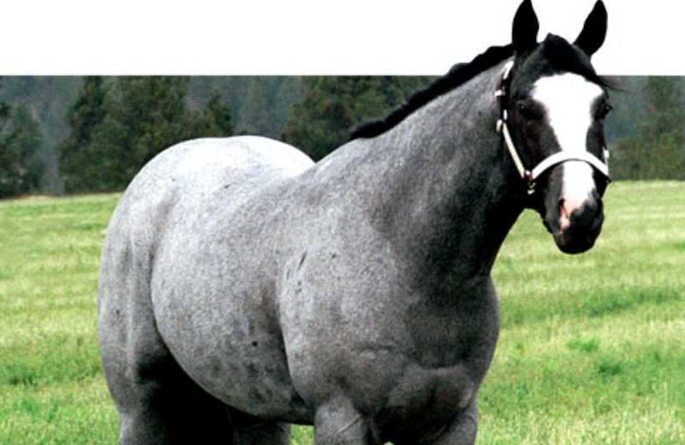
Codominance is a relationship among alleles where both alleles contribute to the phenotype of the heterozygote.
19
Copyright © 2010 Ryan P. Murphy

Slide 59
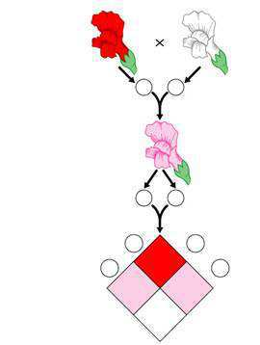
This is an example of...
  A.) Homozygous Dominant
  B.) Heterozygous Dominant
  C.) Incomplete Dominance
  D.) Recessive Alleles
  E.) Pure Breeding
20
Copyright © 2010 Ryan P. Murphy

Slide 60
This is an example of...
  A.) Homozygous Dominant
  B.) Heterozygous Dominant
  C.) Incomplete Dominance
  D.) Recessive Alleles
  E.) Pure Breeding
20
Copyright © 2010 Ryan P. Murphy

Slide 61
This is an example of...
  A.) Homozygous Dominant
  B.) Heterozygous Dominant
  C.) Incomplete Dominance
  D.) Recessive Alleles
  E.) Pure Breeding
20
Copyright © 2010 Ryan P. Murphy

Slide 62
This is an example of...
  A.) Homozygous Dominant
  B.) Heterozygous Dominant
  C.) Incomplete Dominance
  D.) Recessive Alleles
  E.) Pure Breeding
20
Copyright © 2010 Ryan P. Murphy

Slide 63
This is an example of...
  A.) Homozygous Dominant
  B.) Heterozygous Dominant
  C.) Incomplete Dominance
  D.) Recessive Alleles
  E.) Pure Breeding
20
Copyright © 2010 Ryan P. Murphy

Slide 64
This is an example of...
  A.) Homozygous Dominant
  B.) Heterozygous Dominant
  C.) Incomplete Dominance
  D.) Recessive Alleles
  E.) Pure Breeding
20
Copyright © 2010 Ryan P. Murphy

Slide 65
Part V Genetics Review Game
MEN DULL | TYPO | HOT LOTTO | THINK INSIDE THE BOX | -Bonus- FAMILY TIES
1 | 6 | 11 | 16 | *21
2 | 7 | 12 | 17 | *22
3 | 8 | 13 | 18 | *23
4 | 9 | 14 | 19 | *24
5 | 10 | 15 | 20 | *25

Slide 66
Part V Genetics Review Game
MEN DULL | TYPO | HOT LOTTO | THINK INSIDE THE BOX | -Bonus- FAMILY TIES
1 | 6 | 11 | 16 | *21
2 | 7 | 12 | 17 | *22
3 | 8 | 13 | 18 | *23
4 | 9 | 14 | 19 | *24
5 | 10 | 15 | 20 | *25

Slide 67
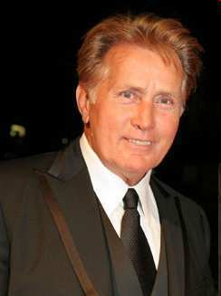
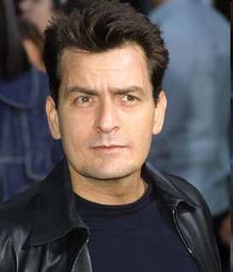

“Who are we?”
Copyright © 2010 Ryan P. Murphy

Slide 68
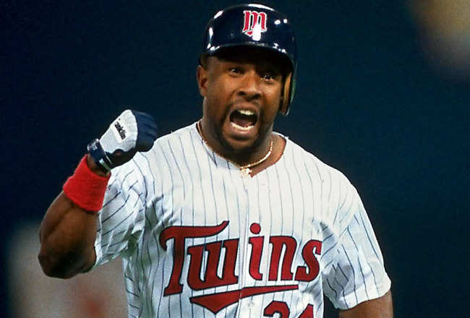

Name this MLB Team?
*22

Slide 69

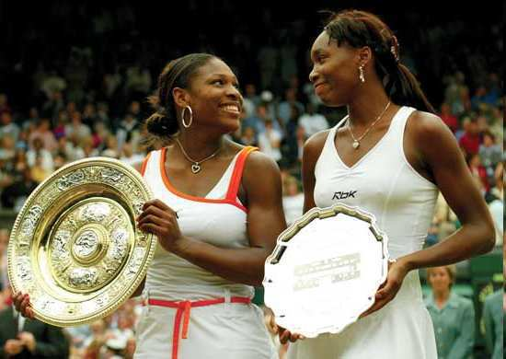
Who are these Grand Slam sisters?
Copyright © 2010 Ryan P. Murphy

Slide 70
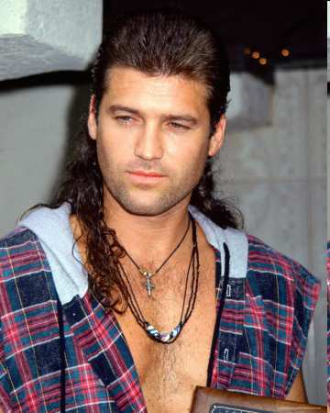

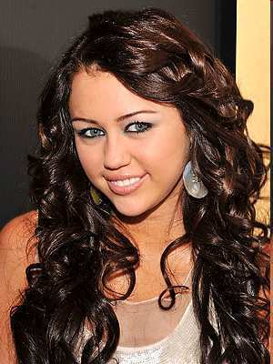
“What’s my dads name?”
Copyright © 2010 Ryan P. Murphy

Slide 71
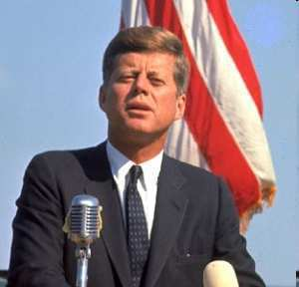
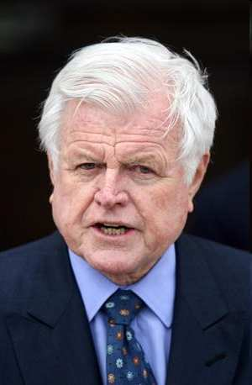

Who are these two?
Copyright © 2010 Ryan P. Murphy

Slide 72
Part V Genetics Review Game
MEN DULL | TYPO | HOT LOTTO | THINK INSIDE THE BOX | -Bonus- FAMILY TIES
1 | 6 | 11 | 16 | *21
2 | 7 | 12 | 17 | *22
3 | 8 | 13 | 18 | *23
4 | 9 | 14 | 19 | *24
5 | 10 | 15 | 20 | *25
Final Question

Slide 73
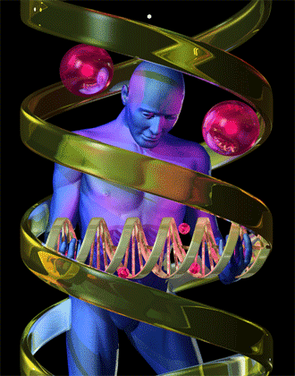
5 Wager Question

Slide 74
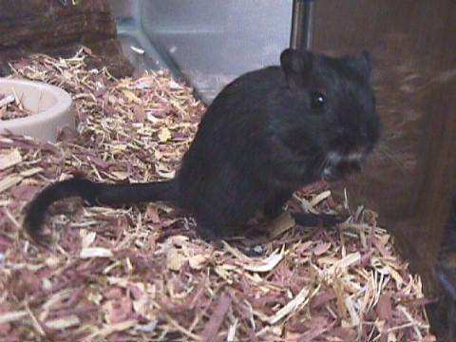
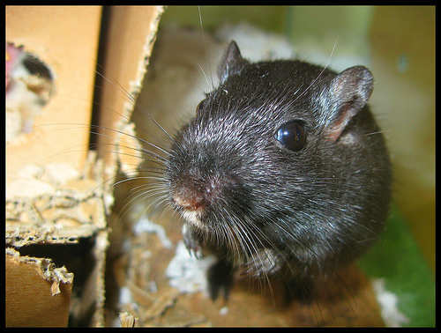
Two black gerbils mate. One is Homozygous Dominant (BB) and one is Heterozygous (Bb), What is the probability that their offspring will be black?
Next
Slide
Copyright© 2010 Ryan P. Murphy

Slide 75
Complete the Punnett Square, BB and Bb
  B = Black Dominant
  bb = White Recessive
B b
B
B
Probability of outcome is:
Copyright© 2010 Ryan P. Murphy

Slide 76
Answer Key

Slide 77
Part V Genetics Review Game
MEN DULL | TYPO | HOT LOTTO | THINK INSIDE THE BOX | -Bonus- FAMILY TIES
1 | 6 | 11 | 16 | *21
2 | 7 | 12 | 17 | *22
3 | 8 | 13 | 18 | *23
4 | 9 | 14 | 19 | *24
5 | 10 | 15 | 20 | *25

Slide 78
Part V Genetics Review Game
MEN DULL | TYPO | HOT LOTTO | THINK INSIDE THE BOX | -Bonus- FAMILY TIES
1 | 6 | 11 | 16 | *21
2 | 7 | 12 | 17 | *22
3 | 8 | 13 | 18 | *23
4 | 9 | 14 | 19 | *24
5 | 10 | 15 | 20 | *25

Slide 79
This Monk is known as the father of modern genetics for his work with pea plants.
1
Copyright © 2010 Ryan P. Murphy

Slide 80
This Monk is known as the father of modern genetics for his work with pea plants.
1
and the answer is…
Copyright © 2010 Ryan P. Murphy

Slide 81
This Monk is known as the father of modern genetics for his work with pea plants.
1
Gregor Mendel
and the answer is…
Copyright © 2010 Ryan P. Murphy

Slide 82
This is the term for when organisms pass traits from parents to offspring.
  A.) Genetics
  B.) Punnett Squares
  C.) Alleles
  D.) Heredity
  E.) Homozygous
2
Copyright© 2010 Ryan P. Murphy

Slide 83
This is the term for when organisms pass traits from parents to offspring.
  A.) Genetics
  B.) Punnett Squares
  C.) Alleles
  D.) Heredity
  E.) Homozygous
2
Copyright© 2010 Ryan P. Murphy

Slide 84
This is the term for when organisms pass traits from parents to offspring.
  A.) Genetics
  B.) Punnett Squares
  C.) Alleles
  D.) Heredity
  E.) Homozygous
2
Copyright© 2010 Ryan P. Murphy

Slide 85
This is the term for when organisms pass traits from parents to offspring.
  A.) Genetics
  B.) Punnett Squares
  C.) Alleles
  D.) Heredity
  E.) Homozygous
2
Copyright© 2010 Ryan P. Murphy

Slide 86
This is the term for when organisms pass traits from parents to offspring.
  A.) Genetics
  B.) Punnett Squares
  C.) Alleles
  D.) Heredity
  E.) Homozygous
2
Copyright© 2010 Ryan P. Murphy

Slide 87
This is the term for when organisms pass traits from parents to offspring.
  A.) Genetics
  B.) Punnett Squares
  C.) Alleles
  D.) Heredity
  E.) Homozygous
2
Copyright© 2010 Ryan P. Murphy

Slide 88
This is the term for when organisms pass traits from parents to offspring.
  A.) Genetics
  B.) Punnett Squares
  C.) Alleles
  D.) Heredity
  E.) Homozygous
2
and the answer is…
Copyright© 2010 Ryan P. Murphy

Slide 89
This is the term for when organisms pass traits from parents to offspring.
  A.) Genetics
  B.) Punnett Squares
  C.) Alleles
  D.) Heredity
  E.) Homozygous
2
and the answer is…
Copyright© 2010 Ryan P. Murphy

Slide 90
When two purebreds mate, they always produce…
  A.) Offspring with different traits as the parent.
  B.) Offspring with the same traits as the parent.
  C.) Offspring without any traits.
  D.) Purebreds cannot produce offspring.
3
Copyright© 2010 Ryan P. Murphy

Slide 91
When two purebreds mate, they always produce…
  A.) Offspring with different traits as the parent.
  B.) Offspring with the same traits as the parent.
  C.) Offspring without any traits.
  D.) Purebreds cannot produce offspring.
3
Copyright© 2010 Ryan P. Murphy

Slide 92
When two purebreds mate, they always produce…
  A.) Offspring with different traits as the parent.
  B.) Offspring with the same traits as the parent.
  C.) Offspring without any traits.
  D.) Purebreds cannot produce offspring.
3
Copyright© 2010 Ryan P. Murphy

Slide 93
When two purebreds mate, they always produce…
  A.) Offspring with different traits as the parent.
  B.) Offspring with the same traits as the parent.
  C.) Offspring without any traits.
  D.) Purebreds cannot produce offspring.
3
Copyright© 2010 Ryan P. Murphy

Slide 94
When two purebreds mate, they always produce…
  A.) Offspring with different traits as the parent.
  B.) Offspring with the same traits as the parent.
  C.) Offspring without any traits.
  D.) Purebreds cannot produce offspring.
3
Copyright© 2010 Ryan P. Murphy

Slide 95
When two purebreds mate, they always produce…
  A.) Offspring with different traits as the parent.
  B.) Offspring with the same traits as the parent.
  C.) Offspring without any traits.
  D.) Purebreds cannot produce offspring.
3
and the answer is…
Copyright© 2010 Ryan P. Murphy

Slide 96
When two purebreds mate, they always produce…
  A.) Offspring with different traits as the parent.
  B.) Offspring with the same traits as the parent.
  C.) Offspring without any traits.
  D.) Purebreds cannot produce offspring.
3
and the answer is…
Copyright© 2010 Ryan P. Murphy

Slide 97

When two purebreds mate, they always produce…
  A.) Offspring with different traits as the parent.
  B.) Offspring with the same traits as the parent.
  C.) Offspring without any traits.
  D.) Purebreds cannot produce offspring.
3
and the answer is…
Copyright© 2010 Ryan P. Murphy

Slide 98
4
What were Mendels results in the F2 Generation?
?
?
?
?
Copyright© 2010 Ryan P. Murphy

Slide 99
4
What were Mendels results in the F2 Generation?
?
?
?
?
Copyright© 2010 Ryan P. Murphy

Slide 100
4
What were Mendels results in the F2 Generation?
3 Tall : 1 Short
Copyright© 2010 Ryan P. Murphy

Slide 101
4
What were Mendels results in the F2 Generation?
  In the next F2 generation, ¼ of the pea plants were short, ¾ were tall.
3 Tall : 1 Short
Copyright© 2010 Ryan P. Murphy

Slide 102
This is the name for an organism’s physical appearance or its visible traits.
5

Slide 103
This is the name for an organism’s physical appearance or its visible traits.
5
and the answer is…

Slide 104
This is the name for an organism’s physical appearance or its visible traits.
5
Phenotype
Phenotype
and the answer is…

Slide 105
Part V Genetics Review Game
MEN DULL | TYPO | HOT LOTTO | THINK INSIDE THE BOX | -Bonus- FAMILY TIES
1 | 6 | 11 | 16 | *21
2 | 7 | 12 | 17 | *22
3 | 8 | 13 | 18 | *23
4 | 9 | 14 | 19 | *24
5 | 10 | 15 | 20 | *25

Slide 106
Part V Genetics Review Game
MEN DULL | TYPO | HOT LOTTO | THINK INSIDE THE BOX | -Bonus- FAMILY TIES
1 | 6 | 11 | 16 | *21
2 | 7 | 12 | 17 | *22
3 | 8 | 13 | 18 | *23
4 | 9 | 14 | 19 | *24
5 | 10 | 15 | 20 | *25

Slide 107
This is the name for an organism’s genetic makeup, or allele combinations
6
Copyright© 2010 Ryan P. Murphy

Slide 108
This is the name for an organism’s genetic makeup, or allele combinations
6
Answer is…
Copyright© 2010 Ryan P. Murphy

Slide 109
End of Preview
Hundreds of more slides,
activities, video links,
homework package, lesson
notes, review games,
rubrics, and much more
on the full version of this unit
and larger curriculum.

Slide 110
DNA and Genetics Unit

Slide 111
DNA and Genetics Unit
Areas of Focus within The DNA and Genetics Unit:
DNA, DNA Extraction, Structure of DNA, Discovery of the Double Helix, Rosalind Franklin, Nucleotides, RNA, Cell Division, Mitosis, Phases of Mitosis, Chromosomes, Cancer, Ways to Avoid Cancer, What is Inside a Cigarette?, Facts about Smoking?, Anti-Smoking Ads, Meiosis, Phases in Meiosis, Mendelian Genetics, Gregor Mendel, Punnett Squares, Probability, Dihybrid Cross, Codominance, Bio-Ethics, Stem Cell Debate, Cloning Debate
http://sciencepowerpoint.com/DNA_Genetics_Unit.html

Slide 112
The entire four year curriculum can be found at... http://sciencepowerpoint.com/ Please feel free to contact me with any questions you may have. Thank you for your interest in this curriculum.
Sincerely,
Ryan Murphy M.Ed
www.sciencepowerpoint@gmail.com

