Slide 1
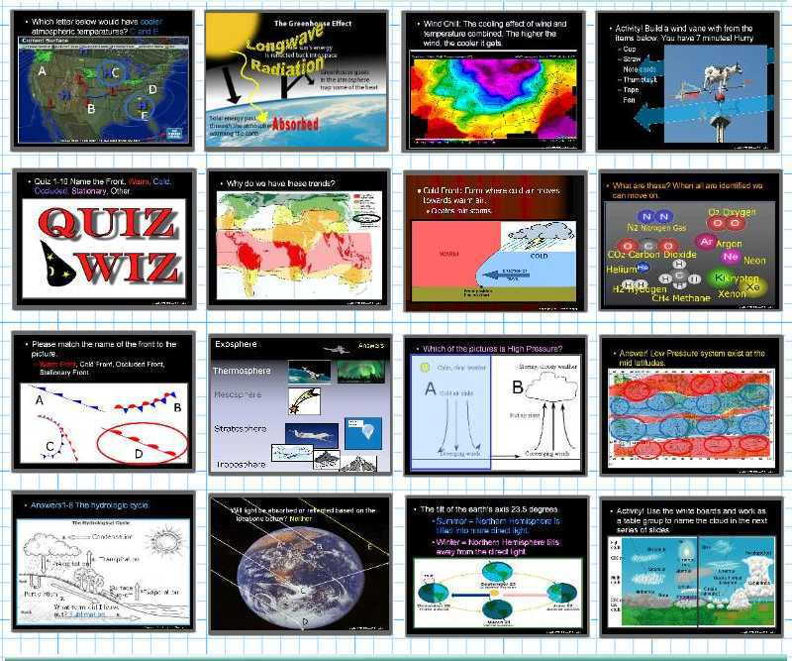
Weather and Climate Unit

Slide 2
Weather and Climate Unit
Areas of Focus within The Weather and Climate Unit:
What is weather?, Climate, Importance of the Atmosphere, Components of the Atmosphere, Layers of the Atmosphere, Air Quality and Pollution, Carbon Monoxide, Ozone Layer, Ways to Avoid Skin Cancer, Air Pressure, Barometer, Air Pressure and Wind, Fronts, Wind, Global Wind, Coriolis Force, Jet Stream, Sea Breeze / Land Breeze, Mountain Winds, Mountain Rain Shadow, Wind Chill, Flight, Dangerous Weather Systems, Light, Albedo, Temperature, Thermometers, Seasons, Humidity / Water, Oceans, Roles of Oceans, El Nino, La Nina Cycle, Dew Points, Clouds, Types of Clouds, Meteorology, Weather Tools, Isotherms, Ocean Currents, Enhanced Global Warming, Greenhouse Effect, The Effects of Global Warming, Biomes, Types of Biomes.
http://sciencepowerpoint.com/Weather_Climate_Unit.html

Slide 3
Weather and Climate Unit Review Game I
THE ATMOSPHERE | LAYERS OF THE ATMOSPHERE | AIR QUALITY | AIR PRESSURE | -BONUS- WEATHER MOVIES
1 | 6 | 11 | 16 | *21
2 | 7 | 12 | 17 | *22
3 | 8 | 13 | 18 | *23
4 | 9 | 14 | 19 | *24
5 | 10 | 15 | 20 | *25
Copyright © 2010 Ryan P. Murphy

Slide 4
How to play…
  Don’t play like Jeo_ _ _ _ y.
  Class should be divided into several small groups.
  Groups should use science journal (red slide notes), homework, and other available materials to assist you.
  Groups can communicate quietly with each other but no sharing answers between groups.
    Practice quietly communicating right now?
    Practice Communication Question:
    Your group gets to order one pizza, and you can have two toppings. What does your group want?

Slide 5

Questions 1-20 = 5pts Each
Final Category (Bonus) = 1pt Each
Final Questions = 5 pt wager
If you wager 5 on the last question and get it wrong you lose 5 pts. Wager 5 and get it right you get 5 pts.
Find the Owl =
Secretly write “Owl” in the correct box worth 1pt.
“I’ll be about this big.”

Slide 6

Is your name on the review sheet?
Name

Slide 7
Is your name on the review sheet?
Add the categories
along the top
on the next slide.

Slide 8
Weather and Climate Unit Review Game I
THE ATMOSPHERE | LAYERS OF THE ATMOSPHERE | AIR QUALITY | AIR PRESSURE | -BONUS- WEATHER MOVIES
1 | 6 | 11 | 16 | *21
2 | 7 | 12 | 17 | *22
3 | 8 | 13 | 18 | *23
4 | 9 | 14 | 19 | *24
5 | 10 | 15 | 20 | *25
Copyright © 2010 Ryan P. Murphy

Slide 9
Weather and Climate Unit Review Game I
THE ATMOSPHERE | LAYERS OF THE ATMOSPHERE | AIR QUALITY | AIR PRESSURE | -BONUS- THINGS WEATHER
1 | 6 | 11 | 16 | *21
2 | 7 | 12 | 17 | *22
3 | 8 | 13 | 18 | *23
4 | 9 | 14 | 19 | *24
5 | 10 | 15 | 20 | *25
Copyright © 2010 Ryan P. Murphy

Slide 10
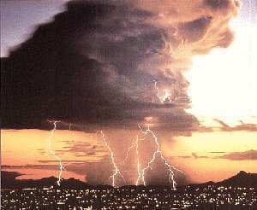
True or False! Climate is the state of the atmosphere at a given time and place.
1
Copyright © 2010 Ryan P. Murphy
Notes:
Category 1 - 10

Slide 11
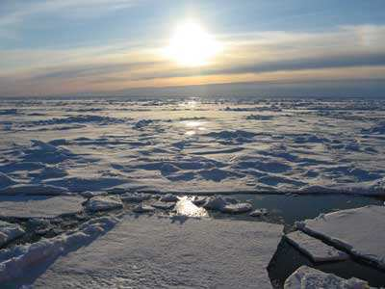
Water exists in what three states of matter on Earth?
2
Copyright © 2010 Ryan P. Murphy
Notes:
Category 1 - 20

Slide 12

This process is not possible without oxygen?
3
Copyright © 2010 Ryan P. Murphy

Slide 13

78% of our atmosphere is composed of this gas?
4
Copyright © 2010 Ryan P. Murphy

Slide 14
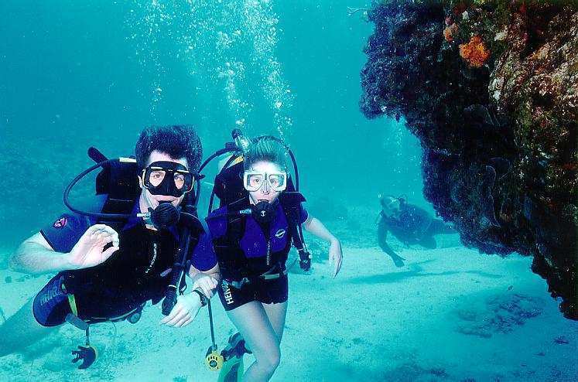
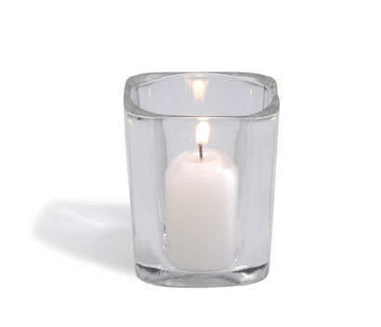

Most of the other 22% of our atmosphere consists of this gas?
5
Copyright © 2010 Ryan P. Murphy

Slide 15
Weather and Climate Unit Review Game I
THE ATMOSPHERE | LAYERS OF THE ATMOSPHERE | AIR QUALITY | AIR PRESSURE | -BONUS- THINGS WEATHER
1 | 6 | 11 | 16 | *21
2 | 7 | 12 | 17 | *22
3 | 8 | 13 | 18 | *23
4 | 9 | 14 | 19 | *24
5 | 10 | 15 | 20 | *25
Copyright © 2010 Ryan P. Murphy

Slide 16
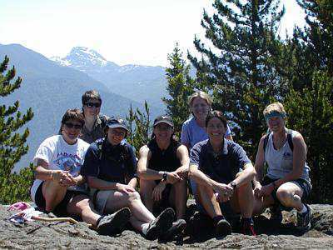
We live in this layer of the atmosphere?
6
Copyright © 2010 Ryan P. Murphy

Slide 17
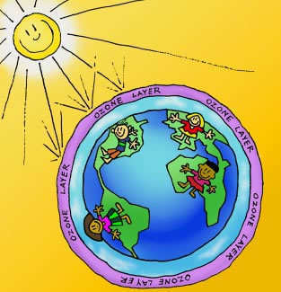
The protective ozone layer is found here?
7
Copyright © 2010 Ryan P. Murphy

Slide 18
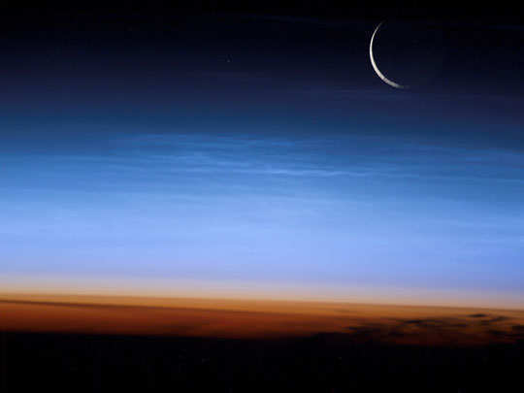
Meteors burn up in this layer of the atmosphere?
8
Copyright © 2010 Ryan P. Murphy

Slide 19
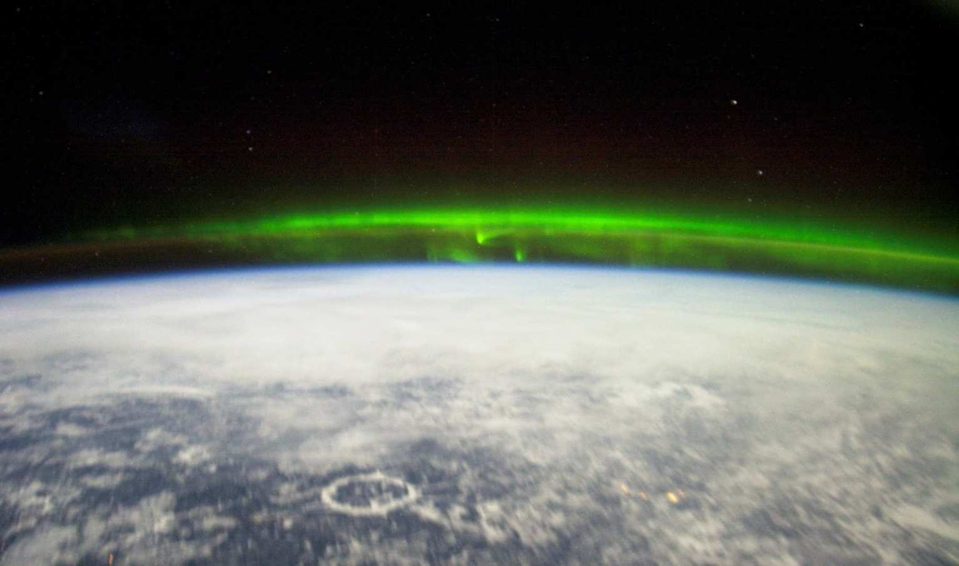
The Space Shuttle orbits in this layer of the atmosphere?
9
Copyright © 2010 Ryan P. Murphy

Slide 20

This layer of atmosphere merges with space?
10
Copyright © 2010 Ryan P. Murphy

Slide 21
Weather and Climate Unit Review Game I
THE ATMOSPHERE | LAYERS OF THE ATMOSPHERE | AIR QUALITY | AIR PRESSURE | -BONUS- THINGS WEATHER
1 | 6 | 11 | 16 | *21
2 | 7 | 12 | 17 | *22
3 | 8 | 13 | 18 | *23
4 | 9 | 14 | 19 | *24
5 | 10 | 15 | 20 | *25
Copyright © 2010 Ryan P. Murphy

Slide 22
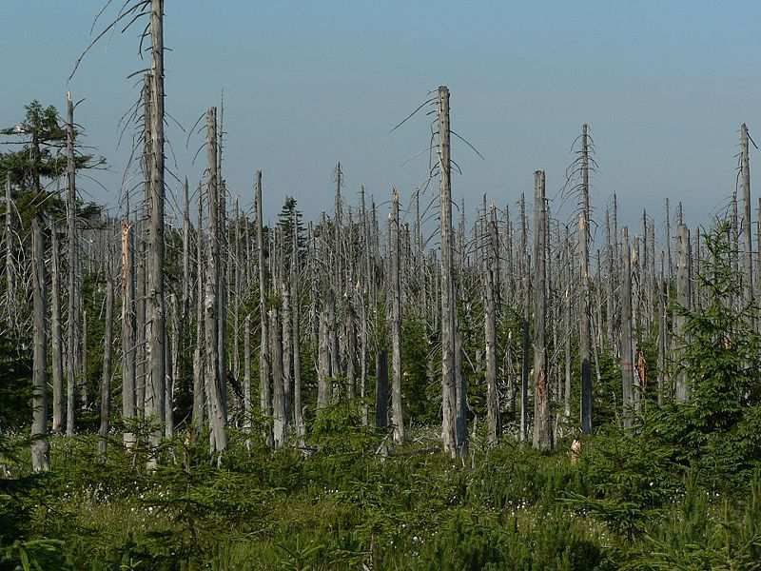
What regional weather problem is evident here?
11
Copyright © 2010 Ryan P. Murphy

Slide 23

What type of poisoning can occur if combustion occurs indoors?
12
Copyright © 2010 Ryan P. Murphy

Slide 24
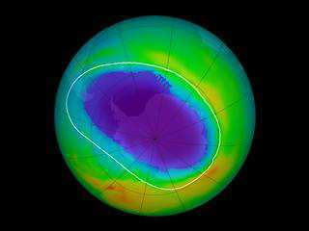
This layer which currently has a hole protects the earth from harmful UV rays.
13
Copyright © 2010 Ryan P. Murphy

Slide 25
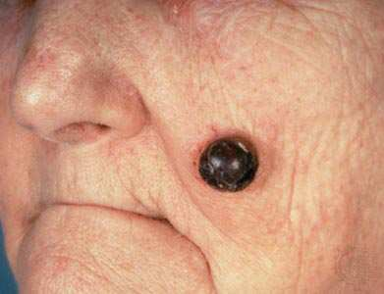
This can occur from too much sun exposure?
14
Copyright © 2010 Ryan P. Murphy

Slide 26
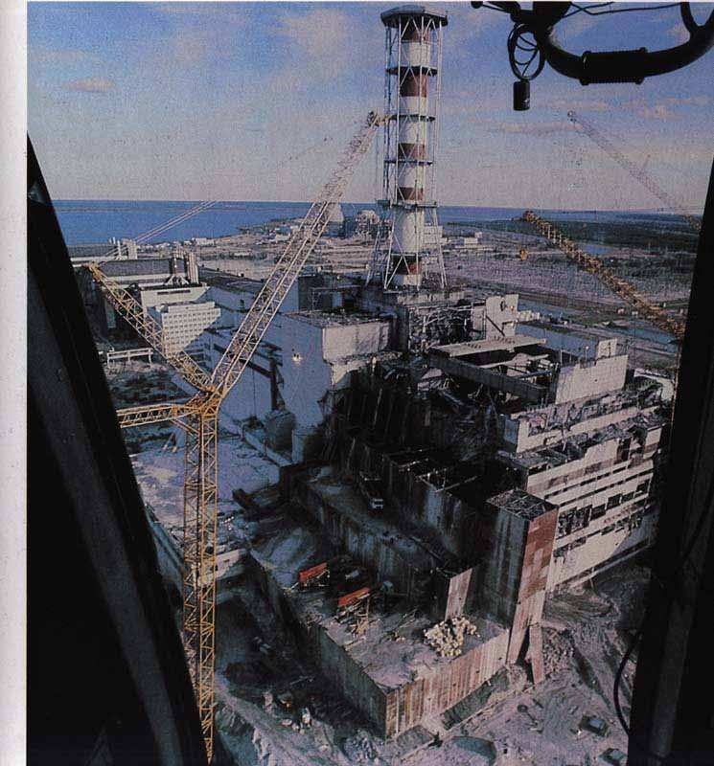
This nuclear disaster in Russia caused worldwide radioactive fallout?
15
Copyright © 2010 Ryan P. Murphy

Slide 27
Weather and Climate Unit Review Game I
THE ATMOSPHERE | LAYERS OF THE ATMOSPHERE | AIR QUALITY | AIR PRESSURE | -BONUS- THINGS WEATHER
1 | 6 | 11 | 16 | *21
2 | 7 | 12 | 17 | *22
3 | 8 | 13 | 18 | *23
4 | 9 | 14 | 19 | *24
5 | 10 | 15 | 20 | *25
Copyright © 2010 Ryan P. Murphy

Slide 28
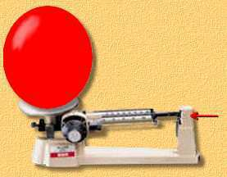
Air is made up of matter which has mass and takes up space?
16
Copyright © 2010 Ryan P. Murphy

Slide 29
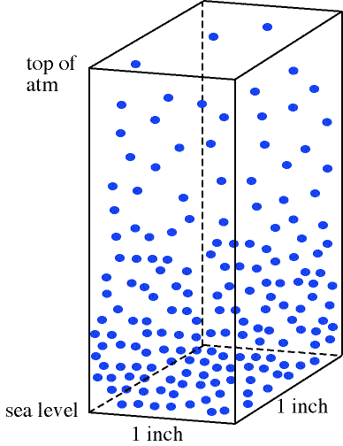
As elevation increases, air pressure…
17
Copyright © 2010 Ryan P. Murphy

Slide 30
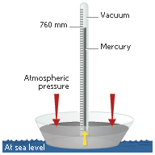
This instrument measures air pressure?
18
How many mm of Mercury = 1 atm
For a + 1pt bonus
Copyright © 2010 Ryan P. Murphy

Slide 31
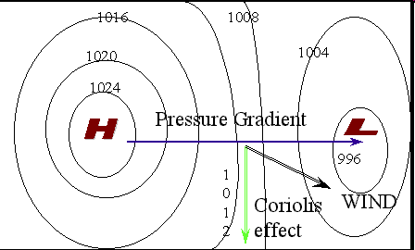
Warm air rises while cool air sinks, this causes differences in air pressure, wind and weather change.
Which has warmer temps?
19
A
B
Copyright © 2010 Ryan P. Murphy

Slide 32
Warm air rises while cool air sinks, this causes differences in air pressure, wind and weather change.
19
Copyright © 2010 Ryan P. Murphy

Slide 33
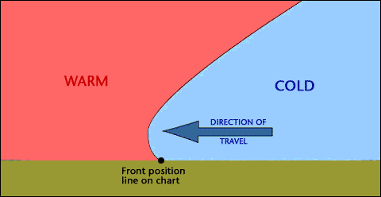
What type of front is this?
20
Copyright © 2010 Ryan P. Murphy

Slide 34
Weather and Climate Unit Review Game I
THE ATMOSPHERE | LAYERS OF THE ATMOSPHERE | AIR QUALITY | AIR PRESSURE | -BONUS- WEATHER MOVIES
1 | 6 | 11 | 16 | *21
2 | 7 | 12 | 17 | *22
3 | 8 | 13 | 18 | *23
4 | 9 | 14 | 19 | *24
5 | 10 | 15 | 20 | *25
Copyright © 2010 Ryan P. Murphy

Slide 35
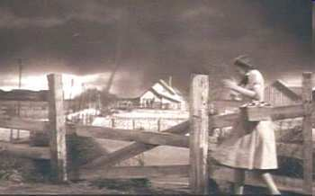
Name this Movie?
*21

Slide 36
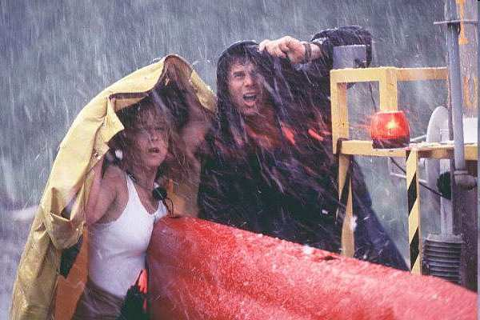
Name this Movie Starring Bill Paxton and Helen Hunt?
*22

Slide 37
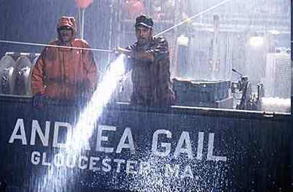
What movie is this based on the best seller by Sebastin Junger?
*23

Slide 38
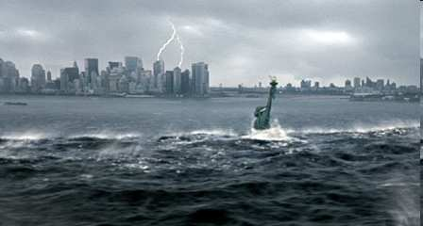
Crazy weather hits the world in this movie starring Dennis Quaid and Jake Gyllenhaal?
*24

Slide 39
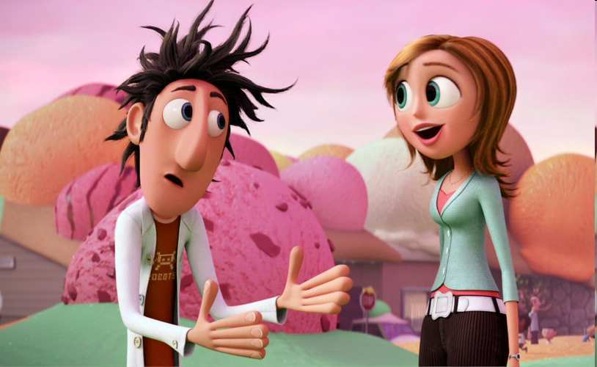
What is my name from the movie Cloudy With A Chance of Meatballs (2009)?
*25

Slide 40
Weather and Climate Unit Review Game I
THE ATMOSPHERE | LAYERS OF THE ATMOSPHERE | AIR QUALITY | AIR PRESSURE | -BONUS- WEATHER MOVIES
1 | 6 | 11 | 16 | *21
2 | 7 | 12 | 17 | *22
3 | 8 | 13 | 18 | *23
4 | 9 | 14 | 19 | *24
5 | 10 | 15 | 20 | *25
FINAL QUESTION:
Copyright © 2010 Ryan P. Murphy

Slide 41
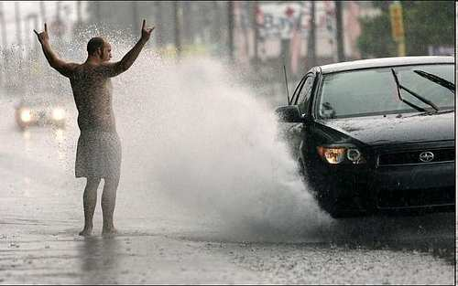
“You may wager up to 5 pts for this final question.”
“Please make your wager now.”

Slide 42
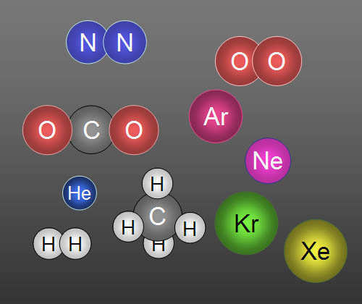
Final Question.
  How many of the molecules below can you name? One point each.
Copyright © 2010 Ryan P. Murphy

Slide 43
ANSWER KEY

Slide 44

Questions 1-20 = 5pts Each
Final Category (Bonus) = 1pt Each
Final Questions = 5 pt wager
Find the Owl = + 1pt
Secretly write “Owl” in the correct box worth 1pt.

Slide 45
Weather and Climate Unit Review Game I
THE ATMOSPHERE | LAYERS OF THE ATMOSPHERE | AIR QUALITY | AIR PRESSURE | -BONUS- THINGS WEATHER
1 | 6 | 11 | 16 | *21
2 | 7 | 12 | 17 | *22
3 | 8 | 13 | 18 | *23
4 | 9 | 14 | 19 | *24
5 | 10 | 15 | 20 | *25
Copyright © 2010 Ryan P. Murphy

Slide 46
True or False! Climate is the state of the atmosphere at a given time and place.
1
Copyright © 2010 Ryan P. Murphy
Notes:
Category 1 - 10

Slide 47
True or False! Climate Weather is the state of the atmosphere at a given time and place.
1
Copyright © 2010 Ryan P. Murphy
Notes:
Category 1 - 10

Slide 48
Water exists in what three states of matter on the earth?
2
Copyright © 2010 Ryan P. Murphy
Notes:
Category 1 - 20

Slide 49
Water exists in what three states of matter on the earth? Solid, Liquid, Gas.
2
Gas
Liquid
Solid
Copyright © 2010 Ryan P. Murphy
Notes:
Category 1 - 20

Slide 50
This process is not possible without oxygen?
3
Copyright © 2010 Ryan P. Murphy

Slide 51
This process is not possible without oxygen?
3
Combustion
Copyright © 2010 Ryan P. Murphy

Slide 52
78% of our atmosphere is composed of this gas?
4
Copyright © 2010 Ryan P. Murphy

Slide 53
78% of our atmosphere is composed of this gas?
4
Nitrogen Gas
Copyright © 2010 Ryan P. Murphy

Slide 54
Most of the other 22% of our atmosphere consists of this gas?
5
Copyright © 2010 Ryan P. Murphy

Slide 55
Most of the other 22% of our atmosphere consists of this gas? Oxygen
5
Oxygen Gas
Copyright © 2010 Ryan P. Murphy

Slide 56

Most of the other 22% of our atmosphere consists of this gas? Oxygen
5
Oxygen Gas
Copyright © 2010 Ryan P. Murphy

Slide 57
Most of the other 22% of our atmosphere consists of this gas? Oxygen
5
Oxygen Gas
Copyright © 2010 Ryan P. Murphy

Slide 58
End of Preview
Hundreds of more slides,
activities, video links,
homework package, lesson
notes, review games,
rubrics, and much more
on the full version of this unit
and larger curriculum.

Slide 59
Weather and Climate Unit

Slide 60
Weather and Climate Unit
Areas of Focus within The Weather and Climate Unit:
What is weather?, Climate, Importance of the Atmosphere, Components of the Atmosphere, Layers of the Atmosphere, Air Quality and Pollution, Carbon Monoxide, Ozone Layer, Ways to Avoid Skin Cancer, Air Pressure, Barometer, Air Pressure and Wind, Fronts, Wind, Global Wind, Coriolis Force, Jet Stream, Sea Breeze / Land Breeze, Mountain Winds, Mountain Rain Shadow, Wind Chill, Flight, Dangerous Weather Systems, Light, Albedo, Temperature, Thermometers, Seasons, Humidity / Water, Oceans, Roles of Oceans, El Nino, La Nina Cycle, Dew Points, Clouds, Types of Clouds, Meteorology, Weather Tools, Isotherms, Ocean Currents, Enhanced Global Warming, Greenhouse Effect, The Effects of Global Warming, Biomes, Types of Biomes.
http://sciencepowerpoint.com/Weather_Climate_Unit.html

Slide 61


The entire four year curriculum can be found at... http://sciencepowerpoint.com/ Please feel free to contact me with any questions you may have. Thank you for your interest in this curriculum.
Sincerely,
Ryan Murphy M.Ed
www.sciencepowerpoint@gmail.com

