Slide 1
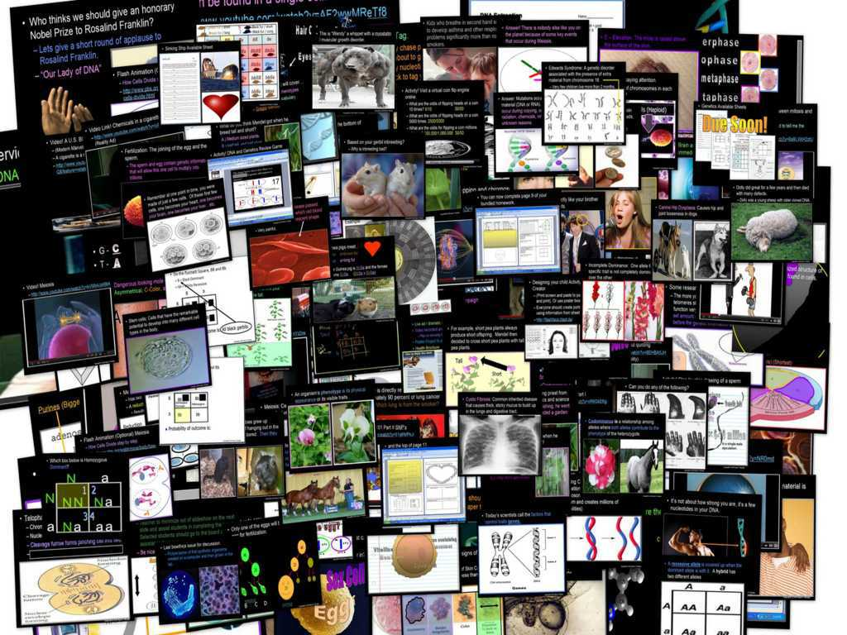
DNA and Genetics Unit

Slide 2
DNA and Genetics Unit
Areas of Focus within The DNA and Genetics Unit:
DNA, DNA Extraction, Structure of DNA, Discovery of the Double Helix, Rosalind Franklin, Nucleotides, RNA, Cell Division, Mitosis, Phases of Mitosis, Chromosomes, Cancer, Ways to Avoid Cancer, What is Inside a Cigarette?, Facts about Smoking?, Anti-Smoking Ads, Meiosis, Phases in Meiosis, Mendelian Genetics, Gregor Mendel, Punnett Squares, Probability, Dihybrid Cross, Codominance, Bio-Ethics, Stem Cell Debate, Cloning Debate
http://sciencepowerpoint.com/DNA_Genetics_Unit.html

Slide 3


The entire four year curriculum can be found at... http://sciencepowerpoint.com/ Please feel free to contact me with any questions you may have. Thank you for your interest in this curriculum.
Sincerely,
Ryan Murphy M.Ed
www.sciencepowerpoint@gmail.com

Slide 4
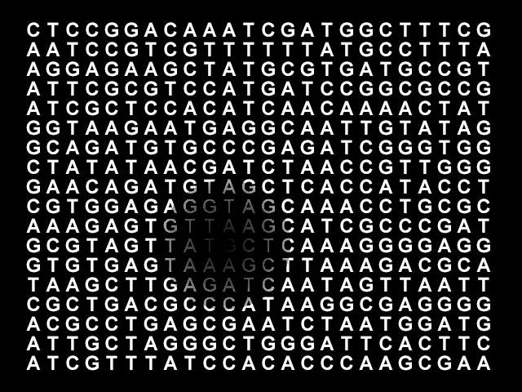
Part I: DNA Review Game
Copyright © 2010 Ryan P. Murphy

Slide 5
DNA Review Game
HIP HIP HOORAY | SPIRAL SPIRAL | SHAPE-UP | LIFE LINE | -Bonus- FAMILY JEANS
1 | 6 | 11 | 16 | *21
2 | 7 | 12 | 17 | *22
3 | 8 | 13 | 18 | *23
4 | 9 | 14 | 19 | *24
5 | 10 | 15 | 20 | *25

Slide 6
How to play…
  Don’t play like Jeo_ _ _ _ y.
  Class should be divided into several small groups.
  Groups should use science journal (red slide notes), homework, and other available materials to assist you.
  Groups can communicate quietly with each other but no sharing answers between groups.
    Practice quietly communicating right now?
    Practice Communication Question:
    Your group gets to order one pizza and you can have two toppings. What does your group want?

Slide 7

Questions 1-20 = 5pts Each
Final Category (Bonus) = 1pt Each
Final Questions = 5 pt wager
If you wager 5 on the last question and get it wrong you lose 5 pts. Wager 5 and get it right you get 5 pts.
Find the Owl =
Secretly write “Owl” in the correct box worth 1pt.
“I’ll be about this big.”

Slide 8

Is your name on the review sheet?
Name

Slide 9
Is your name on the review sheet?
Add the categories
along the top
on the next slide.

Slide 10
DNA Review Game
HIP HIP HOORAY | SPIRAL SPIRAL | SHAPE-UP | LIFE LINE | -Bonus- FAMILY JEANS
1 | 6 | 11 | 16 | *21
2 | 7 | 12 | 17 | *22
3 | 8 | 13 | 18 | *23
4 | 9 | 14 | 19 | *24
5 | 10 | 15 | 20 | *25

Slide 11
DNA Review Game
HIP HIP HOORAY | SPIRAL SPIRAL | SHAPE-UP | LIFE LINE | -Bonus- FAMILY JEANS
1 | 6 | 11 | 16 | *21
2 | 7 | 12 | 17 | *22
3 | 8 | 13 | 18 | *23
4 | 9 | 14 | 19 | *24
5 | 10 | 15 | 20 | *25

Slide 12
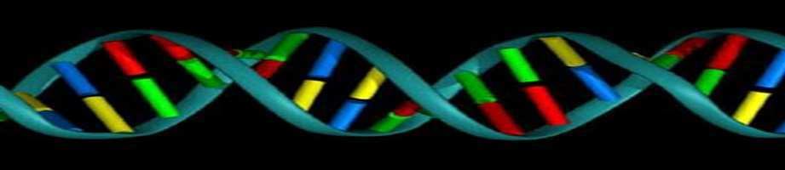
1
Which is not correct of DNA?
  A.) DNA is housed in the nucleus of Eukaryotic Cells.
  B.) DNA stands for Double Nucleus Amino acid.
  C.) The shape is called the double helix.
  D.) DNA has the information for our cells to make proteins.
  E.) DNA through transcription makes mRNA.

Slide 13
1
Which is not correct of DNA?
  A.) DNA is housed in the nucleus of Eukaryotic Cells.
  B.) DNA stands for Double Nucleus Amino acid.
  C.) The shape is called the double helix.
  D.) DNA has the information for our cells to make proteins.
  E.) DNA through transcription makes mRNA.

Slide 14
1
Which is not correct of DNA?
  A.) DNA is housed in the nucleus of Eukaryotic Cells.
  B.) DNA stands for Double Nucleus Amino acid.
  C.) The shape is called the double helix.
  D.) DNA has the information for our cells to make proteins.
  E.) DNA through transcription makes mRNA.

Slide 15
1
Which is not correct of DNA?
  A.) DNA is housed in the nucleus of Eukaryotic Cells.
  B.) DNA stands for Double Nucleus Amino acid.
  C.) The shape is called the double helix.
  D.) DNA has the information for our cells to make proteins.
  E.) DNA through transcription makes mRNA.

Slide 16
1
Which is not correct of DNA?
  A.) DNA is housed in the nucleus of Eukaryotic Cells.
  B.) DNA stands for Double Nucleus Amino acid.
  C.) The shape is called the double helix.
  D.) DNA has the information for our cells to make proteins.
  E.) DNA through transcription makes mRNA.

Slide 17
1
Which is not correct of DNA?
  A.) DNA is housed in the nucleus of Eukaryotic Cells.
  B.) DNA stands for Double Nucleus Amino acid.
  C.) The shape is called the double helix.
  D.) DNA has the information for our cells to make proteins.
  E.) DNA through transcription makes mRNA.

Slide 18
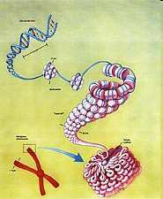
How many meters (roughly) of DNA stretched out can be found in a single cell?
  A.) .18 nanometers
  B.) 18 millimeters
  C.) 1.8 meters
  D.) 180 kilometers
  E.) It can wrap around the world over 180 million times.
2

Slide 19
How many meters (roughly) of DNA stretched out can be found in a single cell?
  A.) .18 nanometers
  B.) 18 millimeters
  C.) 1.8 meters
  D.) 180 kilometers
  E.) It can wrap around the world over 180 million times.
2

Slide 20
How many meters (roughly) of DNA stretched out can be found in a single cell?
  A.) .18 nanometers
  B.) 18 millimeters
  C.) 1.8 meters
  D.) 180 kilometers
  E.) It can wrap around the world over 180 million times.
2

Slide 21
How many meters (roughly) of DNA stretched out can be found in a single cell?
  A.) .18 nanometers
  B.) 18 millimeters
  C.) 1.8 meters
  D.) 180 kilometers
  E.) It can wrap around the world over 180 million times.
2

Slide 22
How many meters (roughly) of DNA stretched out can be found in a single cell?
  A.) .18 nanometers
  B.) 18 millimeters
  C.) 1.8 meters
  D.) 180 kilometers
  E.) It can wrap around the world over 180 million times.
2

Slide 23
How many meters (roughly) of DNA stretched out can be found in a single cell?
  A.) .18 nanometers
  B.) 18 millimeters
  C.) 1.8 meters
  D.) 180 kilometers
  E.) It can wrap around the world over 180 million times.
2

Slide 24
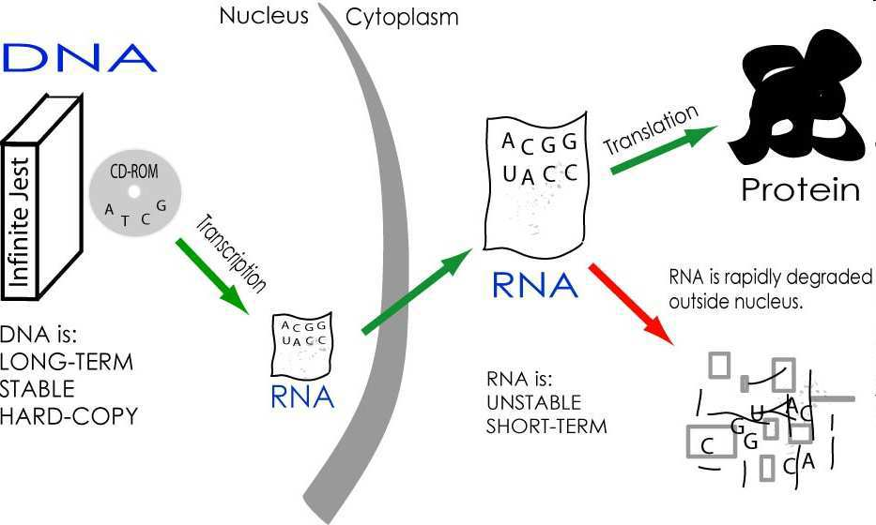





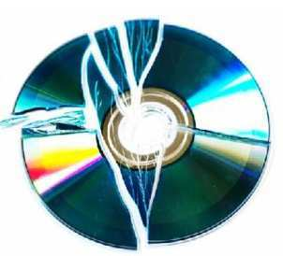
3
DNA has the information for our cells to make proteins. Name A and B?
Except
Proteins
Keep your
hard copy
safe in the nucleus
B
A
Copyright © 2010 Ryan P. Murphy

Slide 25
Same question
different visual

Slide 26
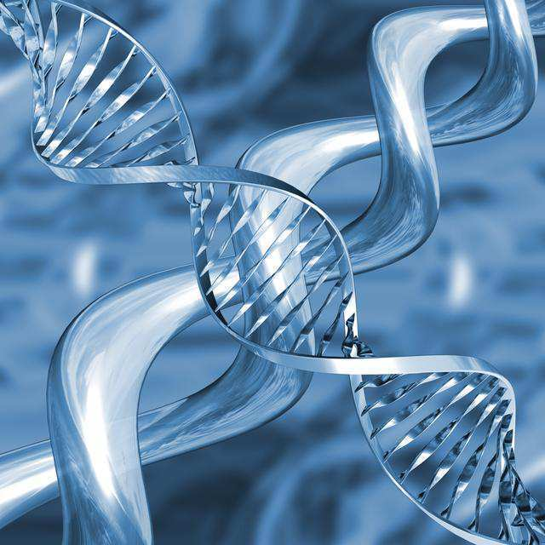
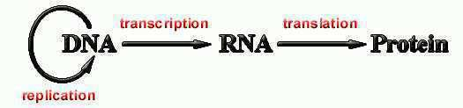
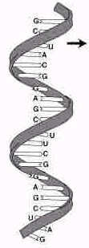
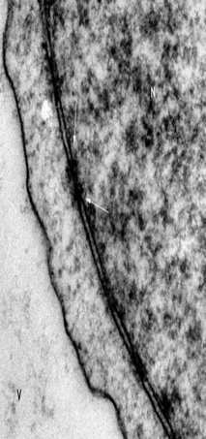
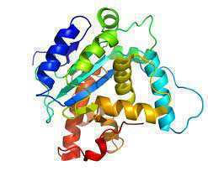
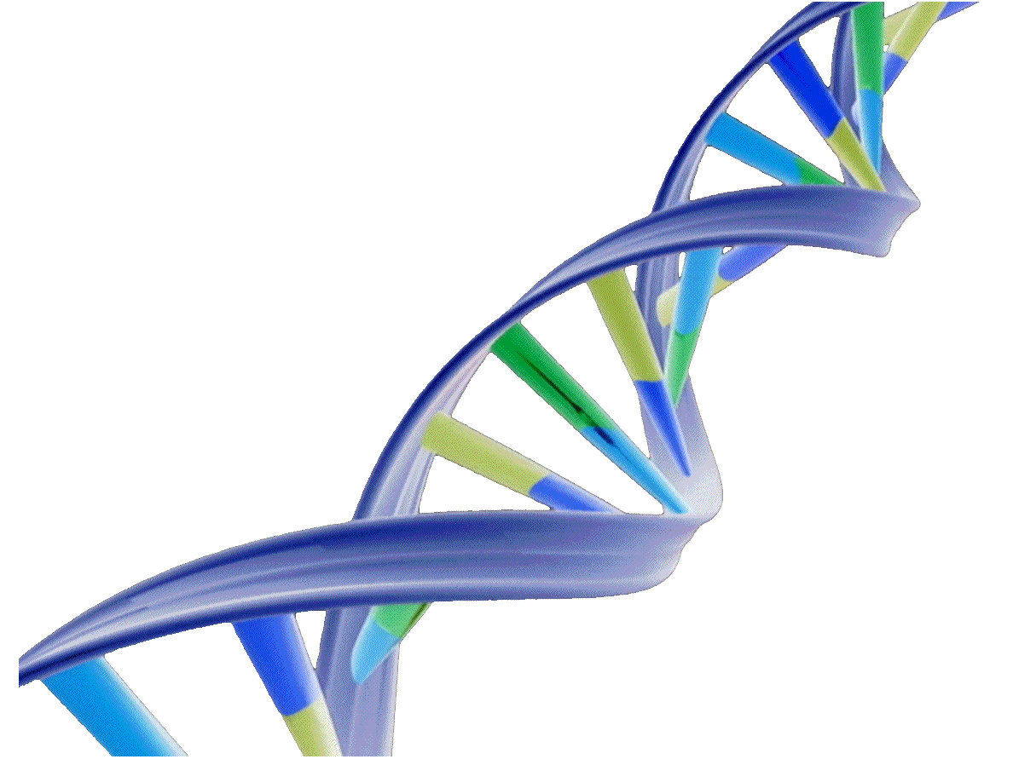
3
.
Nuclear
Membrane
Inside
Nucleus
RNA through
Nuclear Pore
Outside of
Nucleus
Copyright © 2010 Ryan P. Murphy

Slide 27
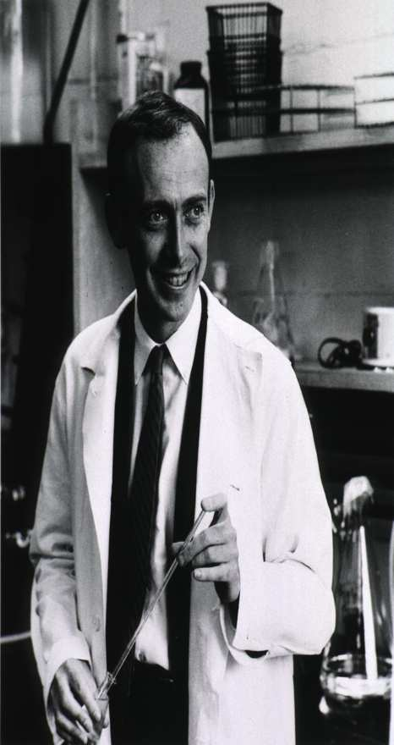
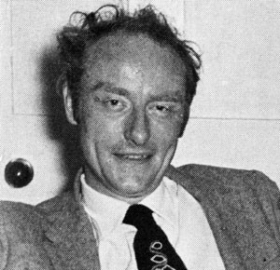
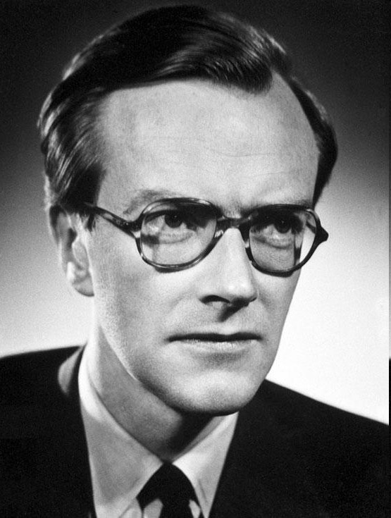
In 1962, Watson, Crick, and Wilkins discovered DNA’s structure and won the Nobel Prize.
4
A
B
C
Copyright © 2010 Ryan P. Murphy

Slide 28
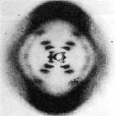

This scientist took X-Ray pictures of DNA’s structure and lectured about phosphate being a part of the outside of the molecule.
  Watson attended her lecture.
5
Copyright © 2010 Ryan P. Murphy

Slide 29
DNA Review Game
HIP HIP HOORAY | SPIRAL SPIRAL | SHAPE-UP | LIFE LINE | -Bonus- FAMILY JEANS
1 | 6 | 11 | 16 | *21
2 | 7 | 12 | 17 | *22
3 | 8 | 13 | 18 | *23
4 | 9 | 14 | 19 | *24
5 | 10 | 15 | 20 | *25

Slide 30
DNA Review Game
HIP HIP HOORAY | SPIRAL SPIRAL | SHAPE-UP | LIFE LINE | -Bonus- FAMILY JEANS
1 | 6 | 11 | 16 | *21
2 | 7 | 12 | 17 | *22
3 | 8 | 13 | 18 | *23
4 | 9 | 14 | 19 | *24
5 | 10 | 15 | 20 | *25

Slide 31
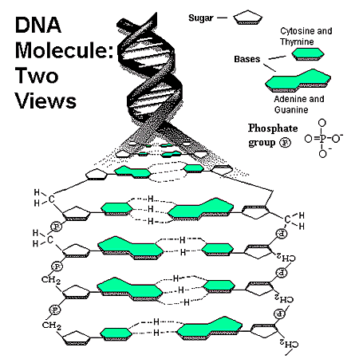
Which one is A, B, and C?
A.) mRNA, DNA, Sugar Complex
B.) Hydrogen Bond, mRNA, DNA wrap.
C.) Phosphate Group, 5 Carbon Sugar, Nitrogen Base
D.) Enzymes, Helix, Ribosomal Unit.
A
B
C
6
Copyright © 2010 Ryan P. Murphy

Slide 32
Which one is A, B, and C?
A.) mRNA, DNA, Sugar Complex
B.) Hydrogen Bond, mRNA, DNA wrap.
C.) Phosphate Group, 5 Carbon Sugar, Nitrogen Base
D.) Enzymes, Helix, Ribosomal Unit.
A
B
C
6
Copyright © 2010 Ryan P. Murphy

Slide 33
Which one is A, B, and C?
A.) mRNA, DNA, Sugar Complex
B.) Hydrogen Bond, mRNA, DNA wrap.
C.) Phosphate Group, 5 Carbon Sugar, Nitrogen Base
D.) Enzymes, Helix, Ribosomal Unit.
A
B
C
6
Copyright © 2010 Ryan P. Murphy

Slide 34
Which one is A, B, and C?
A.) mRNA, DNA, Sugar Complex
B.) Hydrogen Bond, mRNA, DNA wrap.
C.) Phosphate Group, 5 Carbon Sugar, Nitrogen Base
D.) Enzymes, Helix, Ribosomal Unit.
A
B
C
6
Copyright © 2010 Ryan P. Murphy

Slide 35
Which one is A, B, and C?
A.) mRNA, DNA, Sugar Complex
B.) Hydrogen Bond, mRNA, DNA wrap.
C.) Phosphate Group, 5 Carbon Sugar, Nitrogen Base
D.) Enzymes, Helix, Ribosomal Unit.
A
B
C
6
Copyright © 2010 Ryan P. Murphy

Slide 36
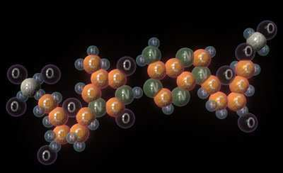

Nucleic Acids – P O N C H (Nucleotide)
Are made of these 5 biologically important elements?
Copyright © 2010 Ryan P. Murphy

Slide 37
There are four different types of nitrogen bases found in DNA. Name them?
A is for adenine
G is for guanine
C is for cytosine
T is for thymine
8
Copyright © 2010 Ryan P. Murphy

Slide 38
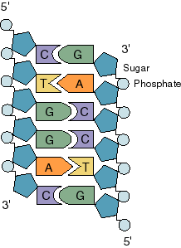
Name the corresponding base pair on the right. Each one is worth 1 point.
9
A
B
C
D
E
F
Copyright © 2010 Ryan P. Murphy

Slide 39
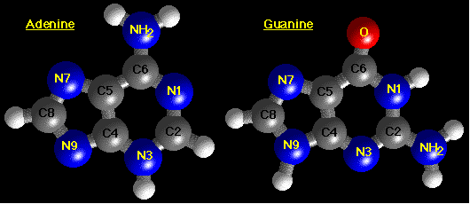
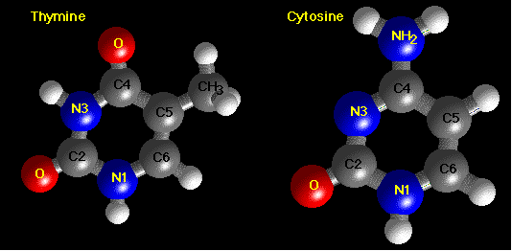
Which two are Purines? The larger of the two types of bases found in DNA.
10
Copyright © 2010 Ryan P. Murphy

Slide 40
DNA Review Game
HIP HIP HOORAY | SPIRAL SPIRAL | SHAPE-UP | LIFE LINE | -Bonus- FAMILY JEANS
1 | 6 | 11 | 16 | *21
2 | 7 | 12 | 17 | *22
3 | 8 | 13 | 18 | *23
4 | 9 | 14 | 19 | *24
5 | 10 | 15 | 20 | *25

Slide 41
DNA Review Game
HIP HIP HOORAY | SPIRAL SPIRAL | SHAPE-UP | LIFE LINE | -Bonus- FAMILY JEANS
1 | 6 | 11 | 16 | *21
2 | 7 | 12 | 17 | *22
3 | 8 | 13 | 18 | *23
4 | 9 | 14 | 19 | *24
5 | 10 | 15 | 20 | *25

Slide 42
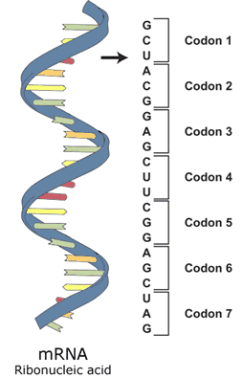
11
Name this molecule?

Slide 43
New Question

Slide 44
12
What nitrogen base is the U?

Slide 45
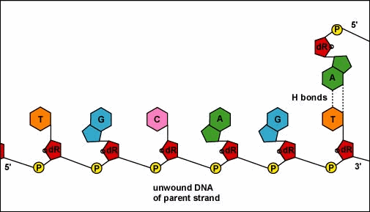
This animation best represents…
  A.) DNA extraction
  B.) Protein Synthesis
  C.) Random Griddle Formation
  D.) DNA Replication
  E.) None of the above.
13

Slide 46
This animation best represents…
  A.) DNA extraction
  B.) Protein Synthesis
  C.) Random Griddle Formation
  D.) DNA Replication
  E.) None of the above.
13

Slide 47
This animation best represents…
  A.) DNA extraction
  B.) Protein Synthesis
  C.) Random Griddle Formation
  D.) DNA Replication
  E.) None of the above.
13

Slide 48
This animation best represents…
  A.) DNA extraction
  B.) Protein Synthesis
  C.) Random Griddle Formation
  D.) DNA Replication
  E.) None of the above.
13

Slide 49
This animation best represents…
  A.) DNA extraction
  B.) Protein Synthesis
  C.) Random Griddle Formation
  D.) DNA Replication
  E.) None of the above.
13

Slide 50
This animation best represents…
  A.) DNA extraction
  B.) Protein Synthesis
  C.) Random Griddle Formation
  D.) DNA Replication
  E.) None of the above.
13

Slide 51
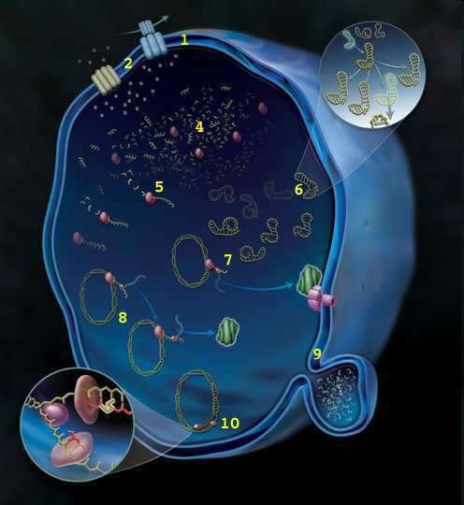
The back story of our lives are that we are the product of billions of years of evolution. The very DNA that allows us to pass on our genetic information to our offspring has its roots in primitive microbes that existed billions of years ago.
14
Copyright © 2010 Ryan P. Murphy

Slide 52
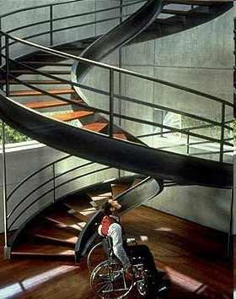
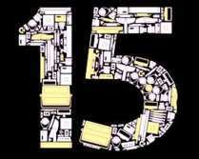
Name a movie starring Ethan Hawke, Uma Thurman, and Jude Law?
C - ____
T - ____
A - ____
A - ____
T - ____
G - ____
T - ____
Copyright © 2010 Ryan P. Murphy

Slide 53
DNA Review Game
HIP HIP HOORAY | SPIRAL SPIRAL | SHAPE-UP | LIFE LINE | -Bonus- FAMILY JEANS
1 | 6 | 11 | 16 | *21
2 | 7 | 12 | 17 | *22
3 | 8 | 13 | 18 | *23
4 | 9 | 14 | 19 | *24
5 | 10 | 15 | 20 | *25

Slide 54
DNA Review Game
HIP HIP HOORAY | SPIRAL SPIRAL | SHAPE-UP | LIFE LINE | -Bonus- FAMILY JEANS
1 | 6 | 11 | 16 | *21
2 | 7 | 12 | 17 | *22
3 | 8 | 13 | 18 | *23
4 | 9 | 14 | 19 | *24
5 | 10 | 15 | 20 | *25

Slide 55
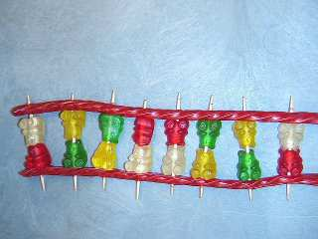
Name, A, B, C, and D?
A
DNA
Phosphate Backbone
C
A
C
T
G
D
16
B
Toothpick
Nitrogen Base

Slide 56
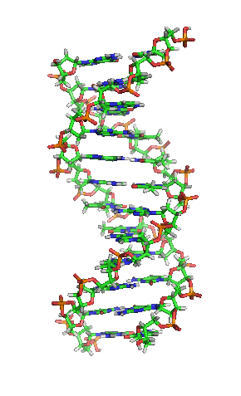
17
Spell what DNA stands for..

Slide 57

DNA has the information for our cells to make proteins?
Copyright © 2010 Ryan P. Murphy

Slide 58
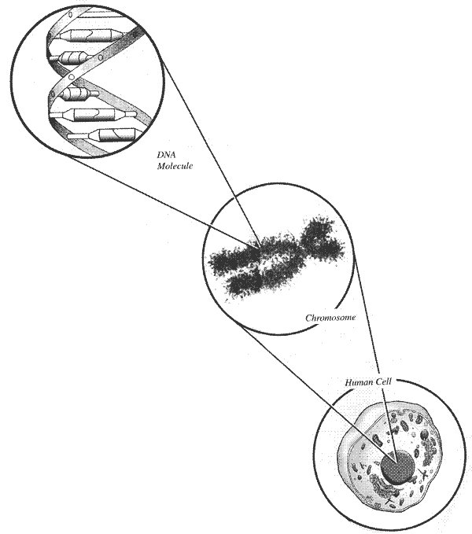
Name this tightly wound package of DNA?
  A structure within the cell that bears the genetic material as a threadlike linear strand of DNA.
19
Copyright © 2010 Ryan P. Murphy

Slide 59
Which is a hard copy (long term) and which is a short term copy?
20
DNA
RNA
Hard
Copy
Short
Term
Copy
Copyright © 2010 Ryan P. Murphy

Slide 60
DNA Review Game
HIP HIP HOORAY | SPIRAL SPIRAL | SHAPE-UP | LIFE LINE | -Bonus- FAMILY JEANS
1 | 6 | 11 | 16 | *21
2 | 7 | 12 | 17 | *22
3 | 8 | 13 | 18 | *23
4 | 9 | 14 | 19 | *24
5 | 10 | 15 | 20 | *25

Slide 61
DNA Review Game
HIP HIP HOORAY | SPIRAL SPIRAL | SHAPE-UP | LIFE LINE | -Bonus- FAMILY JEANS
1 | 6 | 11 | 16 | *21
2 | 7 | 12 | 17 | *22
3 | 8 | 13 | 18 | *23
4 | 9 | 14 | 19 | *24
5 | 10 | 15 | 20 | *25

Slide 62
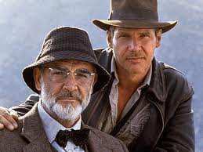
Name the famous movie son?
*21
Copyright © 2010 Ryan P. Murphy

Slide 63

Name this happy family?
*22
Copyright © 2010 Ryan P. Murphy

Slide 64

Name these twins?
*23

Slide 65
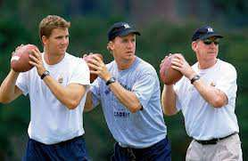
Name this family?
*24

Slide 66

Name either one of these Hollywood Stars?
*25

Slide 67
DNA Review Game
HIP HIP HOORAY | SPIRAL SPIRAL | SHAPE-UP | LIFE LINE | -Bonus- FAMILY JEANS
1 | 6 | 11 | 16 | *21
2 | 7 | 12 | 17 | *22
3 | 8 | 13 | 18 | *23
4 | 9 | 14 | 19 | *24
5 | 10 | 15 | 20 | *25
Final Question

Slide 68
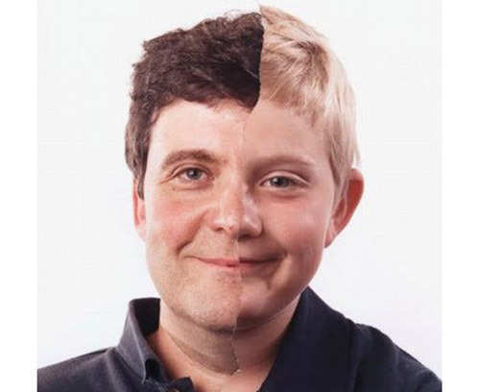
5 Point Wager Question

Slide 69
5 Point Wager Question

Slide 70
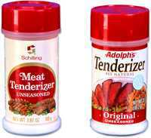
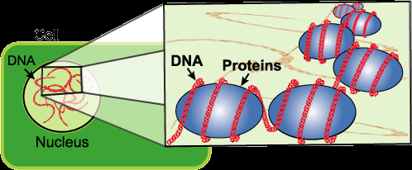
The meat tenderizer was added to break down the protein that the DNA is wrapped around.
This allowed the DNA to be extracted.
Copyright © 2010 Ryan P. Murphy

Slide 71
Answer
Key

Slide 72
DNA Review Game
HIP HIP HOORAY | SPIRAL SPIRAL | SHAPE-UP | LIFE LINE | -Bonus- FAMILY JEANS
1 | 6 | 11 | 16 | *21
2 | 7 | 12 | 17 | *22
3 | 8 | 13 | 18 | *23
4 | 9 | 14 | 19 | *24
5 | 10 | 15 | 20 | *25

Slide 73
DNA Review Game
HIP HIP HOORAY | SPIRAL SPIRAL | SHAPE-UP | LIFE LINE | -Bonus- FAMILY JEANS
1 | 6 | 11 | 16 | *21
2 | 7 | 12 | 17 | *22
3 | 8 | 13 | 18 | *23
4 | 9 | 14 | 19 | *24
5 | 10 | 15 | 20 | *25

Slide 74
1
Which is not correct of DNA?
  A.) DNA is housed in the nucleus of Eukaryotic Cells.
  B.) DNA stands for Double Nucleus Amino acid.
  C.) The shape is called the double helix.
  D.) DNA has the information for our cells to make proteins.
  E.) DNA through transcription makes mRNA.

Slide 75
1
Which is not correct of DNA?
  A.) DNA is housed in the nucleus of Eukaryotic Cells.
  B.) DNA stands for Double Nucleus Amino acid.
  C.) The shape is called the double helix.
  D.) DNA has the information for our cells to make proteins.
  E.) DNA through transcription makes mRNA.

Slide 76
1
Which is not correct of DNA?
  A.) DNA is housed in the nucleus of Eukaryotic Cells.
  B.) DNA stands for Double Nucleus Amino acid.
  C.) The shape is called the double helix.
  D.) DNA has the information for our cells to make proteins.
  E.) DNA through transcription makes mRNA.

Slide 77
1
Which is not correct of DNA?
  A.) DNA is housed in the nucleus of Eukaryotic Cells.
  B.) DNA stands for Double Nucleus Amino acid.
  C.) The shape is called the double helix.
  D.) DNA has the information for our cells to make proteins.
  E.) DNA through transcription makes mRNA.

Slide 78
1
Which is not correct of DNA?
  A.) DNA is housed in the nucleus of Eukaryotic Cells.
  B.) DNA stands for Double Nucleus Amino acid.
  C.) The shape is called the double helix.
  D.) DNA has the information for our cells to make proteins.
  E.) DNA through transcription makes mRNA.

Slide 79
1
Which is not correct of DNA?
  A.) DNA is housed in the nucleus of Eukaryotic Cells.
  B.) DNA stands for Double Nucleus Amino acid.
  C.) The shape is called the double helix.
  D.) DNA has the information for our cells to make proteins.
  E.) DNA through transcription makes mRNA.

Slide 80
1
Which is not correct of DNA?
  A.) DNA is housed in the nucleus of Eukaryotic Cells.
  B.) DNA stands for Double Nucleus Amino acid.
  C.) The shape is called the double helix.
  D.) DNA has the information for our cells to make proteins.
  E.) DNA through transcription makes mRNA.
And the answer is…

Slide 81
1
Which is not correct of DNA?
  A.) DNA is housed in the nucleus of Eukaryotic Cells.
  B.) DNA stands for Double Nucleus Amino acid.
  C.) The shape is called the double helix.
  D.) DNA has the information for our cells to make proteins.
  E.) DNA through transcription makes mRNA.
And the answer is…

Slide 82
1
Which is not correct of DNA?
  A.) DNA is housed in the nucleus of Eukaryotic Cells.
  B.) DNA stands for Deoxyribose Nucleic Acid
  C.) The shape is called the double helix.
  D.) DNA has the information for our cells to make proteins.
  E.) DNA through transcription makes mRNA.
And the answer is…

Slide 83
How many meters (roughly) of DNA stretched out can be found in a single cell?
  A.) .18 nanometers
  B.) 18 millimeters
  C.) 1.8 meters
  D.) 180 kilometers
  E.) It can wrap around the world over 180 million times.
2

Slide 84
How many meters (roughly) of DNA stretched out can be found in a single cell?
  A.) .18 nanometers
  B.) 18 millimeters
  C.) 1.8 meters
  D.) 180 kilometers
  E.) It can wrap around the world over 180 million times.
2

Slide 85
How many meters (roughly) of DNA stretched out can be found in a single cell?
  A.) .18 nanometers
  B.) 18 millimeters
  C.) 1.8 meters
  D.) 180 kilometers
  E.) It can wrap around the world over 180 million times.
2

Slide 86
How many meters (roughly) of DNA stretched out can be found in a single cell?
  A.) .18 nanometers
  B.) 18 millimeters
  C.) 1.8 meters
  D.) 180 kilometers
  E.) It can wrap around the world over 180 million times.
2

Slide 87
How many meters (roughly) of DNA stretched out can be found in a single cell?
  A.) .18 nanometers
  B.) 18 millimeters
  C.) 1.8 meters
  D.) 180 kilometers
  E.) It can wrap around the world over 180 million times.
2

Slide 88
How many meters (roughly) of DNA stretched out can be found in a single cell?
  A.) .18 nanometers
  B.) 18 millimeters
  C.) 1.8 meters
  D.) 180 kilometers
  E.) It can wrap around the world over 180 million times.
2

Slide 89
How many meters (roughly) of DNA stretched out can be found in a single cell?
  A.) .18 nanometers
  B.) 18 millimeters
  C.) 1.8 meters
  D.) 180 kilometers
  E.) It can wrap around the world over 180 million times.
2
and the answer is…

Slide 90
How many meters (roughly) of DNA stretched out can be found in a single cell?
  A.) .18 nanometers
  B.) 18 millimeters
  C.) 1.8 meters
  D.) 180 kilometers
  E.) It can wrap around the world over 180 million times.
2
and the answer is…

Slide 91
3
DNA has the information for our cells to make proteins. Name A and B?
Except
Proteins
Keep your
hard copy
safe in the nucleus
B
A
Copyright © 2010 Ryan P. Murphy

Slide 92
3
DNA has the information for our cells to make proteins. Name A and B?
Except
Proteins
Keep your
hard copy
safe in the nucleus
B
A
Copyright © 2010 Ryan P. Murphy

Slide 93
3
DNA has the information for our cells to make proteins. Name A and B?
Except
Proteins
Keep your
hard copy
safe in the nucleus
B
A
Copyright © 2010 Ryan P. Murphy

Slide 94
3
DNA has the information for our cells to make proteins. Name A and B?
Except
Proteins
Keep your
hard copy
safe in the nucleus
B
A
Copyright © 2010 Ryan P. Murphy

Slide 95
3
DNA has the information for our cells to make proteins. Name A and B?
Except
Proteins
Keep your
hard copy
safe in the nucleus
B
A
Copyright © 2010 Ryan P. Murphy

Slide 96

3
DNA has the information for our cells to make proteins. Name A and B?
Except
Proteins
Keep your
hard copy
safe in the nucleus
B
A
Copyright © 2010 Ryan P. Murphy

Slide 97
Same question
With different visual

Slide 98
3
.
Nuclear
Membrane
Inside
Nucleus
RNA through
Nuclear Pore
Outside of
Nucleus
Copyright © 2010 Ryan P. Murphy

Slide 99
3
.
Nuclear
Membrane
Inside
Nucleus
RNA through
Nuclear Pore
Outside of
Nucleus
Copyright © 2010 Ryan P. Murphy

Slide 100
3
.
Nuclear
Membrane
Inside
Nucleus
RNA through
Nuclear Pore
Outside of
Nucleus
Copyright © 2010 Ryan P. Murphy

Slide 101
3
.
Nuclear
Membrane
Inside
Nucleus
RNA through
Nuclear Pore
Outside of
Nucleus
Copyright © 2010 Ryan P. Murphy

Slide 102
3
.
Nuclear
Membrane
Inside
Nucleus
RNA through
Nuclear Pore
Outside of
Nucleus
Copyright © 2010 Ryan P. Murphy

Slide 103
In 1962, Watson, Crick, and Wilkins discovered DNA’s structure and won the Nobel Prize.
4
A
B
C
Copyright © 2010 Ryan P. Murphy

Slide 104
In 1962, Watson, Crick, and Wilkins discovered DNA’s structure and won the Nobel Prize.
4
A
B
C
Copyright © 2010 Ryan P. Murphy

Slide 105
In 1962, Watson, Crick, and Wilkins discovered DNA’s structure and won the Nobel Prize.
4
A
B
C
Copyright © 2010 Ryan P. Murphy

Slide 106
In 1962, Watson, Crick, and Wilkins discovered DNA’s structure and won the Nobel Prize.
4
A
B
C
Copyright © 2010 Ryan P. Murphy

Slide 107
In 1962, Watson, Crick, and Wilkins discovered DNA’s structure and won the Nobel Prize.
4
A
B
C
Copyright © 2010 Ryan P. Murphy

Slide 108
In 1962, Watson, Crick, and Wilkins discovered DNA’s structure and won the Nobel Prize.
4
A
B
C
Copyright © 2010 Ryan P. Murphy

Slide 109
In 1962, Watson, Crick, and Wilkins discovered DNA’s structure and won the Nobel Prize.
4
A
B
C
Copyright © 2010 Ryan P. Murphy

Slide 110
This scientist took X-Ray pictures of DNA’s structure and lectured about phosphate being a part of the outside of the molecule.
  Watson attended her lecture.
5
Copyright © 2010 Ryan P. Murphy

Slide 111
This scientist took X-Ray pictures of DNA’s structure and lectured about phosphate being a part of the outside of the molecule.
  Watson attended her lecture.
5
Rosalind Franklin
Copyright © 2010 Ryan P. Murphy

Slide 112
This scientist took X-Ray pictures of DNA’s structure and lectured about phosphate being a part of the outside of the molecule.
  Watson attended her lecture.
5
Rosalind Franklin
Copyright © 2010 Ryan P. Murphy

Slide 113
This scientist took X-Ray pictures of DNA’s structure and lectured about phosphate being a part of the outside of the molecule.
  Watson attended her lecture.
5
Rosalind Franklin
Copyright © 2010 Ryan P. Murphy

Slide 114
DNA Review Game
HIP HIP HOORAY | SPIRAL SPIRAL | SHAPE-UP | LIFE LINE | -Bonus- FAMILY JEANS
1 | 6 | 11 | 16 | *21
2 | 7 | 12 | 17 | *22
3 | 8 | 13 | 18 | *23
4 | 9 | 14 | 19 | *24
5 | 10 | 15 | 20 | *25

Slide 115
DNA Review Game
HIP HIP HOORAY | SPIRAL SPIRAL | SHAPE-UP | LIFE LINE | -Bonus- FAMILY JEANS
1 | 6 | 11 | 16 | *21
2 | 7 | 12 | 17 | *22
3 | 8 | 13 | 18 | *23
4 | 9 | 14 | 19 | *24
5 | 10 | 15 | 20 | *25

Slide 116
Which one is A, B, and C?
A.) mRNA, DNA, Sugar Complex
B.) Hydrogen Bond, mRNA, DNA wrap.
C.) Phosphate Group, 5 Carbon Sugar, Nitrogen Base
D.) Enzymes, Helix, Ribosomal Unit.
A
B
C
6
Copyright © 2010 Ryan P. Murphy

Slide 117
Which one is A, B, and C?
A.) mRNA, DNA, Sugar Complex
B.) Hydrogen Bond, mRNA, DNA wrap.
C.) Phosphate Group, 5 Carbon Sugar, Nitrogen Base
D.) Enzymes, Helix, Ribosomal Unit.
A
B
C
6
Copyright © 2010 Ryan P. Murphy

Slide 118
Which one is A, B, and C?
A.) mRNA, DNA, Sugar Complex
B.) Hydrogen Bond, mRNA, DNA wrap.
C.) Phosphate Group, 5 Carbon Sugar, Nitrogen Base
D.) Enzymes, Helix, Ribosomal Unit.
A
B
C
6
Copyright © 2010 Ryan P. Murphy

Slide 119
Which one is A, B, and C?
A.) mRNA, DNA, Sugar Complex
B.) Hydrogen Bond, mRNA, DNA wrap.
C.) Phosphate Group, 5 Carbon Sugar, Nitrogen Base
D.) Enzymes, Helix, Ribosomal Unit.
A
B
C
6
Copyright © 2010 Ryan P. Murphy

Slide 120
Which one is A, B, and C?
A.) mRNA, DNA, Sugar Complex
B.) Hydrogen Bond, mRNA, DNA wrap.
C.) Phosphate Group, 5 Carbon Sugar, Nitrogen Base
D.) Enzymes, Helix, Ribosomal Unit.
A
B
C
6
Copyright © 2010 Ryan P. Murphy

Slide 121
Which one is A, B, and C?
A.) mRNA, DNA, Sugar Complex
B.) Hydrogen Bond, mRNA, DNA wrap.
C.) Phosphate Group, 5 Carbon Sugar, Nitrogen Base
D.) Enzymes, Helix, Ribosomal Unit.
A
B
C
6
And the answer is…
Copyright © 2010 Ryan P. Murphy

Slide 122
Which one is A, B, and C?
A.) mRNA, DNA, Sugar Complex
B.) Hydrogen Bond, mRNA, DNA wrap.
C.) Phosphate Group, 5 Carbon Sugar, Nitrogen Base
D.) Enzymes, Helix, Ribosomal Unit.
A
B
C
6
And the answer is…
Copyright © 2010 Ryan P. Murphy

Slide 123
Which one is A, B, and C?
A.) mRNA, DNA, Sugar Complex
B.) Hydrogen Bond, mRNA, DNA wrap.
C.) Phosphate Group, 5 Carbon Sugar, Nitrogen Base
D.) Enzymes, Helix, Ribosomal Unit.
A
B
C
6
And the answer is…
Copyright © 2010 Ryan P. Murphy

Slide 124
Nucleic Acids – P O N C H (Nucleotide)
Are made of these 5 biologically important elements?
Copyright © 2010 Ryan P. Murphy

Slide 125
Nucleic Acids – P O N C H (Nucleotide)
Phosphorus
Copyright © 2010 Ryan P. Murphy

Slide 126
Nucleic Acids – P O N C H (Nucleotide)
Phosphorus
Copyright © 2010 Ryan P. Murphy

Slide 127
Nucleic Acids – P O N C H (Nucleotide)
Phosphorus
Oxygen
Copyright © 2010 Ryan P. Murphy

Slide 128
Nucleic Acids – P O N C H (Nucleotide)
Phosphorus
Oxygen
Copyright © 2010 Ryan P. Murphy

Slide 129
Nucleic Acids – P O N C H (Nucleotide)
Phosphorus
Oxygen
Nitrogen
Copyright © 2010 Ryan P. Murphy

Slide 130
Nucleic Acids – P O N C H (Nucleotide)
Phosphorus
Oxygen
Nitrogen
Copyright © 2010 Ryan P. Murphy

Slide 131
Nucleic Acids – P O N C H (Nucleotide)
Phosphorus
Oxygen
Nitrogen
Copyright © 2010 Ryan P. Murphy

Slide 132
Nucleic Acids – P O N C H (Nucleotide)
Phosphorus
Oxygen
Nitrogen
Carbon
Copyright © 2010 Ryan P. Murphy

Slide 133
Nucleic Acids – P O N C H (Nucleotide)
Phosphorus
Oxygen
Nitrogen
Carbon
Hydrogen
Copyright © 2010 Ryan P. Murphy

Slide 134
Nucleic Acids – P O N C H (Nucleotide)
Phosphorus
Oxygen
Nitrogen
Carbon
Hydrogen
Copyright © 2010 Ryan P. Murphy

Slide 135
Nucleic Acids – P O N C H (Nucleotide)
Phosphorus
Oxygen
Nitrogen
Carbon
Hydrogen
Copyright © 2010 Ryan P. Murphy

Slide 136
Nucleic Acids – P O N C H (Nucleotide)
Phosphorus
Oxygen
Nitrogen
Carbon
Hydrogen
Copyright © 2010 Ryan P. Murphy

Slide 137
There are four different types of nitrogen bases found in DNA. Name them?
A is for adenine
G is for guanine
C is for cytosine
T is for thymine
8
Copyright © 2010 Ryan P. Murphy

Slide 138
There are four different types of nitrogen bases found in DNA. Name them?
A is for adenine
G is for guanine
C is for cytosine
T is for thymine
8
Copyright © 2010 Ryan P. Murphy

Slide 139
There are four different types of nitrogen bases found in DNA. Name them?
A is for adenine
G is for guanine
C is for cytosine
T is for thymine
8
Copyright © 2010 Ryan P. Murphy

Slide 140
There are four different types of nitrogen bases found in DNA. Name them?
A is for adenine
G is for guanine
C is for cytosine
T is for thymine
8
Copyright © 2010 Ryan P. Murphy

Slide 141
There are four different types of nitrogen bases found in DNA. Name them?
A is for adenine
G is for guanine
C is for cytosine
T is for thymine
8
Copyright © 2010 Ryan P. Murphy

Slide 142
There are four different types of nitrogen bases found in DNA. Name them?
A is for adenine
G is for guanine
C is for cytosine
T is for thymine
8
Copyright © 2010 Ryan P. Murphy

Slide 143
There are four different types of nitrogen bases found in DNA. Name them?
A is for adenine
G is for guanine
C is for cytosine
T is for thymine
8
Copyright © 2010 Ryan P. Murphy

Slide 144
There are four different types of nitrogen bases found in DNA. Name them?
A is for adenine
G is for guanine
C is for cytosine
T is for thymine
8
Copyright © 2010 Ryan P. Murphy

Slide 145
There are four different types of nitrogen bases found in DNA. Name them?
A is for adenine
G is for guanine
C is for cytosine
T is for thymine
8
Copyright © 2010 Ryan P. Murphy

Slide 146
Name the corresponding base pair on the right. Each one is worth 1 point.
9
A
B
C
D
E
F
Copyright © 2010 Ryan P. Murphy

Slide 147
Name the corresponding base pair on the right. Each one is worth 1 point.
9
A
B
C
D
E
F
Copyright © 2010 Ryan P. Murphy

Slide 148
Name the corresponding base pair on the right. Each one is worth 1 point.
9
A
B
C
D
E
F
Copyright © 2010 Ryan P. Murphy

Slide 149
Name the corresponding base pair on the right. Each one is worth 1 point.
9
A
B
C
D
E
F
Copyright © 2010 Ryan P. Murphy

Slide 150
Name the corresponding base pair on the right. Each one is worth 1 point.
9
A
B
C
D
E
F
Copyright © 2010 Ryan P. Murphy

Slide 151
Name the corresponding base pair on the right. Each one is worth 1 point.
9
A
B
C
D
E
F
Copyright © 2010 Ryan P. Murphy

Slide 152
Name the corresponding base pair on the right. Each one is worth 1 point.
9
A
B
C
D
E
F
Copyright © 2010 Ryan P. Murphy

Slide 153
Which two are Purines? The larger of the two types of bases found in DNA.
10
And the answer is…
Copyright © 2010 Ryan P. Murphy

Slide 154
End of Preview
Hundreds of more slides,
activities, video links,
homework package, lesson
notes, review games,
rubrics, and much more
on the full version of this unit
and larger curriculum.

Slide 155
DNA and Genetics Unit

Slide 156
DNA and Genetics Unit
Areas of Focus within The DNA and Genetics Unit:
DNA, DNA Extraction, Structure of DNA, Discovery of the Double Helix, Rosalind Franklin, Nucleotides, RNA, Cell Division, Mitosis, Phases of Mitosis, Chromosomes, Cancer, Ways to Avoid Cancer, What is Inside a Cigarette?, Facts about Smoking?, Anti-Smoking Ads, Meiosis, Phases in Meiosis, Mendelian Genetics, Gregor Mendel, Punnett Squares, Probability, Dihybrid Cross, Codominance, Bio-Ethics, Stem Cell Debate, Cloning Debate
http://sciencepowerpoint.com/DNA_Genetics_Unit.html

Slide 157
The entire four year curriculum can be found at... http://sciencepowerpoint.com/ Please feel free to contact me with any questions you may have. Thank you for your interest in this curriculum.
Sincerely,
Ryan Murphy M.Ed
www.sciencepowerpoint@gmail.com

