Slide 1
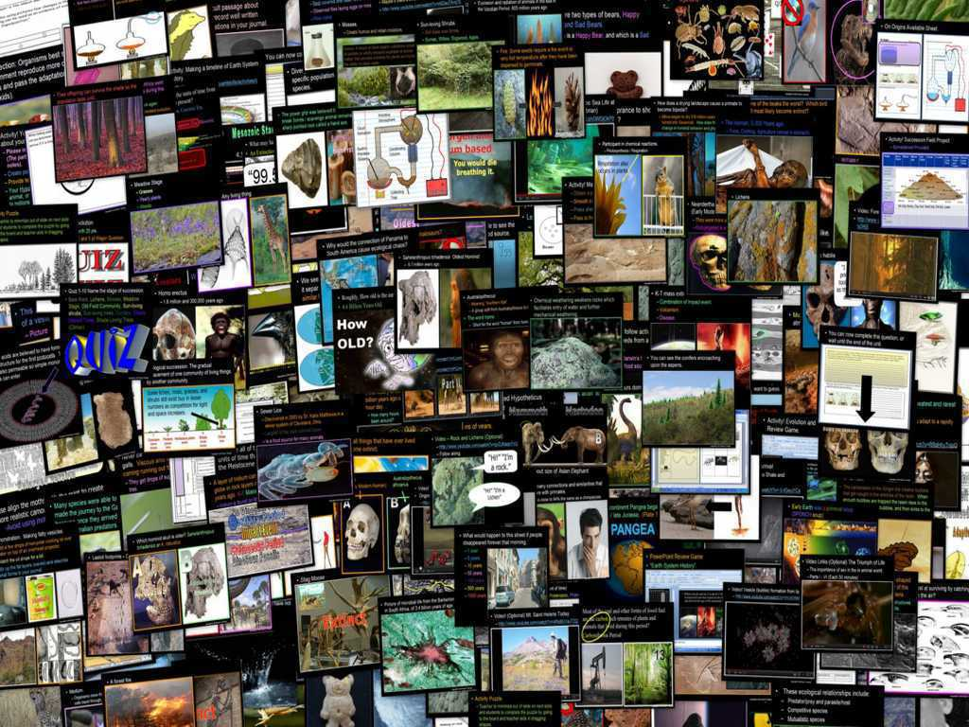
Evolution and Natural
Selection Unit

Slide 2
Evolution and Natural
Selection Unit
Areas of Focus within the Change Topics Unit:
Evolution History, Scopes Monkey Trials, Darwin, Evolution, Evidences of Evolution, Four Parts to Darwin’s Theory, Natural Selection, The Mechanisms for Natural Selection, Divergent Evolution, Convergent Evolution, Diversity of Life Photo Tour, rWhat does it mean to be living?, Characteristics of Living Things, Origins of Life (Other Theories), Origins of Life (Science Theory), Needs of Living Things, Origins of the Universe (Timeline), Miller-Urey Experiment, Amino Acids, How Water Aided in the Origin of Life, Human Evolution, Hominid Features, Evidences of Human Evolution, Hominid Skulls Ecological Succession, Primary Succession, Secondary Succession, Plant Succession, Animal Succession, Stages of Ecological Succession, Events that Restart Succession.
http://sciencepowerpoint.com/Evolution_Natural_Selection_Unit.html

Slide 3
The Evolution and Natural Selection / Change Topics Unit includes…
A Six Part 3,400 Slide PowerPoint roadmap.
26 page bundled homework package that chronologically follows the slideshow, modified version, answer keys, and rubric.
12 pages of unit notes that follows slideshow.
4 PowerPoint Review Games (550 Slides) with answer keys.
Worksheets, crossword puzzles, rubrics, templates, and much more included.
http://www.sciencepowerpoint.com/Evolution_Natural_Selection_Unit.html

Slide 4
Evolution and Natural Selection /
Change Topics Unit
Part I: Evolution
Part II: Natural Selection
Part III: Earth System History
Part IV: Human Evolution
Part V: On Origins
Part VI: Ecological Succession

Slide 5

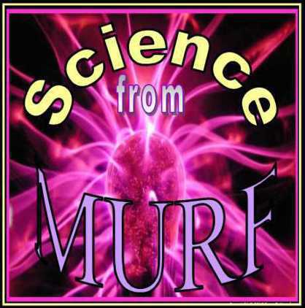
http://sciencepowerpoint.com/index.html
Please feel free to contact me with any questions you may have. Thanks again for your interest in this curriculum.
Sincerely,
Ryan Murphy M.Ed
ryemurf@gmail.com

Slide 6

More Units Available at…
Earth Science: The Soil Science and Glaciers Unit, The Geology Topics Unit, The Astronomy Topics Unit, The Weather and Climate Unit, and The Rivers and Water Quality Unit, The Water Molecule Unit.
Physical Science: The Laws of Motion and Machines Unit, The Atoms and Periodic Table Unit, The Energy and the Environment Unit, and Science Skills Unit.
Life Science: The Diseases and Cells Unit, The DNA and Genetics Unit, The Life Topics Unit, The Plant Unit, The Taxonomy and Classification Unit, Ecology: Feeding Levels Unit, Ecology: Interactions Unit, Ecology: Abiotic Factors, The Evolution and Natural Selection Unit and The Human Body Systems and Health Topics Unit
Copyright © 2010 Ryan P. Murphy

Slide 8
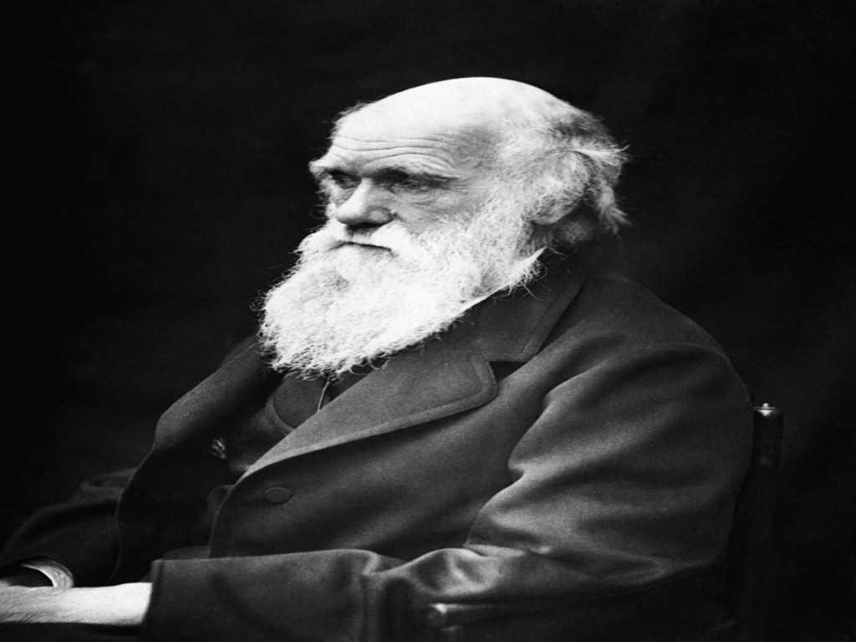
Part I: Darwin, Evolution, Natural Selection

Slide 9
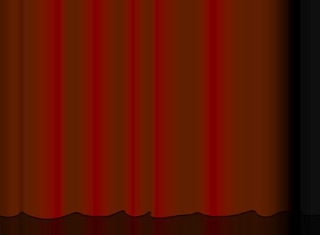
RED SLIDE: These are notes that are very important and should be recorded in your science journal.
Copyright © 2010 Ryan P. Murphy

Slide 10

-Nice neat notes that are legible and use indentations when appropriate. .

Slide 11
-Nice neat notes that are legible and use indentations when appropriate. -Example of indent.

Slide 12
-Nice neat notes that are legible and use indentations when appropriate. -Example of indent. -Skip a line between topics

Slide 13
-Nice neat notes that are legible and use indentations when appropriate. -Example of indent. -Skip a line between topics -Don’t skip pages

Slide 14
-Nice neat notes that are legible and use indentations when appropriate. -Example of indent. -Skip a line between topics -Don’t skip pages -Make visuals clear and well drawn.

Slide 15
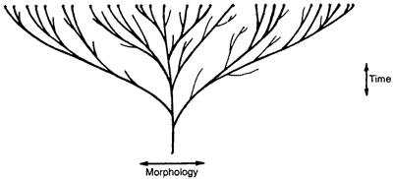
-Nice neat notes that are legible and use indentations when appropriate. -Example of indent. -Skip a line between topics -Don’t skip pages -Make visuals clear and well drawn.

Slide 16
RED SLIDE: These are notes that are very important and should be recorded in your science journal.
BLACK SLIDE: Pay attention, follow directions, complete projects as described and answer required questions neatly.
Copyright © 2010 Ryan P. Murphy

Slide 17

Keep an eye out for “The-Owl” and raise your hand as soon as you see him.
  He will be hiding somewhere in the slideshow
Copyright © 2010 Ryan P. Murphy

Slide 18
“Hoot, Hoot”
“Good Luck!”
Copyright © 2010 Ryan P. Murphy

Slide 19
Part I: Darwin, Evolution, Natural Selection

Slide 20

“What are the laws of life?”

Slide 21
This section of the unit will cover…
  Age of the Earth.
  History associated with Evolution.
  Evidences of Evolution.
  The Four Parts to Darwin’s Theories.
  Natural Selection.
  Adaptive Radiation / Divergent Evolution.
  Convergent Evolution.
  Bird Adaptations.
  Variation of Organisms Photo Tour.

Slide 22
This section of the unit will cover…
  Age of the earth.
  History associated with Evolution.
  Evidences of Evolution.
  The Four Parts to Darwin’s Theories.
  Natural Selection.
  Adaptive Radiation / Divergent Evolution.
  Convergent Evolution.
  Bird Adaptations.
  Variation of Organisms Photo Tour.

Slide 23
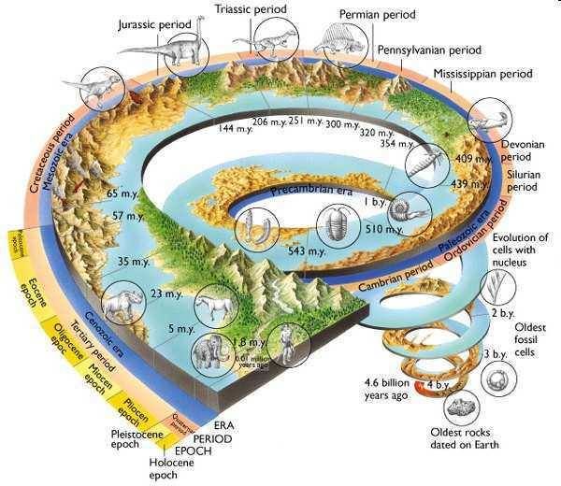
This section of the unit will cover…
  Age of the earth.
  History associated with Evolution.
  Evidences of Evolution.
  The Four Parts to Darwin’s Theories.
  Natural Selection.
  Adaptive Radiation / Divergent Evolution.
  Convergent Evolution.
  Bird Adaptations.
  Variation of Organisms Photo Tour.

Slide 24
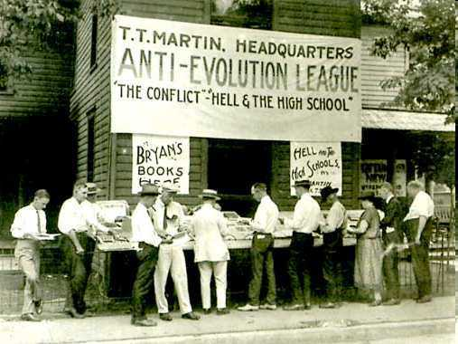
This section of the unit will cover…
  Age of the earth.
  History associated with evolution.
  Evidences of Evolution.
  The Four Parts to Darwin’s Theories.
  Natural Selection.
  Adaptive Radiation / Divergent Evolution.
  Convergent Evolution.
  Bird Adaptations.
  Variation of Organisms Photo Tour.

Slide 25
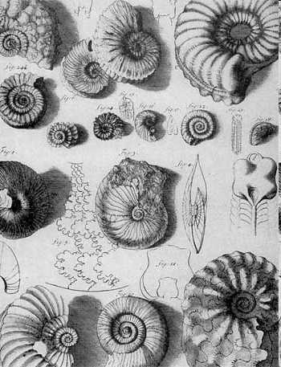
This section of the unit will cover…
  Age of the earth.
  History associated with evolution.
  Evidences of evolution.
  The Four Parts to Darwin’s Theories.
  Natural Selection.
  Adaptive Radiation / Divergent Evolution.
  Convergent Evolution.
  Bird Adaptations.
  Variation of Organisms Photo Tour.

Slide 26
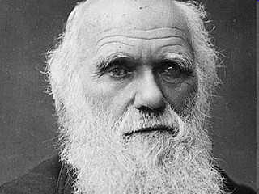
This section of the unit will cover…
  Age of the earth.
  History associated with evolution.
  Evidences of evolution.
  The four parts to Darwin’s theories.
  Natural Selection.
  Adaptive Radiation / Divergent Evolution.
  Convergent Evolution.
  Bird Adaptations.
  Variation of Organisms Photo Tour.

Slide 27
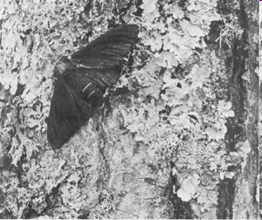
This section of the unit will cover…
  Age of the earth.
  History associated with evolution.
  Evidences of evolution.
  The four parts to Darwin’s theories.
  Natural Selection.
  Adaptive Radiation / Divergent Evolution.
  Convergent Evolution.
  Bird Adaptations.
  Variation of Organisms Photo Tour.

Slide 28
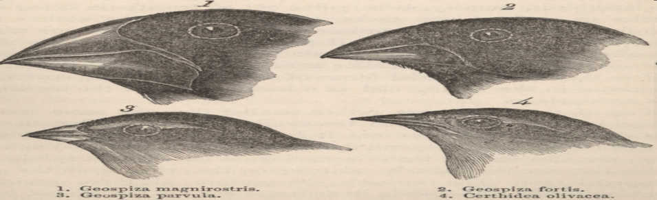
This section of the unit will cover…
  Age of the earth.
  History associated with evolution.
  Evidences of evolution.
  The four parts to Darwin’s theories.
  Natural Selection.
  Adaptive Radiation / Divergent Evolution.
  Convergent Evolution.
  Bird Adaptations.
  Variation of Organisms Photo Tour.

Slide 29
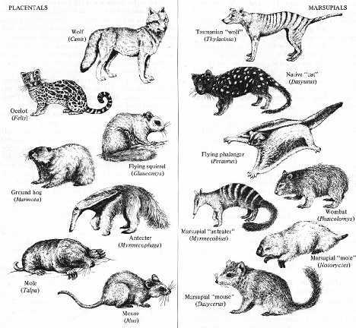
This section of the unit will cover…
  Age of the earth.
  History associated with evolution.
  Evidences of evolution.
  The four parts to Darwin’s theories.
  Natural Selection.
  Adaptive Radiation / Divergent Evolution.
  Convergent Evolution.
  Bird Adaptations.
  Variation of Organisms Photo Tour.

Slide 30
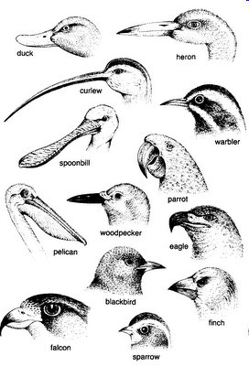
This section of the unit will cover…
  Age of the earth.
  History associated with evolution.
  Evidences of evolution.
  The four parts to Darwin’s theories.
  Natural Selection.
  Adaptive Radiation / Divergent Evolution.
  Convergent Evolution.
  Bird Adaptations.
  Variation of Organisms Photo Tour.

Slide 31
This section of the unit will cover…
  Age of the earth.
  History associated with evolution.
  Evidences of evolution.
  The four parts to Darwin’s theories.
  Natural Selection.
  Adaptive Radiation / Divergent Evolution.
  Convergent Evolution.
  Bird Adaptations.
  Variation of Organisms Photo Tour.

Slide 32
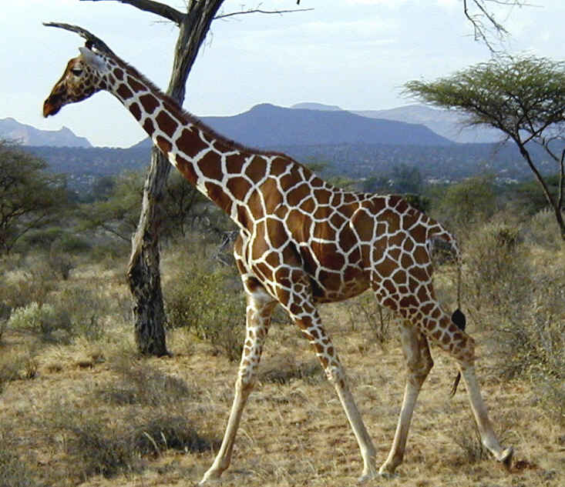
The Change Topics Unit:
  Concept: Everything is changing.
Copyright © 2010 Ryan P. Murphy

Slide 33
The Change Topics Unit:
  Concept: Everything is changing.
Copyright © 2010 Ryan P. Murphy

Slide 34
Pay attention in this unit! Evolution is the backbone to biology.
Copyright © 2010 Ryan P. Murphy

Slide 35
Pay attention in this unit! Evolution is the backbone to biology.
  Nothing makes sense in biology without evolution.
Copyright © 2010 Ryan P. Murphy

Slide 36
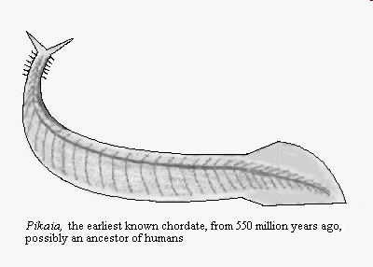
Pay attention in this unit! Evolution is the backbone to biology.
  Nothing makes sense in biology without evolution.
Copyright © 2010 Ryan P. Murphy

Slide 37
Pay attention in this unit! Evolution is the backbone to biology.
  Nothing makes sense in biology without evolution.
Copyright © 2010 Ryan P. Murphy

Slide 38
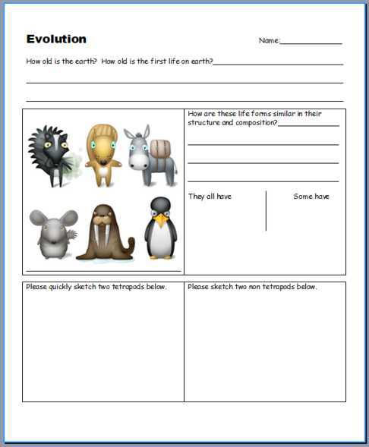
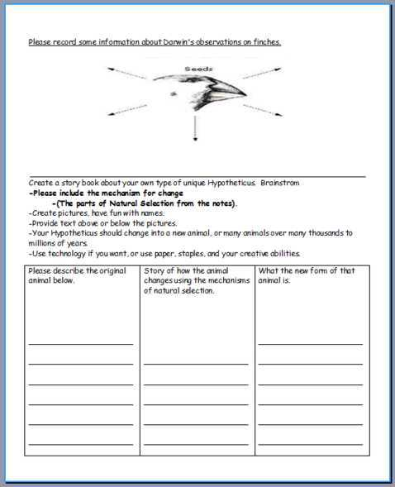
Evolution Available Sheet that follows slideshow for classwork.

Slide 39
Evolution Available Sheet that follows slideshow for classwork.

Slide 40

How old is the earth?
  How old is the first life on earth?
This unit belongs to Ryan P. Murphy Copyright 2010 found at www.sciencepowerpoint.com

Slide 41
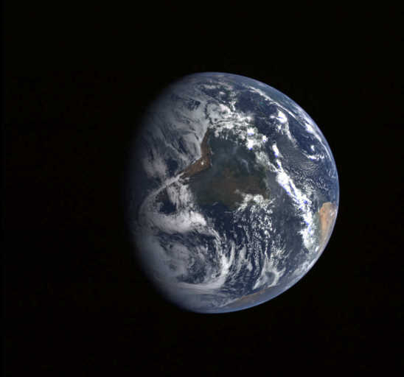

The earth is roughly 4.6 Billion years old.
  Primitive life is believed to have formed 3.85 Billion years ago.
  The earth is old, and a lot has changed over time.
Copyright © 2010 Ryan P. Murphy

Slide 42
The earth is roughly 4.6 Billion years old.
  Primitive life is believed to have formed 3.85 Billion years ago.
  The earth is old, and a lot has changed over time.
Copyright © 2010 Ryan P. Murphy

Slide 43
The earth is roughly 4.6 Billion years old.
  Primitive life is believed to have formed 3.85 Billion years ago.
  The Earth is old, and a lot has changed over time.
Copyright © 2010 Ryan P. Murphy

Slide 44
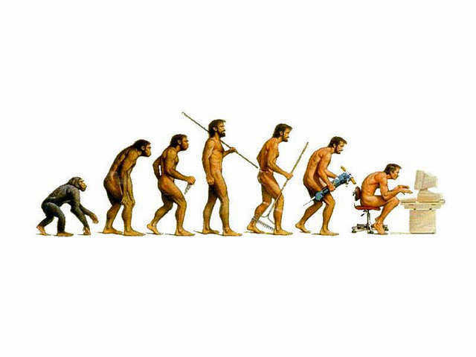
We have all seen pictures like this, what do you really know about evolution?

Slide 45
We have all seen pictures like this, what do you really know about evolution?

Slide 46
We have all seen pictures like this, what do you really know about evolution?

Slide 47
We have all seen pictures like this, what do you really know about evolution?

Slide 48
We have all seen pictures like this, what do you really know about evolution?

Slide 49
We have all seen pictures like this, what do you really know about evolution?

Slide 50
We have all seen pictures like this, what do you really know about evolution?
  Please talk it over with your table group and be prepared to speak about your conversation.

Slide 51
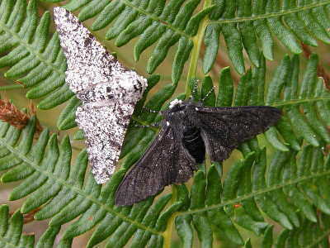
Evolution: Evolution is change (*) of a population of organisms from one generation to the next.
  -
  -
Copyright © 2010 Ryan P. Murphy

Slide 52
Evolution: Evolution is change (*) of a population of organisms from one generation to the next.
  * = in the gene pool
  -
Copyright © 2010 Ryan P. Murphy

Slide 53
Evolution: Evolution is change (*) of a population of organisms from one generation to the next.
  * = in the gene pool
  Usually an advancement.
Copyright © 2010 Ryan P. Murphy

Slide 54
Evolution: Evolution is change (*) of a population of organisms from one generation to the next.
  * = in the gene pool
  Usually an advancement.
We will cover later….
Copyright © 2010 Ryan P. Murphy

Slide 55
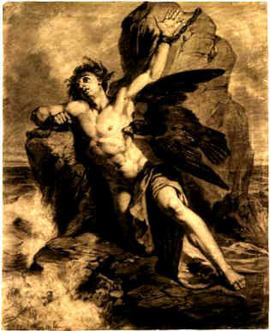
The earliest ideas of evolution as change over time can be seen as lore and myth.
  Still very much unexplained.

Slide 56
The earliest ideas of evolution as change over time can be seen as lore and myth.
  Still very much unexplained.

Slide 57
For most of modern history until the early 1800’s, most biological thinking was essentialism.
Copyright © 2010 Ryan P. Murphy

Slide 58
For most of modern history until the early 1800’s, most biological thinking was essentialism.
  This is the idea that every species has characteristics that are unalterable or cannot change.
Copyright © 2010 Ryan P. Murphy

Slide 59
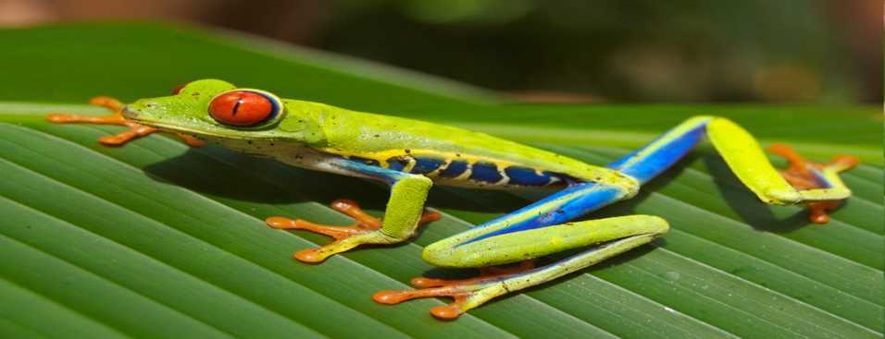
For most of modern history until the early 1800’s, most biological thinking was essentialism.
  This is the idea that every species has characteristics that are unalterable or cannot change.
Copyright © 2010 Ryan P. Murphy

Slide 60
For most of modern history until the early 1800’s, most biological thinking was essentialism.
  This is the idea that every species has characteristics that are unalterable or cannot change.
Not Correct!
Copyright © 2010 Ryan P. Murphy

Slide 61
Geneticist have the ability to actually alter a species by changing genes.

Slide 62
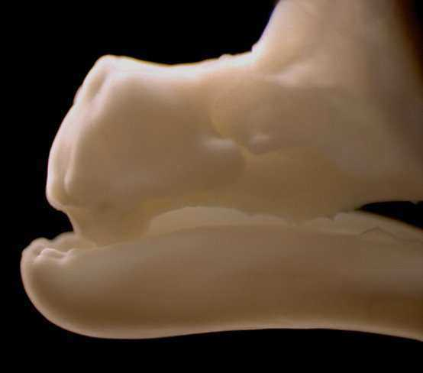
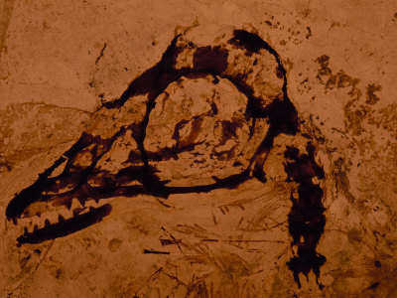
Geneticist have the ability to actually alter a species by changing genes.

Slide 63
Geneticist have the ability to actually alter a species by changing genes.
  This is a picture of a beak that was genetically altered to grow teeth.

Slide 64
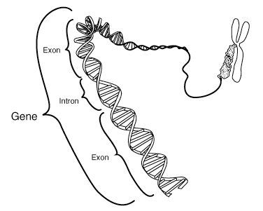
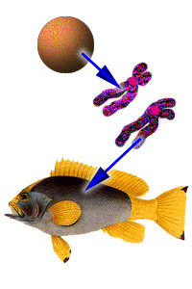
A gene is a unit of heredity that is transferred from a parent to offspring.
DNA

Slide 65
A gene is a unit of heredity that is transferred from a parent to offspring.
This is when genes change over time in a population of organisms… Evolution
DNA

Slide 66
A gene is a unit of heredity that is transferred from a parent to offspring.
This is when genes change over time in a population of organisms… Evolution
DNA

Slide 67
A gene is a unit of heredity that is transferred from a parent to offspring.
This is when genes change over time in a population of organisms… Evolution
DNA

Slide 68
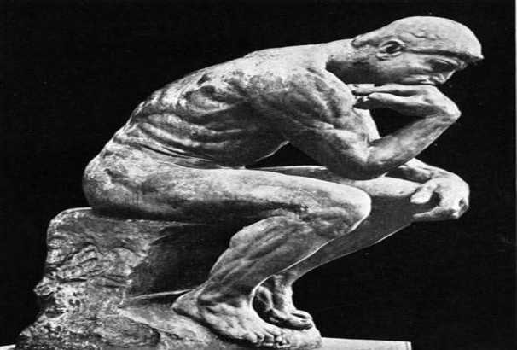
During the Enlightenment of the early 1800’s, many of scientist moved from the physical sciences to natural history.

Slide 69
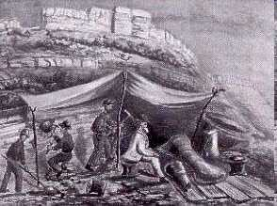
During the Enlightenment of the early 1800’s, many of scientist moved from the physical sciences to natural history.
  Many exciting fossils were found during this period.

Slide 70
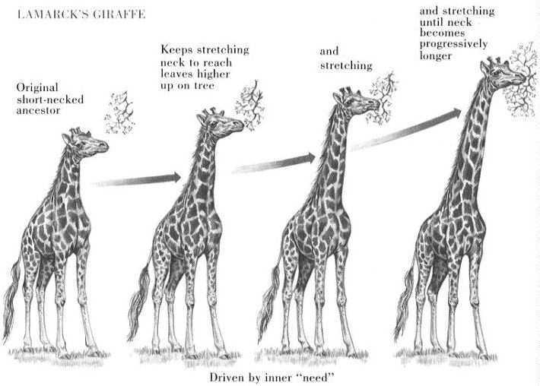
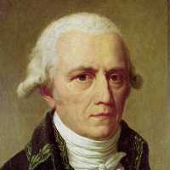
Jean-Baptiste Lamarck
“Just jot my name down somewhere…Ummm.”
Copyright © 2010 Ryan P. Murphy

Slide 71
Jean-Baptiste Lamarck proposed the theory of transmutation of species, which turned out to have some flaws.
  Nonetheless was the first real theory of evolution.
Copyright © 2010 Ryan P. Murphy

Slide 72
Jean-Baptiste Lamarck proposed the theory of transmutation of species, which turned out to have some flaws.
  Nonetheless was the first real theory of evolution.
Copyright © 2010 Ryan P. Murphy

Slide 73
Jean-Baptiste Lamarck proposed the theory of transmutation of species, which turned out to have some flaws.
  Nonetheless was the first real theory of evolution.
“How do you think a giraffe got a long neck?”
Copyright © 2010 Ryan P. Murphy

Slide 74
Jean-Baptiste Lamarck proposed the theory of transmutation of species, which turned out to have some flaws.
  Nonetheless was the first real theory of evolution.
Copyright © 2010 Ryan P. Murphy

Slide 75
Jean-Baptiste Lamarck proposed the theory of transmutation of species, which turned out to have some flaws.
  Nonetheless was the first real theory of evolution.
Copyright © 2010 Ryan P. Murphy

Slide 76
Jean-Baptiste Lamarck proposed the theory of transmutation of species, which turned out to have some flaws.
  Nonetheless was the first real theory of evolution.
Copyright © 2010 Ryan P. Murphy

Slide 77
Jean-Baptiste Lamarck proposed the theory of transmutation of species, which turned out to have some flaws.
  Nonetheless was the first real theory of evolution.
Copyright © 2010 Ryan P. Murphy

Slide 78
Jean-Baptiste Lamarck proposed the theory of transmutation of species, which turned out to have some flaws.
  Nonetheless was the first real theory of evolution.
Incorrect
Kind of..
Copyright © 2010 Ryan P. Murphy

Slide 79

Audio Link! Radio Lab (Optional) Leaving Your Lamarck. 28 minutes. (HE_ _ ) is said.
  http://www.radiolab.org/2012/nov/19/
Copyright © 2010 Ryan P. Murphy

Slide 80
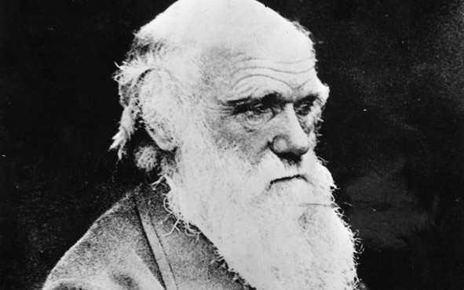
Who is this?
Copyright © 2010 Ryan P. Murphy

Slide 81

Who is this?
”Ho-Ho-Ho!”
Copyright © 2010 Ryan P. Murphy

Slide 82
Who is this? Not Santa Clause.
Copyright © 2010 Ryan P. Murphy

Slide 83
“I’m Charles Darwin.” “I answered the question…” “What are the laws of life.”

Slide 84
It wasn’t until Charles Darwin and Alfred Russel Wallace published their views of evolutionary theory in 1859 that science finally had an explanation for evolution.

Slide 85
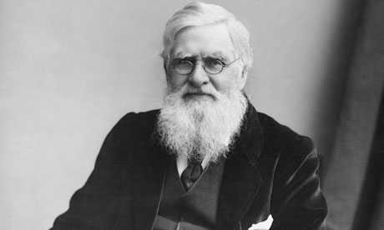
Picture of Alfred Russel Wallace.

Slide 86
Picture of Alfred Russel Wallace.

Slide 87
Picture of Alfred Russel Wallace.

Slide 88
Picture of Alfred Russel Wallace.

Slide 89
Picture of Alfred Russel Wallace.

Slide 90
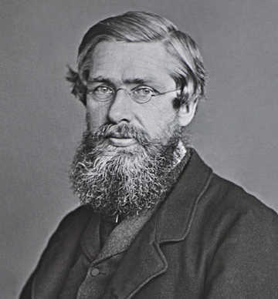
Alfred Russel Wallace
  He is best known for independently proposing a theory of evolution due to natural selection that prompted Charles Darwin to publish his own theory.

Slide 91
Alfred Russel Wallace
  He is best known for independently proposing a theory of evolution due to natural selection that prompted Charles Darwin to publish his own theory.
Why Darwin and not Wallace? Learn more at… http://www.bbc.co.uk/news/uk-wales-21549079

Slide 92
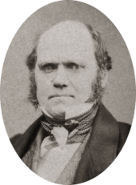
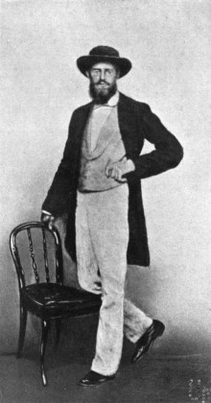
Which one is a younger Charles Darwin, and which one is Alfred Russel Wallace.
A
B

Slide 93
Which one is a younger Charles Darwin, and which one is Alfred Russel Wallace.
A
B

Slide 94
Which one is a younger Charles Darwin, and which one is Alfred Russel Wallace.
A
B
Charles Darwin

Slide 95
Which one is a younger Charles Darwin, and which one is Alfred Russel Wallace.
A
B
Charles Darwin

Slide 96
Which one is a younger Charles Darwin, and which one is Alfred Russel Wallace.
A
B
Alfred
Russel
Wallace
Charles Darwin

Slide 97
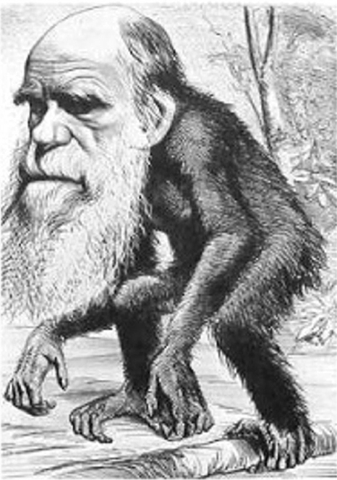
The ideas of Darwin were not widely accepted during his time.
Copyright © 2010 Ryan P. Murphy

Slide 98
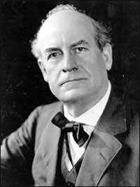
The Butler Bill prevented the teaching of evolution in Tennessee.

Slide 99
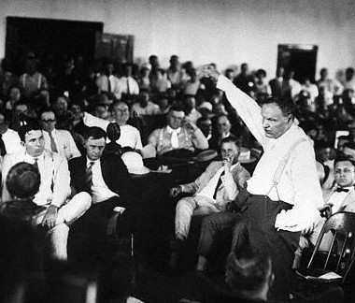
In 1925, The Scopes Monkey Trials occurred.
  Science teacher John Scopes was arrested for teaching evolution which was against state law.
Copyright © 2010 Ryan P. Murphy

Slide 100
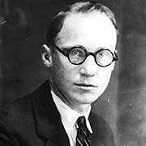
In 1925, The Scopes Monkey Trials occurred.
  Science teacher John Scopes was arrested for teaching evolution which was against state law.
Copyright © 2010 Ryan P. Murphy

Slide 101
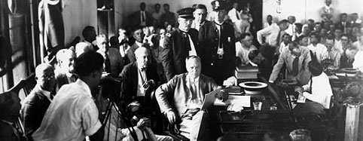

It was the swinging 20’s. The trial occurred at a time that put…
Copyright © 2010 Ryan P. Murphy

Slide 102
It was the swinging 20’s. The trial occurred at a time that put…
Victorians /
Traditionalist
Copyright © 2010 Ryan P. Murphy

Slide 103
It was the swinging 20’s. The trial occurred at a time that put…
Victorians /
Traditionalist
vs.
Copyright © 2010 Ryan P. Murphy

Slide 104
It was the swinging 20’s. The trial occurred at a time that put…
Victorians /
Traditionalist
vs.
Young Modernist
Copyright © 2010 Ryan P. Murphy

Slide 105
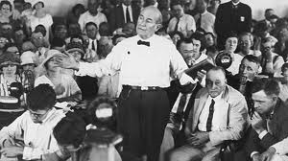
Video Link! The Monkey Trials. (Optional)
  http://www.youtube.com/watch?v=jJLnL8EjIWA
  3:15 minutes.
Copyright © 2010 Ryan P. Murphy

Slide 106
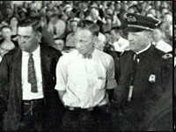
John Scopes lost the trail: He was fined 50 dollars and lost his teaching job.
Copyright © 2010 Ryan P. Murphy

Slide 107
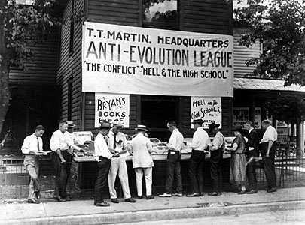
It wasn’t until the mid 1930’s that evolution gained some acceptance in the field of biology.

Slide 108
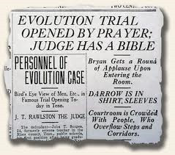
Remembering the Monkey Trials (NPR)
  http://www.npr.org/2005/07/05/4723956/timeline-remembering-the-scopes-monkey-trial
Learn more at… http://www.ushistory.org/us/47b.asp

Slide 109
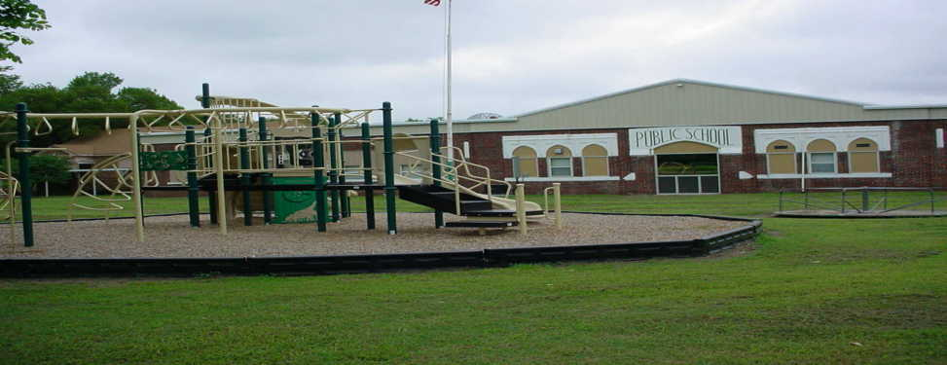
The First Amendment does not permit the state to require that teaching and learning must be tailored to the principles or prohibitions of any religious sect or dogma...
  The state has no legitimate interest in protecting any or all religions from views distasteful to them.
Copyright © 2010 Ryan P. Murphy

Slide 110
The First Amendment does not permit the state to require that teaching and learning must be tailored to the principles or prohibitions of any religious sect or dogma...
  The state has no legitimate interest in protecting any or all religions from views distasteful to them.
Copyright © 2010 Ryan P. Murphy

Slide 111
The First Amendment does not permit the state to require that teaching and learning must be tailored to the principles or prohibitions of any religious sect or dogma...
  The state has no legitimate interest in protecting any or all religions from views distasteful to them.
Copyright © 2010 Ryan P. Murphy

Slide 112
Summary –
  Creationism cannot be taught in a public school.
  Evolution is not a religion.
  Evolution to some is a theory, a fact by others.
  A theory is an educated guess based on large amounts of data. It explains a great deal about how things may have changed over time, but can be revised and changed as new information is found.
  It is the backbone of biology, and backed by mountains of evidence.
Copyright © 2010 Ryan P. Murphy

Slide 113
Summary –
  Creationism cannot be taught in a public school.
  Evolution is not a religion.
  Evolution to some is a theory, a fact by others.
  A theory is an educated guess based on large amounts of data. It explains a great deal about how things may have changed over time, but can be revised and changed as new information is found.
  It is the backbone of biology, and backed by mountains of evidence.
Copyright © 2010 Ryan P. Murphy

Slide 114
Summary –
  Creationism cannot be taught in a public school.
  Evolution is not a religion.
  Evolution to some is a theory, a fact by others.
  A theory is an educated guess based on large amounts of data. It explains a great deal about how things may have changed over time, but can be revised and changed as new information is found.
  It is the backbone of biology, and backed by mountains of evidence.
Copyright © 2010 Ryan P. Murphy

Slide 115
Summary –
  Creationism cannot be taught in a public school.
  Evolution is not a religion.
  Evolution to some is a theory, a fact by others.
  A theory is an educated guess based on large amounts of data. It explains a great deal about how things may have changed over time, but can be revised and changed as new information is found.
  It is the backbone of biology, and backed by mountains of evidence.
Copyright © 2010 Ryan P. Murphy

Slide 116
Summary –
  Creationism cannot be taught in a public school.
  Evolution is not a religion.
  Evolution to some is a theory, a fact by others.
  A theory is an educated guess based on large amounts of data. It explains a great deal about how things may have changed over time, but can be revised and changed as new information is found.
  It is the backbone of biology, and backed by mountains of evidence.
Copyright © 2010 Ryan P. Murphy

Slide 117
Summary –
  Creationism cannot be taught in a public school.
  Evolution is not a religion.
  Evolution to some is a theory, a fact by others.
  A theory is an educated guess based on large amounts of data. It explains a great deal about how things may have changed over time, but can be revised and changed as new information is found.
  It is the backbone of biology, and backed by mountains of evidence.
Copyright © 2010 Ryan P. Murphy

Slide 118
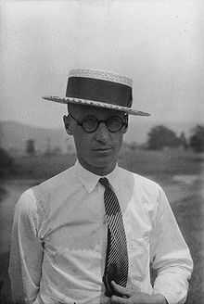
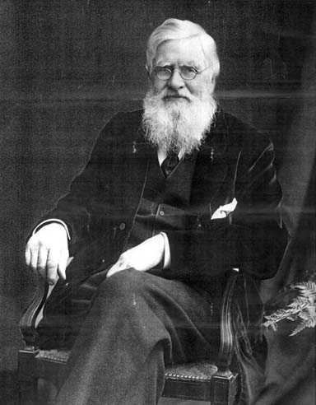
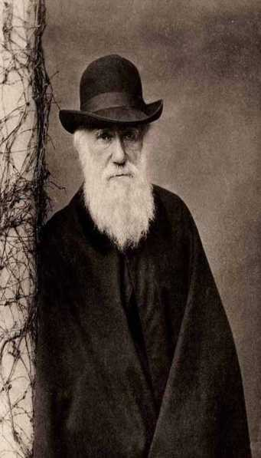
Which is Charles Darwin, Alfred Russel Wallace, and John Scopes?
A
B
C

Slide 119
Which is Charles Darwin, Alfred Russel Wallace, and John Scopes?
A
B
C

Slide 120
Which is Charles Darwin, Alfred Russel Wallace, and John Scopes?
A
B
C
John Scopes

Slide 121
Which is Charles Darwin, Alfred Russel Wallace, and John Scopes?
A
B
C
John Scopes

Slide 122
Which is Charles Darwin, Alfred Russel Wallace, and John Scopes?
A
B
C
Alfred
Russel
Wallace
John Scopes

Slide 123
Which is Charles Darwin, Alfred Russel Wallace, and John Scopes?
A
B
C
Alfred
Russel
Wallace
John Scopes

Slide 124
Which is Charles Darwin, Alfred Russel Wallace, and John Scopes?
A
B
C
Alfred
Russel
Wallace
Charles
Darwin
John Scopes

Slide 125
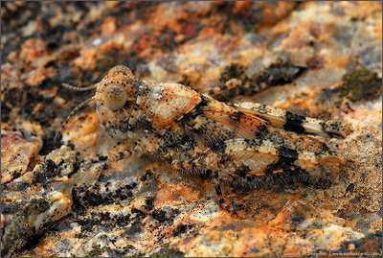
Evidence of Evolution
  -
  -
  -
  -
Copyright © 2010 Ryan P. Murphy

Slide 126
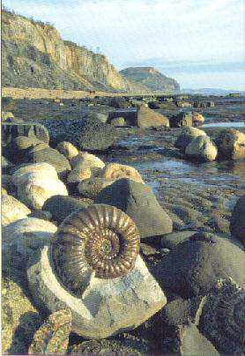
The fossil record of changes in plants and animals over millions of years.
  -
Copyright © 2010 Ryan P. Murphy

Slide 127
The fossil record of changes in plants and animals over millions of years.
  From simple to more complicated.
Copyright © 2010 Ryan P. Murphy

Slide 128

Principle of superposition.
Copyright © 2010 Ryan P. Murphy

Slide 129
Principle of superposition. The rock layers on the bottom are older.
Copyright © 2010 Ryan P. Murphy

Slide 130
Principle of superposition. The rock layers on the bottom are older. More primitive creatures are seen in the older rock layers.
Copyright © 2010 Ryan P. Murphy

Slide 131

Picture of fossilized cyanobacteria. 3.5 billion years ago.
Copyright © 2010 Ryan P. Murphy

Slide 132

Many fossils are primitive sea creatures of the Cambrian period.
Copyright © 2010 Ryan P. Murphy

Slide 133

This is called a Gypsum Daisy.
Copyright © 2010 Ryan P. Murphy

Slide 134

You then find your more complicated marine shelled fossils.
Copyright © 2010 Ryan P. Murphy

Slide 135

Oldest fossilized brain: From a fish 300 million years ago.
Copyright © 2010 Ryan P. Murphy

Slide 136

Earliest fishes: Still millions and millions of years ago.
Copyright © 2010 Ryan P. Murphy

Slide 137

Carbon and Radioactive isotope dating is an extremely accurate method.
Copyright © 2010 Ryan P. Murphy

Slide 138
Carbon and Radioactive isotope dating is an extremely accurate method.
  Dating to millions / billions of years ago.
Copyright © 2010 Ryan P. Murphy

Slide 139
Carbon and Radioactive isotope dating is an extremely accurate method.
  Dating to millions / billions of years ago.
  May be off by 30,000 years.
Copyright © 2010 Ryan P. Murphy

Slide 140
Carbon and Radioactive isotope dating is an extremely accurate method.
  Dating to millions / billions of years ago.
  May be off by 30,000 years.
  But when your talking millions that is very close.
Copyright © 2010 Ryan P. Murphy

Slide 141

Early amphibians.
Copyright © 2010 Ryan P. Murphy

Slide 142

Early Reptiles.
Copyright © 2010 Ryan P. Murphy

Slide 143

Early Birds.
Copyright © 2010 Ryan P. Murphy

Slide 144

Early mammals – Mesozoic, still the time of the dinosaurs. 85 million years ago.
Copyright © 2010 Ryan P. Murphy

Slide 145

Earliest Primate fossil: 47 million years ago.
Copyright © 2010 Ryan P. Murphy

Slide 146

Hominid fossil – 3.2 million years ago.
Copyright © 2010 Ryan P. Murphy

Slide 147

I could have shown thousands of more slides of fossil evidence…
Copyright © 2010 Ryan P. Murphy

Slide 148
I could have shown thousands of more slides of fossil evidence…
  For time sake we must end.
Copyright © 2010 Ryan P. Murphy

Slide 149
I could have shown thousands of more slides of fossil evidence…
  For time sake we must end.
Learn more about the fossil record and evolution at… http://www.agiweb.org/news/evolution/examplesofevolution.html
Copyright © 2010 Ryan P. Murphy

Slide 150

You can now complete this question.

Slide 151

You can now complete this question.

Slide 152

You can now complete this question.

Slide 153

You can now complete this question.

Slide 154


How many neck bones (vertebrae) does a giraffe and human have?

Slide 155
How many neck bones (vertebrae) does a giraffe and human have?

Slide 156
How many neck bones (vertebrae) does a giraffe and human have?
7

Slide 157


How many neck bones (vertebrae) does a giraffe and human have?
7

Slide 158
How many neck bones (vertebrae) does a giraffe and human have?
They are
just longer...
7

Slide 159
Evidence of Evolution
The fossil record of changes in plants and animals over millions of years.
    From simple to more complicated.
  -
  -
  -
Next notes
Copyright © 2010 Ryan P. Murphy

Slide 160


Chemical and anatomical similarities of related life forms.
Copyright © 2010 Ryan P. Murphy

Slide 161
Chemical and anatomical similarities of related life forms.
Copyright © 2010 Ryan P. Murphy

Slide 162
Chemical and anatomical similarities of related life forms.
Copyright © 2010 Ryan P. Murphy

Slide 163
Evolution Available Sheet that follows slideshow for classwork.

Slide 164

How are these life forms similar in their structure and composition?
  Each student must pick one, or teacher will assign.
Copyright © 2010 Ryan P. Murphy

Slide 165
They all have… | Some have…
Copyright © 2010 Ryan P. Murphy

Slide 166
They all have… | Some have…
Eyes, Nose, Ears, Mouth
Warmbloodedness
Heart, Lungs, Organs
Eat Food,
Move
Tetrapods (four limbs)
Walrus has lost limbs.
Copyright © 2010 Ryan P. Murphy

Slide 167
They all have… | Some have…
Eyes, Nose, Ears, Mouth
Warmbloodedness
Heart, Lungs, Organs
Eat Food,
Move
Tetrapods (four limbs)
Walrus has lost limbs.
Teeth,
Fur,
Hoofs,
Smell Glands
Eggs
Live Birth
Copyright © 2010 Ryan P. Murphy

Slide 168
How are these life forms similar in their structure and composition?
How many neck vertebrae do we all have?
Copyright © 2010 Ryan P. Murphy

Slide 169
How are these life forms similar in their structure and composition?
7
7
7
How many neck vertebrae do we all have?
7
7
Copyright © 2010 Ryan P. Murphy

Slide 170
How are these life forms similar in their structure and composition?
7
7
7
How many neck vertebrae do we all have?
13+
7
7
Copyright © 2010 Ryan P. Murphy

Slide 171
How are these life forms similar in their structure and composition?
Mammal
Mammal
Mammal
7
7
7
How many neck vertebrae do we all have?
Mammal
Mammal
13+
7
7
Copyright © 2010 Ryan P. Murphy

Slide 172
How are these life forms similar in their structure and composition?
Mammal
Mammal
Mammal
7
7
7
How many neck vertebrae do we all have?
Bird
Mammal
Mammal
13+
7
7
Copyright © 2010 Ryan P. Murphy

Slide 173
How are these life forms similar in their structure and composition?
Mammal
Mammal
Mammal
7
7
7
Live Birth
Live Birth
Live Birth
How many neck vertebrae do we all have?
Bird
Mammal
Mammal
13+
7
7
Live Birth
Live Birth
Copyright © 2010 Ryan P. Murphy

Slide 174
How are these life forms similar in their structure and composition?
Mammal
Mammal
Mammal
7
7
7
Live Birth
Live Birth
Live Birth
How many neck vertebrae do we all have?
Bird
Mammal
Mammal
13+
7
7
Live Birth
Egg Laying
Live Birth
Copyright © 2010 Ryan P. Murphy

Slide 175
How are these life forms similar in their structure and composition?
Mammal
Mammal
Mammal
7
7
7
Live Birth
Live Birth
All have
warm bloodedness
Live Birth
How many neck vertebrae do we all have?
Bird
Mammal
Mammal
13+
7
7
Live Birth
Egg Laying
Live Birth
Copyright © 2010 Ryan P. Murphy

Slide 176

Modern day animals share similar characteristics.
Copyright © 2010 Ryan P. Murphy

Slide 177
Modern day animals share similar characteristics.
  Here, the arm bones of the earliest amphibian are similar in modern species.
Copyright © 2010 Ryan P. Murphy

Slide 178
Modern day animals share similar characteristics.
  Here, the arm bones of the earliest amphibian are similar in modern species.
  Size and shape changes over time.
Copyright © 2010 Ryan P. Murphy

Slide 179


Which hand is a chimpanzee’s and which is a humans?
A
B
Copyright © 2010 Ryan P. Murphy

Slide 180
Which hand is a chimpanzee’s and which is a humans?
A
B
Copyright © 2010 Ryan P. Murphy

Slide 181
Which hand is a chimpanzee’s and which is a humans?
A
Humans
B
Copyright © 2010 Ryan P. Murphy

Slide 182
Which hand is a chimpanzee’s and which is a humans?
A
Humans
B
Copyright © 2010 Ryan P. Murphy

Slide 183
Which hand is a chimpanzee’s and which is a humans?
A
Humans
B
Chimpanzee
Copyright © 2010 Ryan P. Murphy

Slide 184




Which of the following is a blastula (early embryo) of a sea urchin, starfish, frog, and human
A
B
C
D
Copyright © 2010 Ryan P. Murphy

Slide 185
Which of the following is a blastula (early embryo) of a sea urchin, starfish, frog, and human
A
B
C
D
Copyright © 2010 Ryan P. Murphy

Slide 186
Which of the following is a blastula (early embryo) of a sea urchin, starfish, frog, and human
A
B
C
D
Starfish
Copyright © 2010 Ryan P. Murphy

Slide 187
Which of the following is a blastula (early embryo) of a sea urchin, starfish, frog, and human
A
B
C
D
Starfish
Copyright © 2010 Ryan P. Murphy

Slide 188
Which of the following is a blastula (early embryo) of a sea urchin, starfish, frog, and human
A
B
C
D
Frog
Starfish
Copyright © 2010 Ryan P. Murphy

Slide 189
Which of the following is a blastula (early embryo) of a sea urchin, starfish, frog, and human
A
B
C
D
Frog
Starfish
Copyright © 2010 Ryan P. Murphy

Slide 190
Which of the following is a blastula (early embryo) of a sea urchin, starfish, frog, and human
A
B
Human
C
D
Frog
Starfish
Copyright © 2010 Ryan P. Murphy

Slide 191
Which of the following is a blastula (early embryo) of a sea urchin, starfish, frog, and human
A
B
Human
C
D
Frog
Starfish
Copyright © 2010 Ryan P. Murphy

Slide 192
Which of the following is a blastula (early embryo) of a sea urchin, starfish, frog, and human
A
B
Sea Urchine
Human
C
D
Frog
Starfish
Copyright © 2010 Ryan P. Murphy

Slide 193




Which of the embryos below is a human, chicken, fish, and cat?
A
B
Human
D
C
Copyright © 2010 Ryan P. Murphy

Slide 194
Which of the embryos below is a human, chicken, fish, and cat?
A
B
Human
D
C
Copyright © 2010 Ryan P. Murphy

Slide 195
Which of the embryos below is a human, chicken, fish, and cat?
A
B
Human
D
C
Fish
Copyright © 2010 Ryan P. Murphy

Slide 196
Which of the embryos below is a human, chicken, fish, and cat?
A
B
Human
D
C
Fish
Copyright © 2010 Ryan P. Murphy

Slide 197
Which of the embryos below is a human, chicken, fish, and cat?
Cat
A
B
Human
D
C
Fish
Copyright © 2010 Ryan P. Murphy

Slide 198
Which of the embryos below is a human, chicken, fish, and cat?
Cat
A
B
Human
D
C
Fish
Copyright © 2010 Ryan P. Murphy

Slide 199
Which of the embryos below is a human, chicken, fish, and cat?
Cat
A
B
Chicken
Human
D
C
Fish
Copyright © 2010 Ryan P. Murphy

Slide 200
Which of the embryos below is a human, chicken, fish, and cat?
Cat
A
B
Chicken
Human
Human
D
C
Fish
Copyright © 2010 Ryan P. Murphy

Slide 201



Which are human, frog, and fish cells?
  Cells are the building blocks of living things.
A
B
C
Copyright © 2010 Ryan P. Murphy

Slide 202
Which are human, frog, and fish cells?
  Cells are the building blocks of living things.
A
B
C
Copyright © 2010 Ryan P. Murphy

Slide 203

Which are human, frog, and fish cells?
  Cells are the building blocks of living things.
A
B
C
Frog
Copyright © 2010 Ryan P. Murphy

Slide 204
Which are human, frog, and fish cells?
  Cells are the building blocks of living things.
A
B
C
Frog
Copyright © 2010 Ryan P. Murphy

Slide 205

Which are human, frog, and fish cells?
  Cells are the building blocks of living things.
A
B
C
Frog
Fish
Copyright © 2010 Ryan P. Murphy

Slide 206
Which are human, frog, and fish cells?
  Cells are the building blocks of living things.
A
B
C
Frog
Fish
Copyright © 2010 Ryan P. Murphy

Slide 207

Which are human, frog, and fish cells?
  Cells are the building blocks of living things.
A
B
C
Human
Cheek
Frog
Fish
Copyright © 2010 Ryan P. Murphy

Slide 208
Which are human, frog, and fish cells?
  Cells are the building blocks of living things.
A
B
C
Human
Cheek
Frog
Fish
Similar in size
and composition
Copyright © 2010 Ryan P. Murphy

Slide 209

The cells of a worm, or a jellyfish, or a grizzly bear are made of organelles that are similar in their composition and how they work.
Copyright © 2010 Ryan P. Murphy

Slide 210

Cells are either prokaryotic (bacteria)
Copyright © 2010 Ryan P. Murphy

Slide 211
Cells are either prokaryotic (bacteria)
Copyright © 2010 Ryan P. Murphy

Slide 212
Cells are either prokaryotic (bacteria) or eukaryotic (cells with a nucleus).
Copyright © 2010 Ryan P. Murphy

Slide 213
Cells are either prokaryotic (bacteria) or eukaryotic (cells with a nucleus).
Copyright © 2010 Ryan P. Murphy

Slide 214
Cells are either prokaryotic (bacteria) or eukaryotic (cells with a nucleus).
  All cells are similar in their composition.
Copyright © 2010 Ryan P. Murphy

Slide 215

Why would a modern whale have vestigial leg bones?
Copyright © 2010 Ryan P. Murphy

Slide 216
Why would a modern whale have vestigial leg bones?
Copyright © 2010 Ryan P. Murphy

Slide 217

Millions of Years Ago
Present

Slide 218
Millions of Years Ago
Present

Slide 219
Millions of Years Ago
Present

Slide 220
Millions of Years Ago
Present

Slide 221
Millions of Years Ago
Present

Slide 222
Millions of Years Ago
Present

Slide 223
Millions of Years Ago
Present

Slide 224
Millions of Years Ago
Present

Slide 225
Millions of Years Ago
Present

Slide 226

Answer: It use to be a species with legs before moving to the water.
Copyright © 2010 Ryan P. Murphy

Slide 227


Slide 232

Picture of fossil and recreation of an early amphibian.
  Note location of where the fossil was found. Amphibians don’t inhabit this colder area (Evidence of continental drift).
Copyright © 2010 Ryan P. Murphy

Slide 233
Picture of fossil and recreation of an early amphibian.
  Note location of where the fossil was found. Amphibians don’t inhabit this colder area (Evidence of continental drift).
Copyright © 2010 Ryan P. Murphy

Slide 234

Early Amphibians
Time
Lobe finned fish

Slide 235
Early Amphibians
Time
Lobe finned fish

Slide 236
Early Amphibians
Time
Lobe finned fish

Slide 237
Early Amphibians
Time
Lobe finned fish

Slide 238
Early Amphibians
Time
Lobe finned fish

Slide 239
Early Amphibians
Time
Lobe finned fish

Slide 240

The Coelacanth.

Slide 241
The Coelacanth.
  Believed to have gone extinct with dinosaurs.

Slide 242
The Coelacanth.
  Believed to have gone extinct with dinosaurs.
  Rediscovered (living) in 1938 off the coast of South Africa.

Slide 243

The lobe-finned fish are thought to be the start of the terrestrial (land) animals.

Slide 244
The lobe-finned fish are thought to be the start of the terrestrial (land) animals.
  Picture of lung fish moving across the mud.

Slide 245
The lobe-finned fish are thought to be the start of the terrestrial (land) animals.
  Picture of lung fish moving across the mud.
Tetrapod

Slide 246
The lobe-finned fish are thought to be the start of the terrestrial (land) animals.
  Picture of lung fish moving across the mud.
Tetrapod
Having four feet,
legs,
or leglike
appendages

Slide 247

The lobe-finned fish are thought to be the start of the terrestrial (land) animals.
  Picture of lung fish moving across the mud.
Tetrapod
Having four feet,
legs,
or leglike
appendages

Slide 248
The lobe-finned fish are thought to be the start of the terrestrial (land) animals.
  Picture of lung fish moving across the mud.
Tetrapod
Having four feet,
legs,
or leglike
appendages
1

Slide 249
The lobe-finned fish are thought to be the start of the terrestrial (land) animals.
  Picture of lung fish moving across the mud.
Tetrapod
Having four feet,
legs,
or leglike
appendages
1
2

Slide 250
The lobe-finned fish are thought to be the start of the terrestrial (land) animals.
  Picture of lung fish moving across the mud.
Tetrapod
Having four feet,
legs,
or leglike
appendages
1
2
3

Slide 251
The lobe-finned fish are thought to be the start of the terrestrial (land) animals.
  Picture of lung fish moving across the mud.
Tetrapod
Having four feet,
legs,
or leglike
appendages
1
2
4
3

Slide 252
The lobe-finned fish are thought to be the start of the terrestrial (land) animals.
  Picture of lung fish moving across the mud.
Tetrapod
“What we call arms were once legs.” “We are tetrapods.”
Having four feet,
legs,
or leglike
appendages
1
2
4
3

Slide 253

One theory suggests that land animals developed when smaller bodies of water periodically dried up.

Slide 254
One theory suggests that land animals developed when smaller bodies of water periodically dried up.
  Being able to crawl from one pool to the next aided in survival.

Slide 255
One theory suggests that land animals developed when smaller bodies of water periodically dried up.
  Being able to crawl from one pool to the next aided in survival.
  This ability was passed on from one generation to the next.

Slide 256

Another theory

Slide 257
Another theory
  Lunged gulping fish could to avoid predation in the aquatic habitats by climbing into the shallows and then eventually the land.

Slide 258
Evolution Available Sheet that follows slideshow for classwork.

Slide 259


Which picture below is a tetrapod?
A
B

Slide 260
Which picture below is a tetrapod?
A
B

Slide 261
Which picture below is a tetrapod?
A
B
Tetrapod

Slide 262
Which picture below is a tetrapod?
A
B
Tetrapod

Slide 263
Which picture below is a tetrapod?
A
B
Tetrapod
Fish

Slide 264


Which picture below is a tetrapod?
A
B

Slide 265
Which picture below is a tetrapod?
A
B

Slide 266
Which picture below is a tetrapod?
A
B
Insect
Exoskeleton
Not a Tetrapod

Slide 267
Which picture below is a tetrapod?
A
B
Insect
Exoskeleton
Not a Tetrapod

Slide 268
Which picture below is a tetrapod?
A
B
Whale
Tetrapod
(Lost legs but
still grouped)
Insect
Exoskeleton
Not a Tetrapod

Slide 269


Which picture below is a tetrapod?
A
B

Slide 270
Which picture below is a tetrapod?
A
B

Slide 271

Which picture below is a tetrapod?
A
B

Slide 272
Which picture below is a tetrapod?
A
B
Snake
Tetrapod
(Use to have legs
like a lizards).

Slide 273
Which picture below is a tetrapod?
A
B
Snake
Tetrapod
(Use to have legs
like a lizards).

Slide 274
Which picture below is a tetrapod?
A
B
Snake
Tetrapod
(Use to have legs
like a lizards).
Worms
(Not Tetrapods)

Slide 275

What type of snake is this?
Copyright © 2010 Ryan P. Murphy

Slide 276
What type of snake is this?
?
Copyright © 2010 Ryan P. Murphy

Slide 277

Copyright © 2010 Ryan P. Murphy

Slide 278
This is not a snake, it’s a skink.
Copyright © 2010 Ryan P. Murphy

Slide 279
This is not a snake, it’s a skink.
  An example of intermediate species between lizards and snakes.
Copyright © 2010 Ryan P. Murphy

Slide 280

Many Pythons (snakes) have spurs (toenails) from when they use to have legs.
Copyright © 2010 Ryan P. Murphy

Slide 281
Many Pythons (snakes) have spurs (toenails) from when they use to have legs.
Copyright © 2010 Ryan P. Murphy

Slide 282
Many Pythons (snakes) have spurs (toenails) from when they use to have legs.
Tetrapod
Copyright © 2010 Ryan P. Murphy

Slide 283

This is a human tailbone. This is an example of a vestigial structure.
Copyright © 2010 Ryan P. Murphy

Slide 284

This is a human tailbone. This is an example of a vestigial structure.
  Picture on right is human embryo.
Copyright © 2010 Ryan P. Murphy

Slide 285

Question to answer in your journal to optional video on next slide.
  Describe 3 pieces of information about Tetrapod evolution.
  Include visuals and evidence found and not found.
Copyright © 2010 Ryan P. Murphy

Slide 286

Video Link (Optional)! Tetrapod Evolution
Part I http://www.youtube.com/watch?v=k-5oQlnXSTM&feature=results_main&playnext=1&list=PL05E9C5F10C1EB2B4
Part II http://www.youtube.com/watch?v=B3iFADplW6U&feature=related
Part III http://www.youtube.com/watch?v=8HCTFe_XZFQ&feature=related
Part IV http://www.youtube.com/watch?v=JKRTrC1B1PI&feature=related
Part V http://www.youtube.com/watch?v=khUw_OGRcBs&feature=related

Slide 287

You can now complete these questions.

Slide 288
Evidence of Evolution
The fossil record of changes in plants and animals over millions of years.
    From simple to more complicated.
  - Chemical and Anatomical similarities
  -
  -
Next notes
Copyright © 2010 Ryan P. Murphy

Slide 289

The geographic distribution of related species.
Copyright © 2010 Ryan P. Murphy

Slide 290


Slide 291
?

Slide 292

?

Slide 293
Alfred Russel Wallace reasoned that the Indonesian archipelago can be divided into two distinct parts.
  One in which animals are closely related to those of Australia.
  And one in which the species are largely of Asian origin.

Slide 294
Alfred Russel Wallace reasoned that the Indonesian archipelago can be divided into two distinct parts.
  One in which animals are closely related to those of Australia.
  And one in which the species are largely of Asian origin.
Species are largely
of Asian origin.

Slide 295
Alfred Russel Wallace reasoned that the Indonesian archipelago can be divided into two distinct parts.
  One in which animals are closely related to those of Australia.
  And one in which the species are largely of Asian origin.
Species are largely
of Asian origin.
Animals are closely
related to those
of Australia.

Slide 296
Alfred Russel Wallace reasoned that the Indonesian archipelago can be divided into two distinct parts.
  One in which animals are closely related to those of Australia.
  And one in which the species are largely of Asian origin.
Ocean is a
barrier
Species are largely
of Asian origin.
Animals are closely
related to those
of Australia.

Slide 297

These different salamander species are closely related and live within a close geographic border of one another.
Copyright © 2010 Ryan P. Murphy

Slide 298
Original salamander

Slide 299
Original salamander
Moved right and left of valley

Slide 300
Original salamander
Moved right and left of valley
Continued migration

Slide 301
Original salamander
Moved right and left of valley
Continued migration
Adaptive radiation

Slide 302
Original salamander
Moved right and left of valley
Continued migration
Adaptive radiation

Slide 303
Original salamander
Moved right and left of valley
Continued migration
Adaptive radiation
These two are different species

Slide 304
Original salamander
Moved right and left of valley
Continued migration
Adaptive radiation
These two are different species
They cannot mate

Slide 305


Slide 306

What is so unique about this salamander?

Slide 307
What is so unique about this salamander?

Slide 308

Many species have entered caves where they have changed form.
Copyright © 2010 Ryan P. Murphy

Slide 309
Many species have entered caves where they have changed form.
  If you live in complete darkness, than you don’t need eyes and rely on other senses such smell, and touch.
Copyright © 2010 Ryan P. Murphy

Slide 310


Slide 311

This is a cave angel fish.
Copyright © 2010 Ryan P. Murphy

Slide 312
This is a cave angel fish.
  It has special hooks so that if can hold on to rocks in cave waterfalls.
Copyright © 2010 Ryan P. Murphy

Slide 313
This is a cave angel fish.
  It has special hooks so that if can hold on to rocks in cave waterfalls.
  It also doesn’t have eyes and has lost the colored pigment in its skin.
Copyright © 2010 Ryan P. Murphy

Slide 314

Video! Cave Dwellers
  Life evolving in one of the most difficult places on Earth.
  http://www.youtube.com/watch?v=2ke1agwb00U
  More: http://www.youtube.com/watch?v=RbZ0T0TlwjE

Slide 315
Evidence of Evolution
The fossil record of changes in plants and animals over millions of years.
    From simple to more complicated.
  - Chemical and Anatomical similarities
  - The geographic distribution of species
  -
Next notes
Copyright © 2010 Ryan P. Murphy

Slide 316


Genetics (DNA)
Copyright © 2010 Ryan P. Murphy

Slide 317
Genetics (DNA) A more recent branch of science that shows how organisms have evolved and are related on a genetic level.
Copyright © 2010 Ryan P. Murphy

Slide 318
Genetics (DNA) A more recent branch of science that shows how organisms have evolved and are related on a genetic level.
Remember: Evolution is the change in the gene pool over time
Copyright © 2010 Ryan P. Murphy

Slide 319
Genetics (DNA) A more recent branch of science that shows how organisms have evolved and are related on a genetic level.
Remember: Evolution is the change in the gene pool over time
Copyright © 2010 Ryan P. Murphy

Slide 320
Genetics (DNA) A more recent branch of science that shows how organisms have evolved and are related on a genetic level.
Remember: Evolution is the change in the gene pool over time
Copyright © 2010 Ryan P. Murphy

Slide 321

Genetics (DNA) A more recent branch of science that shows how organisms have evolved and are related on a genetic level.
Remember: Evolution is the change in the gene pool over time
Copyright © 2010 Ryan P. Murphy

Slide 322
Genetics (DNA) A more recent branch of science that shows how organisms have evolved and are related on a genetic level.
Genes get
Passed on through
reproduction
Remember: Evolution is the change in the gene pool over time
Copyright © 2010 Ryan P. Murphy

Slide 323

Genetics (DNA) A more recent branch of science that shows how organisms have evolved and are related on a genetic level.
Genes get
Passed on through
reproduction
Remember: Evolution is the change in the gene pool over time
,
The gene pool is the set of all genes, or genetic information, in any population.
Copyright © 2010 Ryan P. Murphy

Slide 324


Slide 325
Gene Pool

Slide 327
Time Passes /
New Generations

Slide 328
Time Passes /
New Generations

Slide 330
Gene Pool has
changed

Slide 331
Evolution has occurred
Gene Pool has
changed

Slide 332

Everyone trace your hand like so in your journal.

Slide 333
Everyone trace your hand like so in your journal.
Take notes on each finger

Slide 334

Video Link! Five Fingers of Evolution
  Describes genes / genetics a bit.
  http://www.youtube.com/watch?v=5NdMnlt2keE

Slide 335
Evolution is the change in the gene pool overtime.
  Gene Pools can change when…
  Populations can shrink
    Diseases, extinctions, introduction of new better adapted species, predators.
  Non-random mating
    Organisms choose strongest mate, ones in similar boundaries,
  Mutations in the genes
    Genes can change. Some are good, some are bad.
    The environment will decide.
  Movement in and out of the population
    Immigration, gene flow.
  Natural selection
    Adaptations to the environment that do well replace poor ones. Usually an advancement.

Slide 336
Evolution is the change in the gene pool overtime.
  Gene Pools can change when…
  Populations can shrink
    Diseases, extinctions, introduction of new better adapted species, predators.
  Non-random mating
    Organisms choose strongest mate, ones in similar boundaries,
  Mutations in the genes
    Genes can change. Some are good, some are bad.
    The environment will decide.
  Movement in and out of the population
    Immigration, gene flow.
  Natural selection
    Adaptations to the environment that do well replace poor ones. Usually an advancement.
Study for 1 minute

Slide 337
Evolution is the change in the gene pool overtime.
  Gene Pools can change when…
  Populations can shrink
    Diseases, extinctions, introduction of new better adapted species, predators.
  Non-random mating
    Organisms choose strongest mate, ones in similar boundaries,
  Mutations in the genes
    Genes can change. Some are good, some are bad.
    The environment will decide.
  Movement in and out of the population
    Immigration, gene flow.
  Natural selection
    Adaptations to the environment that do well replace poor ones. Usually an advancement.

Slide 338


Slide 339
Evolution is the change in the gene pool overtime.
  Gene Pools can change when…
  Populations can shrink
    Diseases, extinctions, introduction of new better adapted species, predators.
  Non-random mating
    Organisms choose strongest mate, ones in similar boundaries,
  Mutations in the genes
    Genes can change. Some are good, some are bad.
    The environment will decide.
  Movement in and out of the population
    Immigration, gene flow.
  Natural selection
    Adaptations to the environment that do well replace poor ones. Usually an advancement.

Slide 340
Evolution is the change in the gene pool overtime.
  Gene Pools can change when…
  Populations can shrink
    Diseases, extinctions, introduction of new better adapted species, predators.
  Non-random mating
    Organisms choose strongest mate, ones in similar boundaries,
  Mutations in the genes
    Genes can change. Some are good, some are bad.
    The environment will decide.
  Movement in and out of the population
    Immigration, gene flow.
  Natural selection
    Adaptations to the environment that do well replace poor ones. Usually an advancement.

Slide 341
Evolution is the change in the gene pool overtime.
  Gene Pools can change when…
  Populations can shrink
    Diseases, extinctions, introduction of new better adapted species, predators.
  Non-random mating
    Organisms choose strongest mate, ones in similar boundaries,
  Mutations in the genes
    Genes can change. Some are good, some are bad.
    The environment will decide.
  Movement in and out of the population
    Immigration, gene flow.
  Natural selection
    Adaptations to the environment that do well replace poor ones. Usually an advancement.

Slide 342


Slide 343
Evolution is the change in the gene pool overtime.
  Gene Pools can change when…
  Populations can shrink
    Diseases, extinctions, introduction of new better adapted species, predators.
  Non-random mating
    Organisms choose strongest mate, ones in similar boundaries,
  Mutations in the genes
    Genes can change. Some are good, some are bad.
    The environment will decide.
  Movement in and out of the population
    Immigration, gene flow.
  Natural selection
    Adaptations to the environment that do well replace poor ones. Usually an advancement.

Slide 344
Evolution is the change in the gene pool overtime.
  Gene Pools can change when…
  Populations can shrink
    Diseases, extinctions, introduction of new better adapted species, predators.
  Non-random mating
    Organisms choose strongest mate, ones in similar boundaries,
  Mutations in the genes
    Genes can change. Some are good, some are bad.
    The environment will decide.
  Movement in and out of the population
    Immigration, gene flow.
  Natural selection
    Adaptations to the environment that do well replace poor ones. Usually an advancement.

Slide 345


Slide 346
Evolution is the change in the gene pool overtime.
  Gene Pools can change when…
  Populations can shrink
    Diseases, extinctions, introduction of new better adapted species, predators.
  Non-random mating
    Organisms choose strongest mate, ones in similar boundaries,
  Mutations in the genes
    Genes can change. Some are good, some are bad.
    The environment will decide.
  Movement in and out of the population
    Immigration, gene flow.
  Natural selection
    Adaptations to the environment that do well replace poor ones. Usually an advancement.

Slide 347
Evolution is the change in the gene pool overtime.
  Gene Pools can change when…
  Populations can shrink
    Diseases, extinctions, introduction of new better adapted species, predators.
  Non-random mating
    Organisms choose strongest mate, ones in similar boundaries,
  Mutations in the genes
    Genes can change. Some are good, some are bad.
    The environment will decide.
  Movement in and out of the population
    Immigration, gene flow.
  Natural selection
    Adaptations to the environment that do well replace poor ones. Usually an advancement.

Slide 348


Slide 349
Evolution is the change in the gene pool overtime.
  Gene Pools can change when…
  Populations can shrink
    Diseases, extinctions, introduction of new better adapted species, predators.
  Non-random mating
    Organisms choose strongest mate, ones in similar boundaries,
  Mutations in the genes
    Genes can change. Some are good, some are bad.
    The environment will decide.
  Movement in and out of the population
    Immigration, gene flow.
  Natural selection
    Adaptations to the environment that do well replace poor ones. Usually an advancement.

Slide 350
Evolution is the change in the gene pool overtime.
  Gene Pools can change when…
  Populations can shrink
    Diseases, extinctions, introduction of new better adapted species, predators.
  Non-random mating
    Organisms choose strongest mate, ones in similar boundaries,
  Mutations in the genes
    Genes can change. Some are good, some are bad.
    The environment will decide.
  Movement in and out of the population
    Immigration, gene flow.
  Natural selection
    Adaptations to the environment that do well replace poor ones. Usually an advancement.

Slide 351


Slide 352
Evolution is the change in the gene pool overtime.
  Gene Pools can change when…
  Populations can shrink
    Diseases, extinctions, introduction of new better adapted species, predators.
  Non-random mating
    Organisms choose strongest mate, ones in similar boundaries,
  Mutations in the genes
    Genes can change. Some are good, some are bad.
    The environment will decide.
  Movement in and out of the population
    Immigration, gene flow.
  Natural selection
    Adaptations to the environment that do well replace poor ones. Usually an advancement.

Slide 353
Evolution is the change in the gene pool overtime.
  Gene Pools can change when…
  Populations can shrink
    Diseases, extinctions, introduction of new better adapted species, predators.
  Non-random mating
    Organisms choose strongest mate, ones in similar boundaries,
  Mutations in the genes
    Genes can change. Some are good, some are bad.
    The environment will decide.
  Movement in and out of the population
    Immigration, gene flow.
  Natural selection
    Adaptations to the environment that do well replace poor ones. Usually an advancement.

Slide 354

Scientist look at the genes in a DNA molecule (It is in all of our cells).
Copyright © 2010 Ryan P. Murphy

Slide 355
Scientist look at the genes in a DNA molecule (It is in all of our cells).
  DNA provides a unique marker.
Copyright © 2010 Ryan P. Murphy

Slide 356
Scientist look at the genes in a DNA molecule (It is in all of our cells).
  DNA provides a unique marker.
  It shows how similar and how different species are.
Copyright © 2010 Ryan P. Murphy

Slide 357

Scientist look at the genes in a DNA molecule (It is in all of our cells).
  DNA provides a unique marker.
  It shows how similar and how different species are.
Copyright © 2010 Ryan P. Murphy

Slide 358


Scientist look at the genes in a DNA molecule (It is in all of our cells).
  DNA provides a unique marker.
  It shows how similar and how different species are.
Copyright © 2010 Ryan P. Murphy

Slide 359
How does society use the information learned from studying DNA.
  DNA is used to convict criminal in a court of law.
  DNA is used to determine genetic diseases and disorders.
  DNA is used to determine paternity – Whose the father or mother of a child?
  DNA is also used as a tool to see how species are connected, and how they have changed.
Copyright © 2010 Ryan P. Murphy

Slide 360
How does society use the information learned from studying DNA.
  DNA is used to convict criminal in a court of law.
  DNA is used to determine genetic diseases and disorders.
  DNA is used to determine paternity – Whose the father or mother of a child?
  DNA is also used as a tool to see how species are connected, and how they have changed.
Copyright © 2010 Ryan P. Murphy

Slide 361
DNA provides insight into how similar and how different organisms are.
Copyright © 2010 Ryan P. Murphy

Slide 362
DNA provides insight into how similar and how different organisms are. This allows taxonomist to classify organisms more accurately.
Copyright © 2010 Ryan P. Murphy

Slide 363

DNA provides insight into how similar and how different organisms are. This allows taxonomist to classify organisms more accurately.
Copyright © 2010 Ryan P. Murphy

Slide 364

Humans and Chimpanzee share 94% of the same genes.
Copyright © 2010 Ryan P. Murphy

Slide 365
Humans and Chimpanzee share 94% of the same genes.
Copyright © 2010 Ryan P. Murphy

Slide 366
Humans and Chimpanzee share 94% of the same genes.
Copyright © 2010 Ryan P. Murphy

Slide 367
Humans and Chimpanzee share 94% of the same genes.
  We can get a blood transfusion from a chimp.
Copyright © 2010 Ryan P. Murphy

Slide 368
You can now complete this questions.

Slide 369

Modern Importance of evolution.
  Evolution is the change in species over long periods of time.
  Today, the environment is changing at an alarming rate.
  Can organisms evolve to this rapid environmental change? Is it occurring too fast? Will they change or will they be wiped out.
Copyright © 2010 Ryan P. Murphy

Slide 370
Modern Importance of evolution.
  Evolution is the change in species over long periods of time.
  Today, the environment is changing at an alarming rate.
  Can organisms evolve to this rapid environmental change? Is it occurring too fast? Will they change or will they be wiped out.
Copyright © 2010 Ryan P. Murphy

Slide 371
Modern Importance of evolution.
  Evolution is the change in species over long periods of time.
  Today, the environment is changing at an alarming rate.
  Can organisms evolve to this rapid environmental change? Is it occurring too fast? Will they change or will they be wiped out.
Copyright © 2010 Ryan P. Murphy

Slide 372
Modern Importance of evolution.
  Evolution is the change in species over long periods of time.
  Today, the environment is changing at an alarming rate.
  Can organisms evolve to this rapid environmental change? Is it occurring too fast? Will they change or will they be wiped out.
Copyright © 2010 Ryan P. Murphy

Slide 373


Activity Reading! Charles Darwin
  Found in activities folder.
  Please read the difficult passage about Charles Darwin and record well written responses to the questions in your journal.

Slide 374

Video Link! Darwin Biography
  https://www.youtube.com/watch?v=xOl0tHVV6Ck

Slide 375

You can now complete page one of the bundled homework.

Slide 376

The four parts to Darwin’s theories.
  -
  -
  -
  -
Copyright © 2010 Ryan P. Murphy

Slide 377
End of Preview
Thousands of more slides,
activities, video links,
homework package, lesson
notes, review games,
rubrics, and much more
on the full version of this unit
and larger curriculum.

Slide 378
Evolution and Natural Selection /
Change Topics Unit
Part I: Evolution
Part II: Natural Selection
Part III: Earth System History
Part IV: Human Evolution
Part V: On Origins
Part VI: Ecological Succession

Slide 379
The Evolution and Natural Selection / Change Topics Unit includes…
A Six Part 3,400 Slide PowerPoint roadmap.
26 page bundled homework package that chronologically follows the slideshow, modified version, answer keys, and rubric.
12 pages of unit notes that follows slideshow.
4 PowerPoint Review Games (550 Slides) with answer keys.
Worksheets, crossword puzzles, rubrics, templates, and much more included.
http://www.sciencepowerpoint.com/Evolution_Natural_Selection_Unit.html

Slide 380
This was a very brief 5 mb tour. Please visit the links below to learn more about each of the units in this curriculum package.
  These units take me about four years to complete with my students in grades 5-10.
Earth Science Units | Extended Tour Link and Curriculum Guide
Geology Topics Unit | http://sciencepowerpoint.com/Geology_Unit.html
Astronomy Topics Unit | http://sciencepowerpoint.com/Astronomy_Unit.html
Weather and Climate Unit | http://sciencepowerpoint.com/Weather_Climate_Unit.html
Soil Science, Weathering, More | http://sciencepowerpoint.com/Soil_and_Glaciers_Unit.html
Water Unit | http://sciencepowerpoint.com/Water_Molecule_Unit.html
Rivers Unit | http://sciencepowerpoint.com/River_and_Water_Quality_Unit.html
= Easier = More Difficult = Most Difficult
5th – 7th grade 6th – 8th grade 8th – 10th grade

Slide 381
Physical Science Units | Extended Tour Link and Curriculum Guide
Science Skills Unit | http://sciencepowerpoint.com/Science_Introduction_Lab_Safety_Metric_Methods.html
Motion and Machines Unit | http://sciencepowerpoint.com/Newtons_Laws_Motion_Machines_Unit.html
Matter, Energy, Envs. Unit | http://sciencepowerpoint.com/Energy_Topics_Unit.html
Atoms and Periodic Table Unit | http://sciencepowerpoint.com/Atoms_Periodic_Table_of_Elements_Unit.html
Life Science Units | Extended Tour Link and Curriculum Guide
Human Body / Health Topics | http://sciencepowerpoint.com/Human_Body_Systems_and_Health_Topics_Unit.html
DNA and Genetics Unit | http://sciencepowerpoint.com/DNA_Genetics_Unit.html
Cell Biology Unit | http://sciencepowerpoint.com/Cellular_Biology_Unit.html
Infectious Diseases Unit | http://sciencepowerpoint.com/Infectious_Diseases_Unit.html
Taxonomy and Classification Unit | http://sciencepowerpoint.com/Taxonomy_Classification_Unit.html
Evolution / Natural Selection Unit | http://sciencepowerpoint.com/Evolution_Natural_Selection_Unit.html
Botany Topics Unit | http://sciencepowerpoint.com/Plant_Botany_Unit.html
Ecology Feeding Levels Unit | http://sciencepowerpoint.com/Ecology_Feeding_Levels_Unit.htm
Ecology Interactions Unit | http://sciencepowerpoint.com/Ecology_Interactions_Unit.html
Ecology Abiotic Factors Unit | http://sciencepowerpoint.com/Ecology_Abiotic_Factors_Unit.html

Slide 382
The entire four year curriculum can be found at... http://sciencepowerpoint.com/ Please feel free to contact me with any questions you may have. Thank you for your interest in this curriculum.
Sincerely,
Ryan Murphy M.Ed
www.sciencepowerpoint@gmail.com

