Slide 1
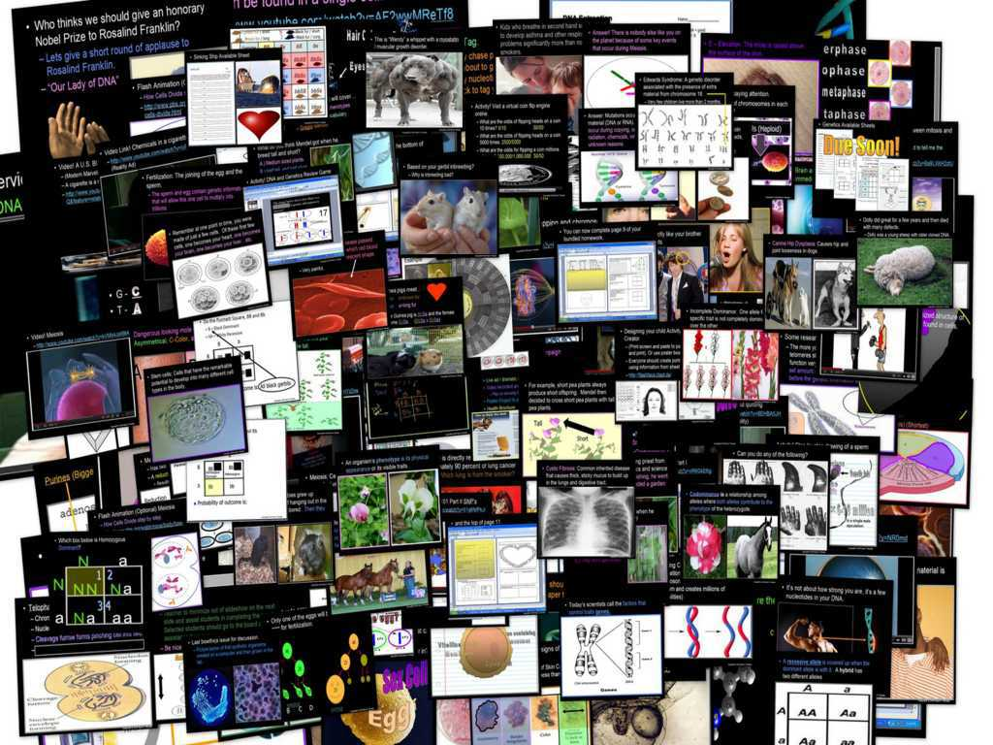
DNA and Genetics Unit

Slide 2
DNA and Genetics Unit
Areas of Focus within The DNA and Genetics Unit:
DNA, DNA Extraction, Structure of DNA, Discovery of the Double Helix, Rosalind Franklin, Nucleotides, RNA, Cell Division, Mitosis, Phases of Mitosis, Chromosomes, Cancer, Ways to Avoid Cancer, What is Inside a Cigarette?, Facts about Smoking?, Anti-Smoking Ads, Meiosis, Phases in Meiosis, Mendelian Genetics, Gregor Mendel, Punnett Squares, Probability, Dihybrid Cross, Codominance, Bio-Ethics, Stem Cell Debate, Cloning Debate
http://sciencepowerpoint.com/DNA_Genetics_Unit.html

Slide 3


The entire four year curriculum can be found at... http://sciencepowerpoint.com/ Please feel free to contact me with any questions you may have. Thank you for your interest in this curriculum.
Sincerely,
Ryan Murphy M.Ed
www.sciencepowerpoint@gmail.com

Slide 4
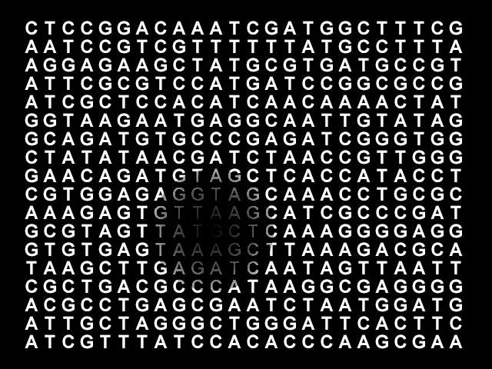
Part II, III, IV: Cell Division
Copyright © 2010 Ryan P. Murphy

Slide 5
Parts II, III, IV Cell Division Review Game
THE GREAT DIVIDE | IT’S JUST A PHASE | BAD IDEA | MY OATH IS | -Bonus- FAMILY QUEST
1 | 6 | 11 | 16 | *21
2 | 7 | 12 | 17 | *22
3 | 8 | 13 | 18 | *23
4 | 9 | 14 | 19 | *24
5 | 10 | 15 | 20 | *25

Slide 6
How to play…
  Don’t play like Jeo_ _ _ _ y.
  Class should be divided into several small groups.
  Groups should use science journal (red slide notes), homework, and other available materials to assist you.
  Groups can communicate quietly with each other but no sharing answers between groups.
    Practice quietly communicating right now?
    Practice Communication Question:
    Your group gets to order one pizza and you can have two toppings. What does your group want?

Slide 7

Questions 1-20 = 5pts Each
Final Category (Bonus) = 1pt Each
Final Questions = 5 pt wager
If you wager 5 on the last question and get it wrong you lose 5 pts. Wager 5 and get it right you get 5 pts.
Find the Owl =
Secretly write “Owl” in the correct box worth 1pt.
“I’ll be about this big.”

Slide 8

Is your name on the review sheet?
Name

Slide 9
Is your name on the review sheet?
Add the categories
along the top
on the next slide.

Slide 10
Parts II, III, IV Cell Division Review Game
THE GREAT DIVIDE | IT’S JUST A PHASE | BAD IDEA | MY OATH IS | -Bonus- FAMILY QUEST
1 | 6 | 11 | 16 | *21
2 | 7 | 12 | 17 | *22
3 | 8 | 13 | 18 | *23
4 | 9 | 14 | 19 | *24
5 | 10 | 15 | 20 | *25

Slide 11
Parts II, III, IV Cell Division Review Game
THE GREAT DIVIDE | IT’S JUST A PHASE | BAD IDEA | MY OATH IS | -Bonus- FAMILY QUEST
1 | 6 | 11 | 16 | *21
2 | 7 | 12 | 17 | *22
3 | 8 | 13 | 18 | *23
4 | 9 | 14 | 19 | *24
5 | 10 | 15 | 20 | *25

Slide 12
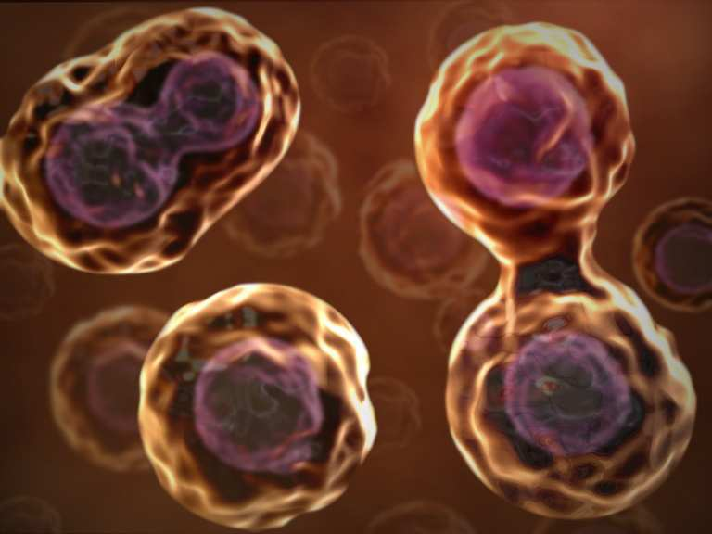
This is the name of the process where one cell divides into two?
  An exact copy is made. (Hopefully)
1
Copyright © 2010 Ryan P. Murphy

Slide 13
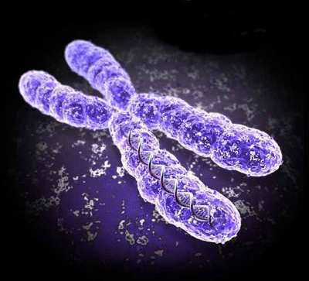
This is an organized structure of DNA and protein that is found in cells.
2
6
Copyright © 2010 Ryan P. Murphy

Slide 14
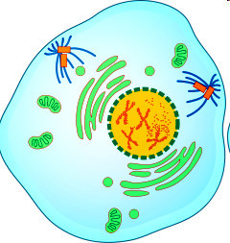
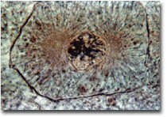
Name this phase of Mitosis.
  Chromatin draws together to create chromosomes.
  Spindle fibers form.
3
Copyright © 2010 Ryan P. Murphy

Slide 15
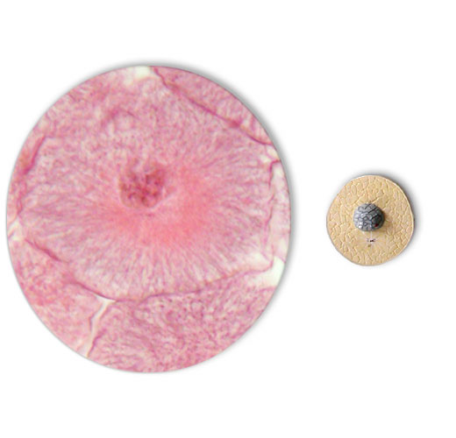
4
Name this phase of Mitosis.
  Most of cell cycle (90%)
  Cell grows and develops (gets bigger)
  Chromosomes not visible
  Nucleus intact
  DNA is copied
Copyright © 2010 Ryan P. Murphy

Slide 16
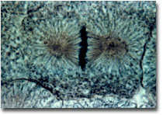
This phase of mitosis (cellular division) is best represented by the image below?
5
7
Copyright © 2010 Ryan P. Murphy

Slide 17
Parts II, III, IV Cell Division Review Game
THE GREAT DIVIDE | IT’S JUST A PHASE | BAD IDEA | MY OATH IS | -Bonus- FAMILY QUEST
1 | 6 | 11 | 16 | *21
2 | 7 | 12 | 17 | *22
3 | 8 | 13 | 18 | *23
4 | 9 | 14 | 19 | *24
5 | 10 | 15 | 20 | *25

Slide 18
Parts II, III, IV Cell Division Review Game
THE GREAT DIVIDE | IT’S JUST A PHASE | BAD IDEA | MY OATH IS | -Bonus- FAMILY QUEST
1 | 6 | 11 | 16 | *21
2 | 7 | 12 | 17 | *22
3 | 8 | 13 | 18 | *23
4 | 9 | 14 | 19 | *24
5 | 10 | 15 | 20 | *25

Slide 19
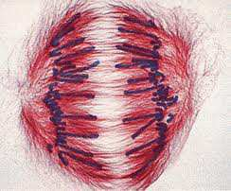
These structures help pull the chromosomes to opposite poles of the cell.
A.) DNA
B.) Cytoplasm
C.) Spindle Fibers /
Microtubules
D.) Membrane
E.) None of the
above.
6

Slide 20
These structures help pull the chromosomes to opposite poles of the cell.
A.) DNA
B.) Cytoplasm
C.) Spindle Fibers /
Microtubules
D.) Membrane
E.) None of the
above.
6

Slide 21
These structures help pull the chromosomes to opposite poles of the cell.
A.) DNA
B.) Cytoplasm
C.) Spindle Fibers /
Microtubules
D.) Membrane
E.) None of the
above.
6

Slide 22
These structures help pull the chromosomes to opposite poles of the cell.
A.) DNA
B.) Cytoplasm
C.) Spindle Fibers /
Microtubules
D.) Membrane
E.) None of the
above.
6

Slide 23
These structures help pull the chromosomes to opposite poles of the cell.
A.) DNA
B.) Cytoplasm
C.) Spindle Fibers /
Microtubules
D.) Membrane
E.) None of the
above.
6

Slide 24
These structures help pull the chromosomes to opposite poles of the cell.
A.) DNA
B.) Cytoplasm
C.) Spindle Fibers /
Microtubules
D.) Membrane
E.) None of the
above.
6

Slide 25
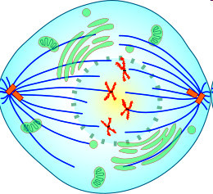
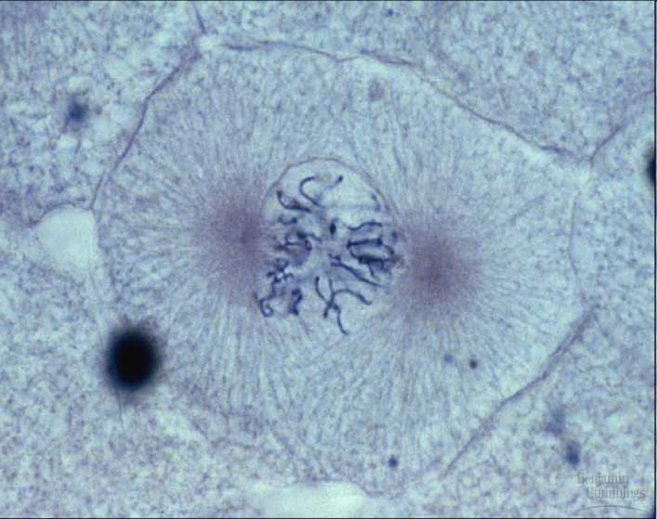
Name this phase just before metaphase?
  Nuclear envelope breaks down.
  Centrosomes are positioned at opposite poles of the cell.
  Spindle fibers attach to chromosome at the kinetochore.
7

Slide 26
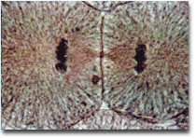
Name this phase of Mitosis?
  Chromosomes reaching poles.
  Nuclear membrane begins to form.
  Cleavage furrow forms pinching cell into two.
  Chromosomes begin to unwrap.
8

Slide 27
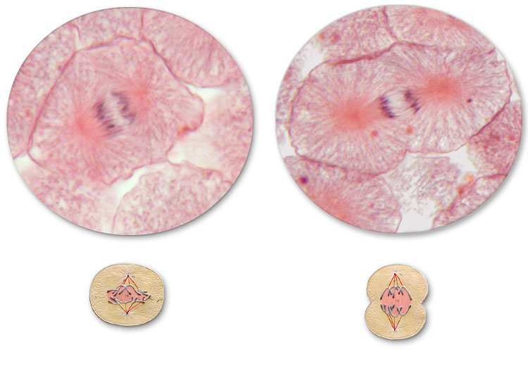
9
Early Anaphase
Late Anaphase

Slide 28
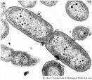
This is the term for when the cell breaks into two identical cells?
10

Slide 29
Parts II, III, IV Cell Division Review Game
THE GREAT DIVIDE | IT’S JUST A PHASE | BAD IDEA | MY OATH IS | -Bonus- FAMILY QUEST
1 | 6 | 11 | 16 | *21
2 | 7 | 12 | 17 | *22
3 | 8 | 13 | 18 | *23
4 | 9 | 14 | 19 | *24
5 | 10 | 15 | 20 | *25

Slide 30
Parts II, III, IV Cell Division Review Game
THE GREAT DIVIDE | IT’S JUST A PHASE | BAD IDEA | MY OATH IS | -Bonus- FAMILY QUEST
1 | 6 | 11 | 16 | *21
2 | 7 | 12 | 17 | *22
3 | 8 | 13 | 18 | *23
4 | 9 | 14 | 19 | *24
5 | 10 | 15 | 20 | *25

Slide 31
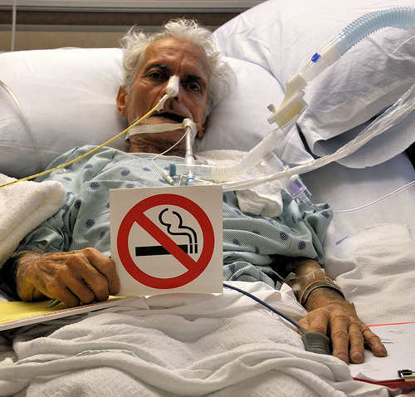
What is the #1 way you can try to avoid cancer and a slow painful death?
11
Copyright © 2010 Ryan P. Murphy

Slide 32
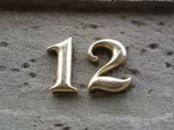
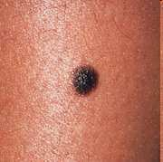
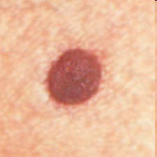
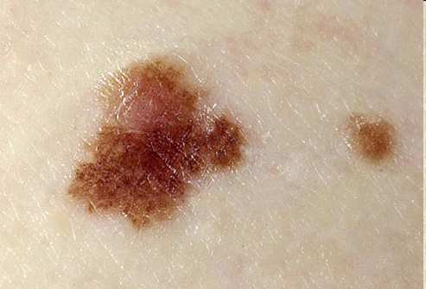
Which of the following moles looks most dangerous and should be brought to the attention of a dermatologist?
-Remember your ABCDE’s
A | B | C
A
B
C
Copyright © 2010 Ryan P. Murphy

Slide 33
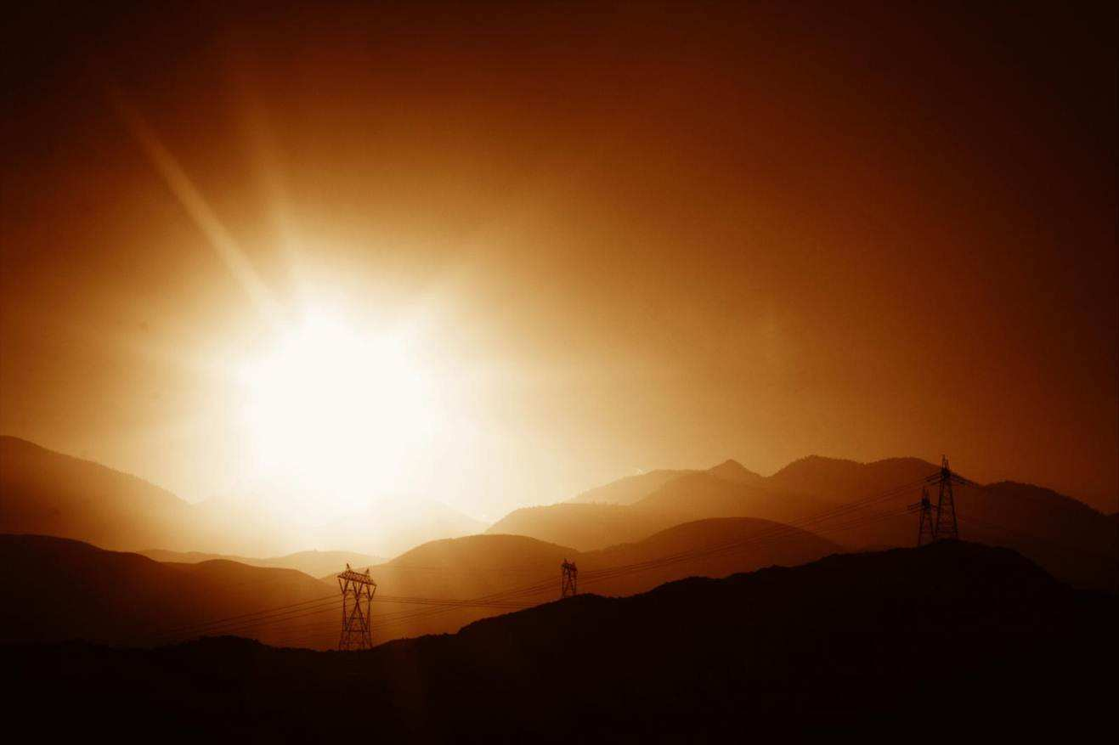
13
All of the following are ways to avoid skin cancer except?
A.)
B.)
C.)
D.)
E.)
F.)
Copyright © 2010 Ryan P. Murphy

Slide 34
13
All of the following are ways to avoid skin cancer except?
A.) Seek Shade
B.)
C.)
D.)
E.)
F.)
Copyright © 2010 Ryan P. Murphy

Slide 35
13
All of the following are ways to avoid skin cancer except?
A.) Seek Shade
B.) Avoid UV exposure
C.)
D.)
E.)
F.)
Copyright © 2010 Ryan P. Murphy

Slide 36
13
All of the following are ways to avoid skin cancer except?
A.) Seek Shade
B.) Avoid UV exposure
C.) Wear large hats
D.)
E.)
F.)
Copyright © 2010 Ryan P. Murphy

Slide 37
13
All of the following are ways to avoid skin cancer except?
A.) Seek Shade
B.) Avoid UV exposure
C.) Wear large hats
D.) Use tanning beds
E.)
F.)
Copyright © 2010 Ryan P. Murphy

Slide 38
13
All of the following are ways to avoid skin cancer except?
A.) Seek Shade
B.) Avoid UV exposure
C.) Wear large hats
D.) Use tanning beds
E.) Use sunscreen
F.)
Copyright © 2010 Ryan P. Murphy

Slide 39
13
All of the following are ways to avoid skin cancer except?
A.) Seek Shade
B.) Avoid UV exposure
C.) Wear large hats
D.) Use tanning beds
E.) Use sunscreen
F.) Avoid Sun during peek hours
Copyright © 2010 Ryan P. Murphy

Slide 40
All of the following are other ways to avoid all types of cancers except…?
  A.) Don’t smoke or chew
  B.) Avoid UV exposure
  C.) Exercise daily
  D.) Eat healthy
  E.) Drink excessive alcohol
  F.) Avoid radiation / energy exposure
  G.) Avoid unprotected sex (HPV virus)
  H.) Get regular checks up with your doctor
14
Copyright © 2010 Ryan P. Murphy

Slide 41
All of the following are other ways to avoid all types of cancers except…?
  A.) Don’t smoke or chew
  B.) Avoid UV exposure
  C.) Exercise daily
  D.) Eat healthy
  E.) Drink excessive alcohol
  F.) Avoid radiation / energy exposure
  G.) Avoid unprotected sex (HPV virus)
  H.) Get regular checks up with your doctor
14
Copyright © 2010 Ryan P. Murphy

Slide 42
All of the following are other ways to avoid all types of cancers except…?
  A.) Don’t smoke or chew
  B.) Avoid UV exposure
  C.) Exercise daily
  D.) Eat healthy
  E.) Drink excessive alcohol
  F.) Avoid radiation / energy exposure
  G.) Avoid unprotected sex (HPV virus)
  H.) Get regular checks up with your doctor
14
Copyright © 2010 Ryan P. Murphy

Slide 43
All of the following are other ways to avoid all types of cancers except…?
  A.) Don’t smoke or chew
  B.) Avoid UV exposure
  C.) Exercise daily
  D.) Eat healthy
  E.) Drink excessive alcohol
  F.) Avoid radiation / energy exposure
  G.) Avoid unprotected sex (HPV virus)
  H.) Get regular checks up with your doctor
14
Copyright © 2010 Ryan P. Murphy

Slide 44
All of the following are other ways to avoid all types of cancers except…?
  A.) Don’t smoke or chew
  B.) Avoid UV exposure
  C.) Exercise daily
  D.) Eat healthy
  E.) Drink excessive alcohol
  F.) Avoid radiation / energy exposure
  G.) Avoid unprotected sex (HPV virus)
  H.) Get regular checks up with your doctor
14
Copyright © 2010 Ryan P. Murphy

Slide 45
All of the following are other ways to avoid all types of cancers except…?
  A.) Don’t smoke or chew
  B.) Avoid UV exposure
  C.) Exercise daily
  D.) Eat healthy
  E.) Drink excessive alcohol
  F.) Avoid radiation / energy exposure
  G.) Avoid unprotected sex (HPV virus)
  H.) Get regular checks up with your doctor
14
Copyright © 2010 Ryan P. Murphy

Slide 46
All of the following are other ways to avoid all types of cancers except…?
  A.) Don’t smoke or chew
  B.) Avoid UV exposure
  C.) Exercise daily
  D.) Eat healthy
  E.) Drink excessive alcohol
  F.) Avoid radiation / energy exposure
  G.) Avoid unprotected sex (HPV virus)
  H.) Get regular checks up with your doctor
14
Copyright © 2010 Ryan P. Murphy

Slide 47
All of the following are other ways to avoid all types of cancers except…?
  A.) Don’t smoke or chew
  B.) Avoid UV exposure
  C.) Exercise daily
  D.) Eat healthy
  E.) Drink excessive alcohol
  F.) Avoid radiation / energy exposure
  G.) Avoid unprotected sex (HPV virus)
  H.) Get regular checks up with your doctor
14
Copyright © 2010 Ryan P. Murphy

Slide 48
All of the following are other ways to avoid all types of cancers except…?
  A.) Don’t smoke or chew
  B.) Avoid UV exposure
  C.) Exercise daily
  D.) Eat healthy
  E.) Drink excessive alcohol
  F.) Avoid radiation / energy exposure
  G.) Avoid unprotected sex (HPV virus)
  H.) Get regular checks up with your doctor
14
Copyright © 2010 Ryan P. Murphy

Slide 49
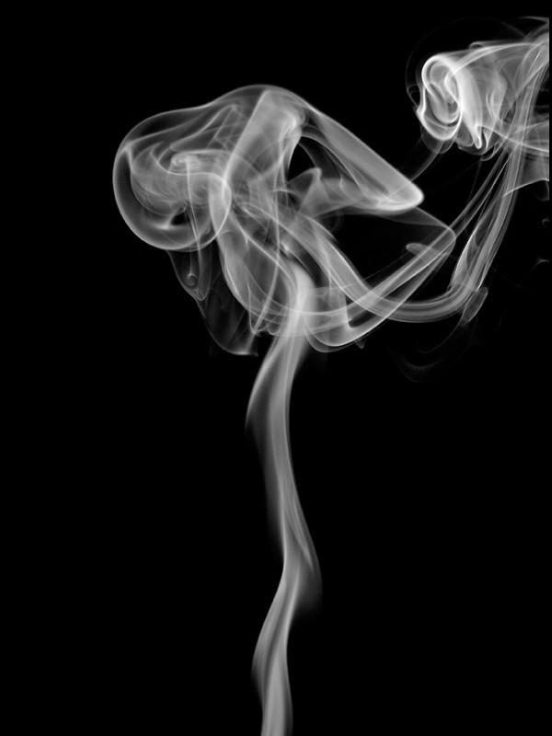
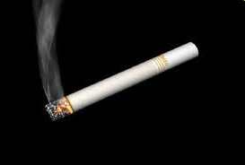
Which ingredient below would be best to put in your body? Only one from the list below doesn’t cause cancer.
1) Cadmium 11) Lead
2) Methane 12) DDT
3) Nicotine 13) Mercury
4) Dioxins 14) Acetone
5) Ammonia 15) Hydrogen Cyanide
6) Methanol 16) Urethane
7) Toluene 17) Bananas
8) Hexamine 18) Formaldehdye
9) Arsenic 19) Carbon Monoxide
10) Butane 20) Road Tar
Bonus *Polonium
15

Slide 50
Parts II, III, IV Cell Division Review Game
THE GREAT DIVIDE | IT’S JUST A PHASE | BAD IDEA | MY OATH IS | -Bonus- FAMILY QUEST
1 | 6 | 11 | 16 | *21
2 | 7 | 12 | 17 | *22
3 | 8 | 13 | 18 | *23
4 | 9 | 14 | 19 | *24
5 | 10 | 15 | 20 | *25

Slide 51
Parts II, III, IV Cell Division Review Game
THE GREAT DIVIDE | IT’S JUST A PHASE | BAD IDEA | MY OATH IS | -Bonus- FAMILY QUEST
1 | 6 | 11 | 16 | *21
2 | 7 | 12 | 17 | *22
3 | 8 | 13 | 18 | *23
4 | 9 | 14 | 19 | *24
5 | 10 | 15 | 20 | *25

Slide 52
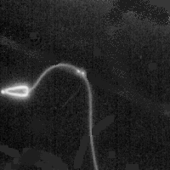
Name these two cells?
How many chromosomes
do they each have?
flagellating tail,
In a single male ejaculation
16

Slide 53
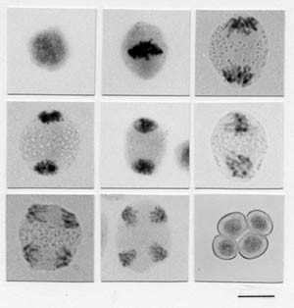
This is the name of the cell division that produces reproductive cells.
17
Copyright © 2010 Ryan P. Murphy

Slide 54
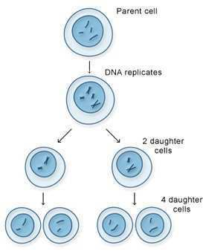
Meiosis has two cell divisions that results in a reduction in the amount of genetic material.
18
Copyright © 2010 Ryan P. Murphy

Slide 55
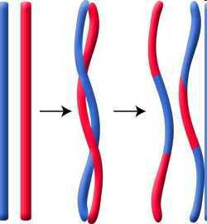
This is when genetic segments of information are swapped when the chromosomes are next to each other.
  Occurs at random and creates millions of possibilities.
19
Copyright © 2010 Ryan P. Murphy

Slide 56
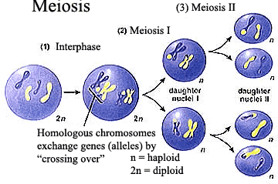
20
Which letter represents haploid, and which letter is diploid?
B
A
Copyright © 2010 Ryan P. Murphy

Slide 57
Parts II, III, IV Cell Division Review Game
THE GREAT DIVIDE | IT’S JUST A PHASE | BAD IDEA | MY OATH IS | -Bonus- FAMILY QUEST
1 | 6 | 11 | 16 | *21
2 | 7 | 12 | 17 | *22
3 | 8 | 13 | 18 | *23
4 | 9 | 14 | 19 | *24
5 | 10 | 15 | 20 | *25

Slide 58
Parts II, III, IV Cell Division Review Game
THE GREAT DIVIDE | IT’S JUST A PHASE | BAD IDEA | MY OATH IS | -Bonus- FAMILY QUEST
1 | 6 | 11 | 16 | *21
2 | 7 | 12 | 17 | *22
3 | 8 | 13 | 18 | *23
4 | 9 | 14 | 19 | *24
5 | 10 | 15 | 20 | *25

Slide 59

*21
Name this family?

Slide 60
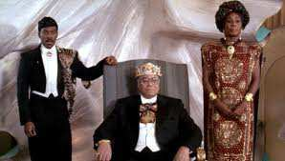
*22
Name this movie?

Slide 61

*23
Meet…

Slide 62

*24

Slide 63

Name this family?
*25

Slide 64
Parts II, III, IV Cell Division Review Game
THE GREAT DIVIDE | IT’S JUST A PHASE | BAD IDEA | MY OATH IS | -Bonus- FAMILY QUEST
1 | 6 | 11 | 16 | *21
2 | 7 | 12 | 17 | *22
3 | 8 | 13 | 18 | *23
4 | 9 | 14 | 19 | *24
5 | 10 | 15 | 20 | *25
Final Question

Slide 65
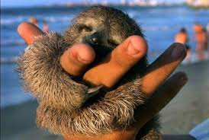
5 Point Wager Question

Slide 66
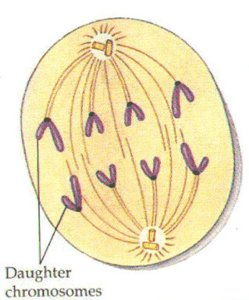
Name this phase of Mitosis?
  Chromosomes get split at centromere
  The two identical copies get pulled apart
Copyright © 2010 Ryan P. Murphy

Slide 67
Answer Key
Copyright © 2010 Ryan P. Murphy

Slide 68
Parts II, III, IV Cell Division Review Game
THE GREAT DIVIDE | IT’S JUST A PHASE | BAD IDEA | MY OATH IS | -Bonus- FAMILY QUEST
1 | 6 | 11 | 16 | *21
2 | 7 | 12 | 17 | *22
3 | 8 | 13 | 18 | *23
4 | 9 | 14 | 19 | *24
5 | 10 | 15 | 20 | *25

Slide 69
Parts II, III, IV Cell Division Review Game
THE GREAT DIVIDE | IT’S JUST A PHASE | BAD IDEA | MY OATH IS | -Bonus- FAMILY QUEST
1 | 6 | 11 | 16 | *21
2 | 7 | 12 | 17 | *22
3 | 8 | 13 | 18 | *23
4 | 9 | 14 | 19 | *24
5 | 10 | 15 | 20 | *25

Slide 70
This is the name of the process where one cell divides into two?
  Exact copy is made.
1
Copyright © 2010 Ryan P. Murphy

Slide 71
This is the name of the process where one cell divides into two?
  An exact copy is made. (Hopefully)
1
and the answer is…
Copyright © 2010 Ryan P. Murphy

Slide 72
This is the name of the process where one cell divides into two?
  An exact copy is made. (Hopefully)
1
Mitosis
and the answer is…
Copyright © 2010 Ryan P. Murphy

Slide 73
This is an organized structure of DNA and protein that is found in cells.
2
6
Copyright © 2010 Ryan P. Murphy

Slide 74
This is an organized structure of DNA and protein that is found in cells.
2
6
and the answer is…
Copyright © 2010 Ryan P. Murphy

Slide 75
This is an organized structure of DNA and protein that is found in cells.
2
6
Chromosomes
and the answer is…
Copyright © 2010 Ryan P. Murphy

Slide 76
Name this phase of Mitosis.
  Chromatin draws together to create chromosomes.
  Spindle fibers form.
3
Copyright © 2010 Ryan P. Murphy

Slide 77
Name this phase of Mitosis.
  Chromatin draws together to create chromosomes.
  Spindle fibers form.
3
Prophase
Copyright © 2010 Ryan P. Murphy

Slide 78

Name this phase of Mitosis.
  Chromatin draws together to create chromosomes.
  Spindle fibers form.
3
Prophase
Copyright © 2010 Ryan P. Murphy

Slide 79
Name this phase of Mitosis.
  Chromatin draws together to create chromosomes.
  Spindle fibers form.
3
Prophase
Copyright © 2010 Ryan P. Murphy

Slide 80
4
Name this phase of Mitosis.
  Most of cell cycle (90%)
  Cell grows and develops (gets bigger)
  Chromosomes not visible
  Nucleus intact
  DNA is copied
Copyright © 2010 Ryan P. Murphy

Slide 81
4
Name this phase of Mitosis.
  Most of cell cycle (90%)
  Cell grows and develops (gets bigger)
  Chromosomes not visible
  Nucleus intact
  DNA is copied
Interphase
Copyright © 2010 Ryan P. Murphy

Slide 82
This phase of mitosis (cellular division) is best represented by the image below?
5
7
Copyright © 2010 Ryan P. Murphy

Slide 83
This phase of mitosis (cellular division) is best represented by the image below?
5
7
Metaphase
Copyright © 2010 Ryan P. Murphy

Slide 84
Parts II, III, IV Cell Division Review Game
THE GREAT DIVIDE | IT’S JUST A PHASE | BAD IDEA | MY OATH IS | -Bonus- FAMILY QUEST
1 | 6 | 11 | 16 | *21
2 | 7 | 12 | 17 | *22
3 | 8 | 13 | 18 | *23
4 | 9 | 14 | 19 | *24
5 | 10 | 15 | 20 | *25

Slide 85
Parts II, III, IV Cell Division Review Game
THE GREAT DIVIDE | IT’S JUST A PHASE | BAD IDEA | MY OATH IS | -Bonus- FAMILY QUEST
1 | 6 | 11 | 16 | *21
2 | 7 | 12 | 17 | *22
3 | 8 | 13 | 18 | *23
4 | 9 | 14 | 19 | *24
5 | 10 | 15 | 20 | *25

Slide 86
These structures help pull the chromosomes to opposite poles of the cell.
A.) DNA
B.) Cytoplasm
C.) Spindle Fibers /
Microtubules
D.) Membrane
E.) None of the
above.
6

Slide 87
These structures help pull the chromosomes to opposite poles of the cell.
A.) DNA
B.) Cytoplasm
C.) Spindle Fibers /
Microtubules
D.) Membrane
E.) None of the
above.
6

Slide 88
These structures help pull the chromosomes to opposite poles of the cell.
A.) DNA
B.) Cytoplasm
C.) Spindle Fibers /
Microtubules
D.) Membrane
E.) None of the
above.
6

Slide 89
These structures help pull the chromosomes to opposite poles of the cell.
A.) DNA
B.) Cytoplasm
C.) Spindle Fibers /
Microtubules
D.) Membrane
E.) None of the
above.
6

Slide 90
These structures help pull the chromosomes to opposite poles of the cell.
A.) DNA
B.) Cytoplasm
C.) Spindle Fibers /
Microtubules
D.) Membrane
E.) None of the
above.
6

Slide 91
These structures help pull the chromosomes to opposite poles of the cell.
A.) DNA
B.) Cytoplasm
C.) Spindle Fibers /
Microtubules
D.) Membrane
E.) None of the
above.
6

Slide 92
These structures help pull the chromosomes to opposite poles of the cell.
A.) DNA
B.) Cytoplasm
C.) Spindle Fibers /
Microtubules
D.) Membrane
E.) None of the
above.
6
and the answer is…

Slide 93
These structures help pull the chromosomes to opposite poles of the cell.
A.) DNA
B.) Cytoplasm
C.) Spindle Fibers /
Microtubules
D.) Membrane
E.) None of the
above.
6
and the answer is…

Slide 94
Name this phase just before metaphase?
  Nuclear envelope breaks down.
  Centrosomes are positioned at opposite poles of the cell.
  Spindle fibers attach to chromosome at the kinetochore.
7

Slide 95
Name this phase just before metaphase?
  Nuclear envelope breaks down.
  Centrosomes are positioned at opposite poles of the cell.
  Spindle fibers attach to chromosome at the kinetochore.
7
and the answer is…

Slide 96
End of Preview
Hundreds of more slides,
activities, video links,
homework package, lesson
notes, review games,
rubrics, and much more
on the full version of this unit
and larger curriculum.

Slide 97
DNA and Genetics Unit

Slide 98
DNA and Genetics Unit
Areas of Focus within The DNA and Genetics Unit:
DNA, DNA Extraction, Structure of DNA, Discovery of the Double Helix, Rosalind Franklin, Nucleotides, RNA, Cell Division, Mitosis, Phases of Mitosis, Chromosomes, Cancer, Ways to Avoid Cancer, What is Inside a Cigarette?, Facts about Smoking?, Anti-Smoking Ads, Meiosis, Phases in Meiosis, Mendelian Genetics, Gregor Mendel, Punnett Squares, Probability, Dihybrid Cross, Codominance, Bio-Ethics, Stem Cell Debate, Cloning Debate
http://sciencepowerpoint.com/DNA_Genetics_Unit.html

Slide 99
The entire four year curriculum can be found at... http://sciencepowerpoint.com/ Please feel free to contact me with any questions you may have. Thank you for your interest in this curriculum.
Sincerely,
Ryan Murphy M.Ed
www.sciencepowerpoint@gmail.com

